Slide 1
Thermal sneutrino dark matter in an inverse seesaw model
Hiroyuki Ishida (NCTS)
@Mini-Workshop on Dark Sector Phenomenology: Models, Satellites, and Colliders
2018/10/19
Collaborators:
Jung Chang (Chonnam Natl. U.)
Kingman Cheung (NTHU)
Chih-Ting Lu (NTHU)
Martin Spinrath (NTHU)
Yue-Lin Sming Tsai (AS)
Refs:
1707.04374, 1806.04468

Slide 2
Motivation
Why do we need to extend the SM?
Seesaw mechanism
by adding RHνs
・Neutrino masses
・Gauge hierarchy problem
・DM candidate
Supersymmetry
・Gauge coupling unification
MSSM+type-I seesaw mechanism
Problems above can be solved, but type-I seesaw
requires Majorana mass scale as
How small Majorana mass is possible?

Slide 3
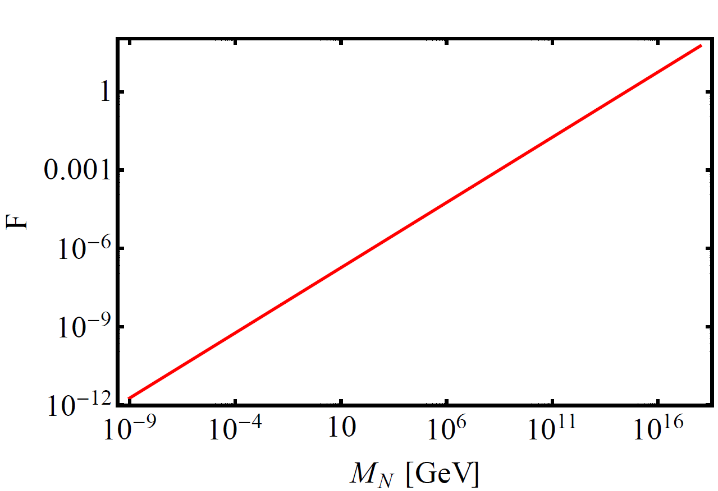
Motivation
Linear scaling of neutrino Yukawa coupling (type-I)
Coupling is O(1)
Impossible to
be produced
Could be
accessible
Production rate
is small

Slide 4
Motivation
There are lots of alternative ideas
・Inverse seesaw (ISS) mechanism
[Mohapatra (1986); Mohapatra and Valle (1986)]
Amplify the model by using another gauge singlet
Neutrino mass matrix
Small M_{S}(Lepton # violation) leads tiny m_{ν}

Slide 5
Motivation
Assumption in most of works
technically naturalness
when lepton # sym. is recovered
smallness of M_{S} is technically natural

Slide 6
Motivation
Assumption in most of works
benefit of inverse seesaw
extension at TeV scale with O(1) Yukawa is possible
Rich phenomenology at collider!
Dynamical origin of lepton number violating scale?

Slide 7
Contents
Motivation
Model
DM estimation
DM properties
Conclusions

Slide 8
Model
arXiv:1707.04374

Slide 9
Model (NCTS model)
forbid R-parity violating terms
without imposing R-parity
Symmetry：
New super potential in addition to MSSM
Lagrangian related to neutrino

Slide 10
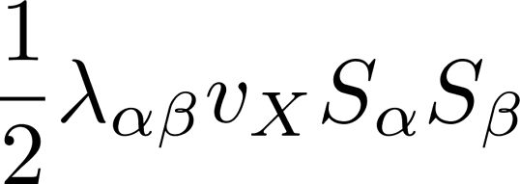
Model
Symmetry breaking：
Requirement to scalar fields
・No field takes VEV except for Hu, Hd, X
From potential analysis,
Origin of "lepton #" violation

Slide 11
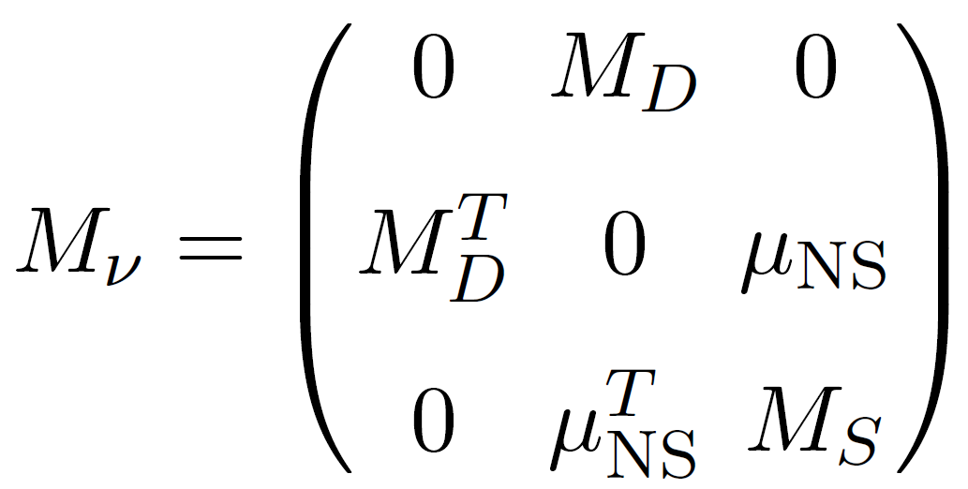
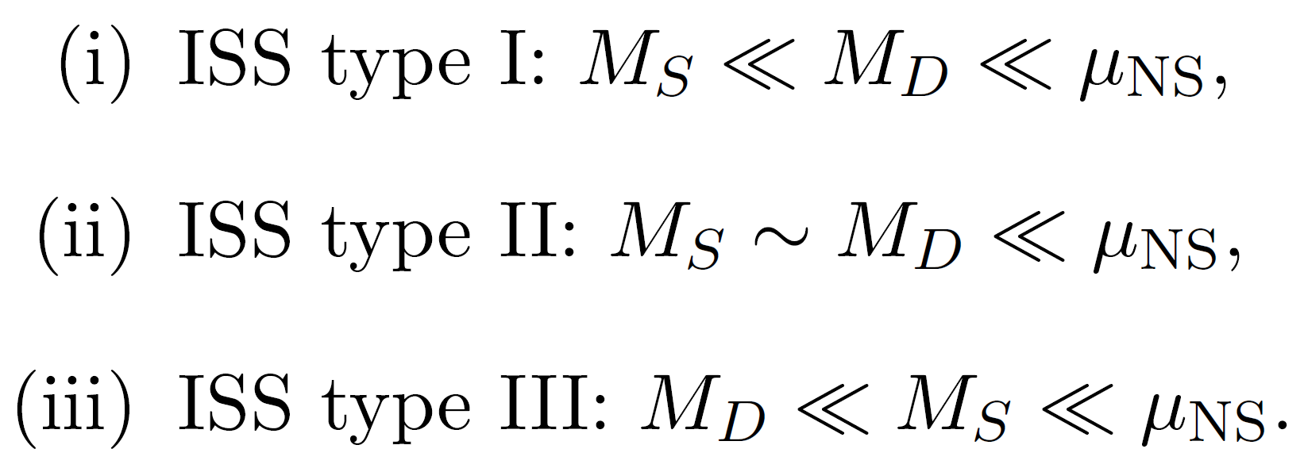
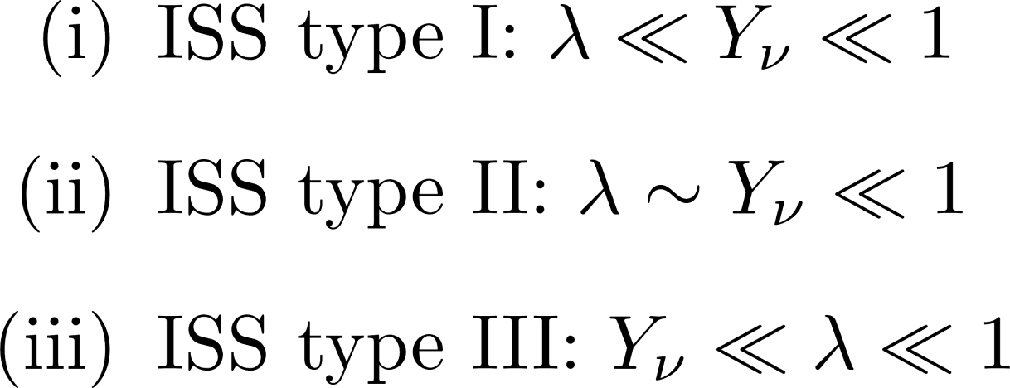
Model
Neutrino mass matrix：
Smallness of is explained by coupling
As possibilities,

Slide 12
Model
Feature of model
Matter parity is defined
LSP can be DM candidate!
Gravitino, Sneutrino, Neutralino
Non-MSSM candidate!

Slide 13
WIMP in the model
Definition of WIMP before
"Weakly" interacting massive particle
same magnitude as weak interaction
Definition of WIMP now
"Weakly" interacting massive particle
as weak as you want
as long as you can explain abundance

Slide 14
Model
Phenomenological constraints?
-LFV
1. Non-SUSY contribution:
2. SUSY contribution:
depends on sparticle mixing
-0νββ decay
1. Non-SUSY contribution:
2. SUSY contribution:
no contribution due to
"R-parity" conservation

Slide 15
DM estimation
arXiv:1806.04468

Slide 16
DM estimation
Boundary conditions
-Put arbitrary factor to make colored particles
heavy enough
-m₀ and M_{1/2} are fixed at high scale
-v_{X} a and κ are fixed at low scale
not to worry about running effect

Slide 17
DM estimation
Sneutrino mass matrix
boundary conditions
Eigenvalues at tree level

Slide 18
DM estimation
Sneutrino mass matrix
-RG corrections to them is small enough
-Physical states
-Mass difference between CP-even & –odd states

Slide 19
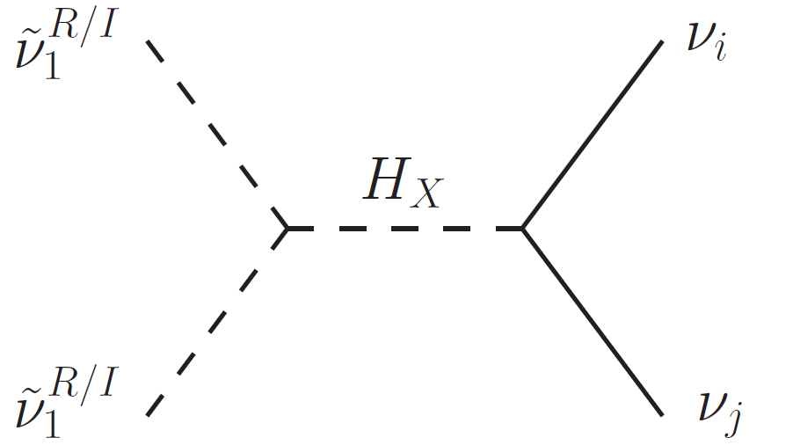
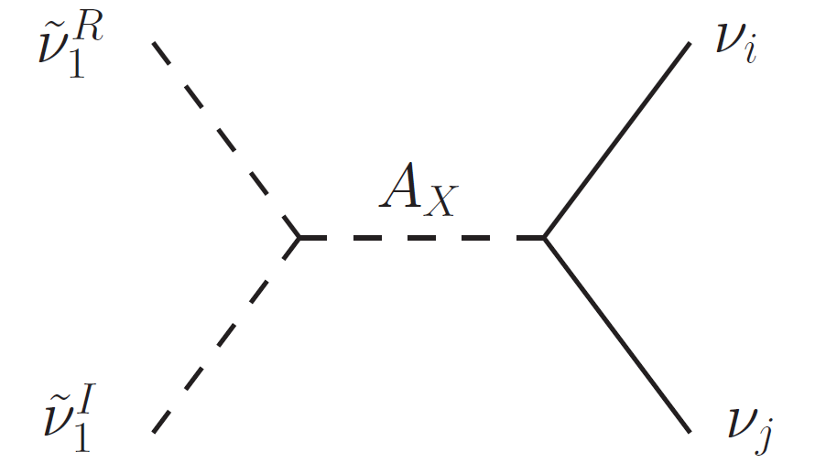
DM estimation
Dominant (co-)annihilation channels
H-funnel
A-funnel

Slide 20
DM estimation
Higgs masses (H_{X} and A_{X})
-We have two more Higgs compared to MSSM
which are composed X-scalar
-Mixing with MSSM scalars is extremely suppressed
-Approximate masses

Slide 21
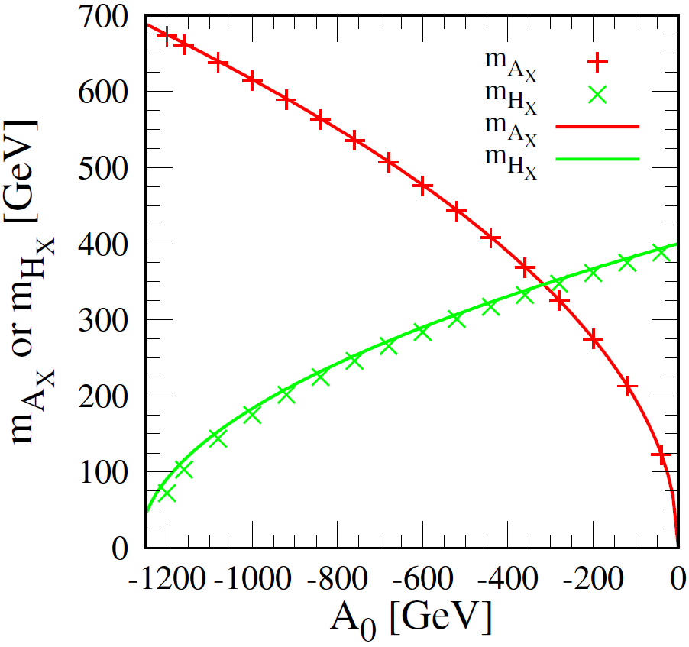
DM estimation
Higgs masses (H_{X} and A_{X})
-Comparison

Slide 22
DM estimation
Features of our analysis
-Three exceptions of thermal relic calculation
[Griest and Seckel (1991)]
1. Co-annihilation
2. Annihilation into forbidden channel
(near threshold)
3. Annihilation near pole (resonance)
We have to take into account 1 and 3!

Slide 23
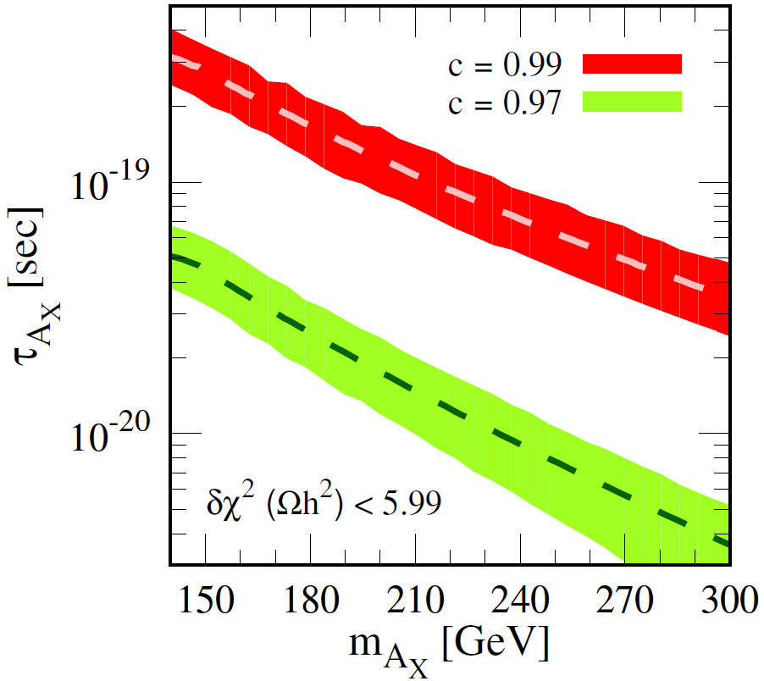
DM estimation
Results in A_{X}-funnel scenario

Slide 24
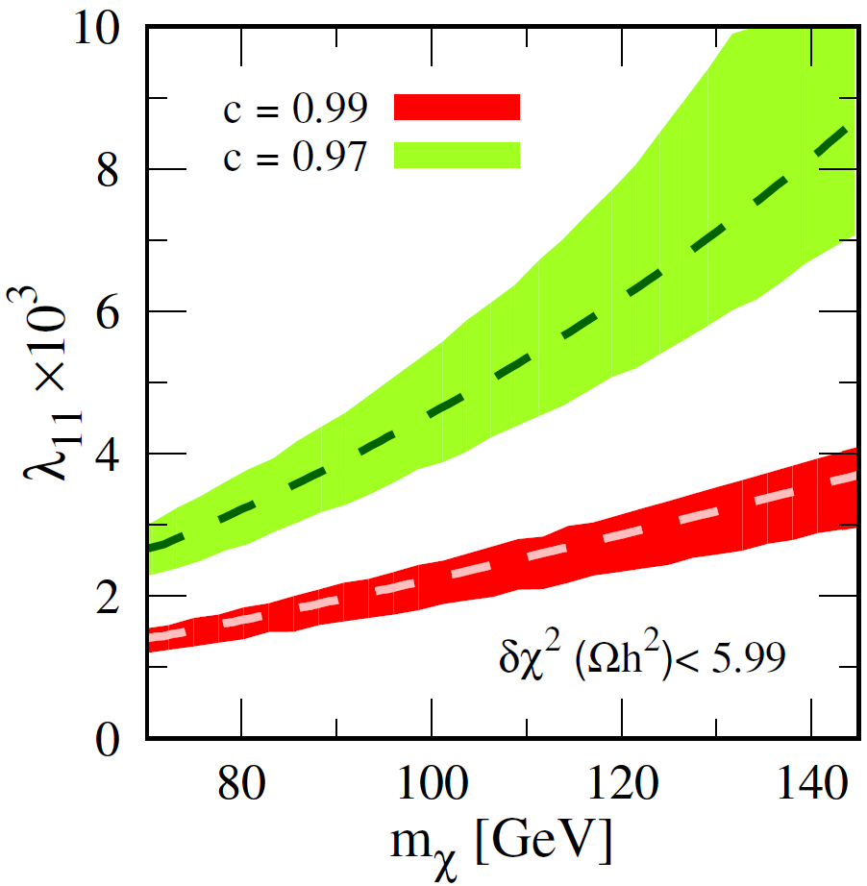
DM estimation
Results in A_{X}-funnel scenario

Slide 25
DM estimation
How about H_{X}-funnel?
-H_{X}-funnel does NOT work because…
1. H_{X}-funnel has p-wave suppression
2. To compensate, larger λ is required
3. When λ gets large, it closes the decay channel
into heavy neutrinos due to mass splitting

Slide 26
DM properties
arXiv:1806.04468

Slide 27
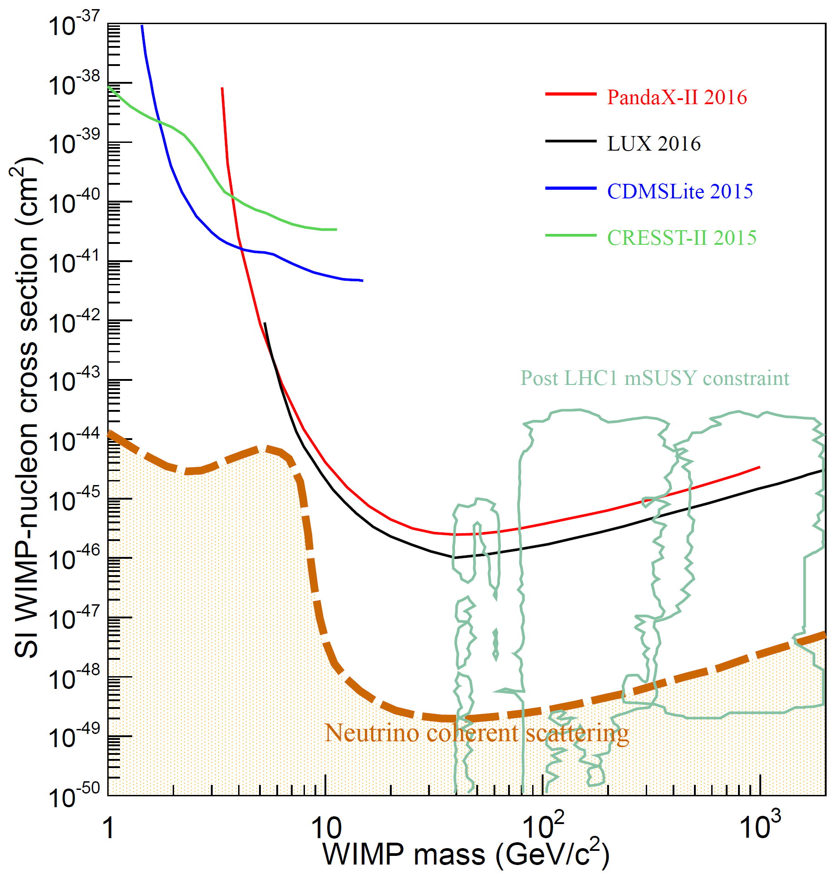
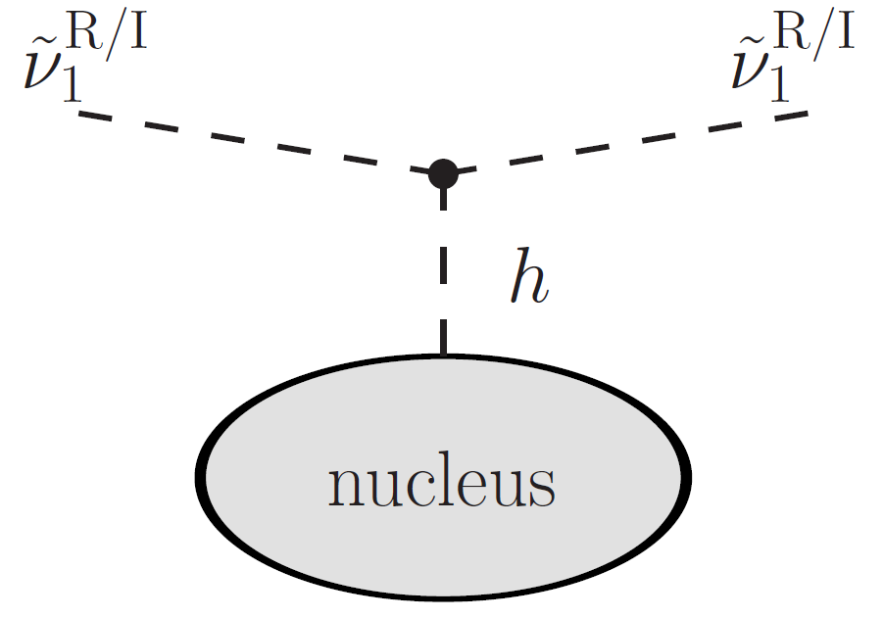
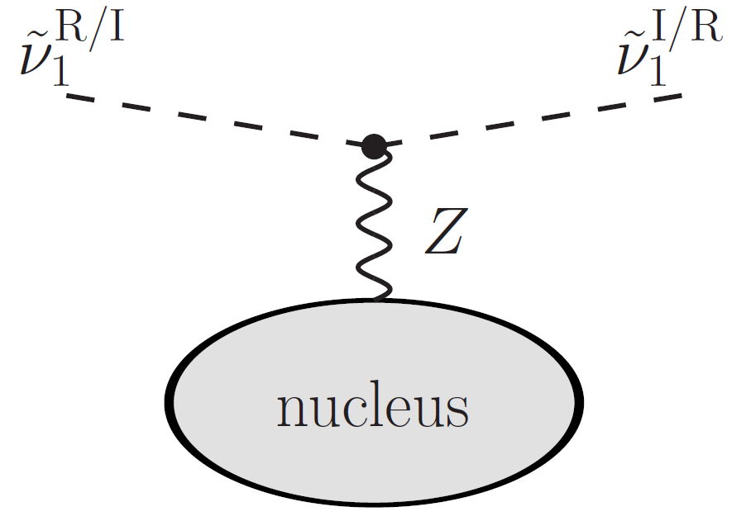
DM properties
1709.00688
Direct detection
-Using Y_{ν}～10⁻⁶ and M_{SUSY}=1 TeV, Higgs exchange
cross section is given as O(10⁻²⁹) pb which is
even below neutrino floor
-Z exchange is more suppressed
10⁻⁵³

Slide 28
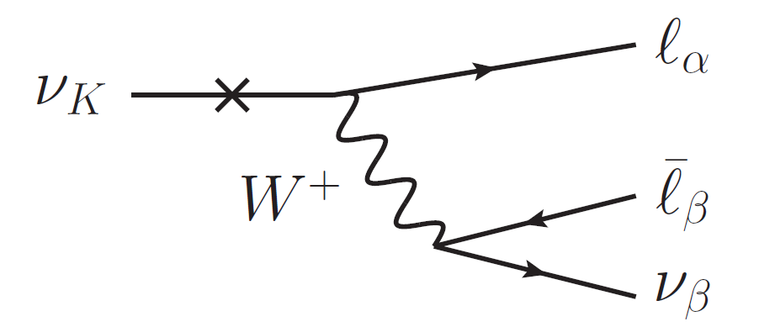
DM properties
Indirect detection
-If DM annihilate into two active neutrinos or
one active and one heavy neutrino,
we could see line signal of active ν at IceCube
-Since heavy neutrino can decay into SM leptons,
we could see some signal from this cascade decay

Slide 29
DM properties
Indirect detection
-Since annihilation cross section into two active
neutrinos O(10⁻⁴¹)cm³ s⁻¹,
this signal seems not to be so promising
-However, this cross section is a few order of
magnitude smaller, we could see signal in future

Slide 30
Conclusions

Slide 31
Conclusions
・SUSY inverse seesaw model
-Lepton number is dynamically induced
-Low scale seesaw mechanism can be realized
-Thermal relic sneutrino DM is possible
thanks to existing the origin of lepton # violation
-Our extensions to MSSM is really hidden,
in other words,
our model can be easily excluded by observations

Slide 32
Future prospects
・At the moment, our model is playing hide & seek
but…
-Collider phenomenology
-Aspects for early universe
-Astrophysical observation
Any suggestion to study is welcome!
need to be explored

Slide 33
Open questions
・So far so good as one of the models, but…
-How to find our DM as a signal?
-How to discriminate our model from others?

Slide 34
Thank you
for your attention

Slide 36
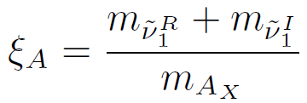
DM estimation
How to hit the funnel
-First, we define a parameter c
c is chosen either 0.97 or 0.99
-Second, we fix μ_{NS} by using mass formulae
-Third, we run SPheno to calculate mass spectrum,
estimate μ_{NS} again and take the ratio
requiring not to deviate more than 2.5 × 10⁻³

Slide 37
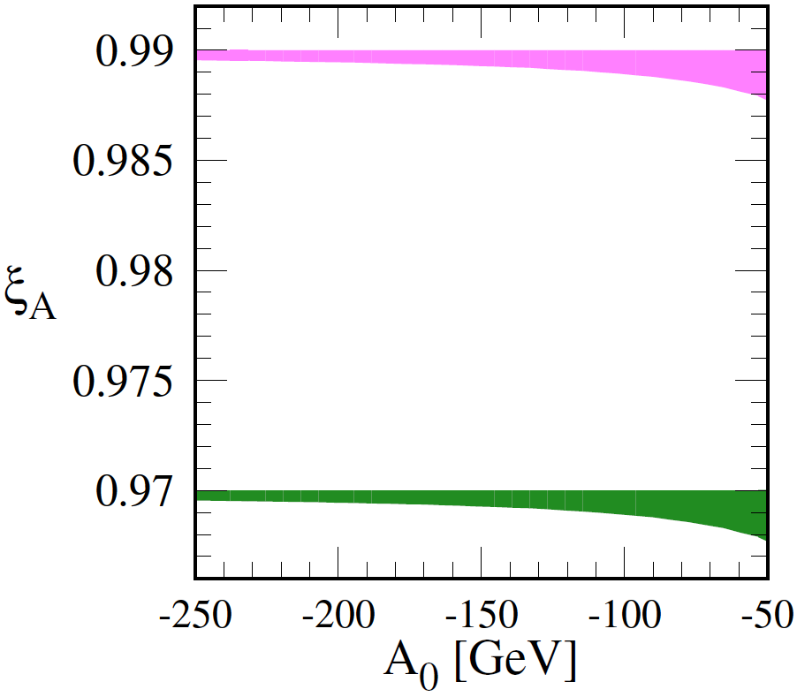
DM estimation
How to hit the funnel

