Slide 1
Introduction of trigger system:
E906 as an example
Shiuan-Hal,Shiu 05/02/2011

Slide 2
Contents
Introduction
  Why we need trigger?
  An example of a trigger system in our daily life
Trigger structure
  Hardware trigger
  Software trigger
  Trend of trigger system
The E906 Trigger System

Slide 3
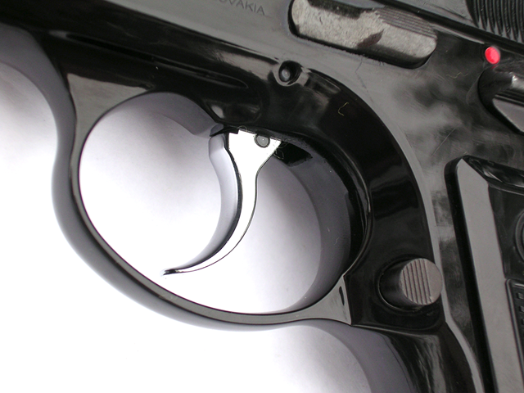
Introduction
In the modern high energy experiments, a particle accelerator produces a large number of events for physicists to study.
Most of the events are not of interest.
A trigger system is to separate the interesting data(signal), and uninteresting data(background).
Trigger system can provide the timing information for the detector to look back the data at the corresponding moment.

Slide 4
Why trigger?
A high energy physics experiment can generate hundreds of petabyte of data in several months.
But the primary data of interest may be of the size of only several megabyte.
To analyze all the data may take too much CPU power.
The storage I/O dead time is much longer than all other detector components.
We can not handle all raw data without selection!!!

Slide 5

A well-known trigger system
Trigger system
Trigger
Detector and DAQ system
Holder system

Slide 6
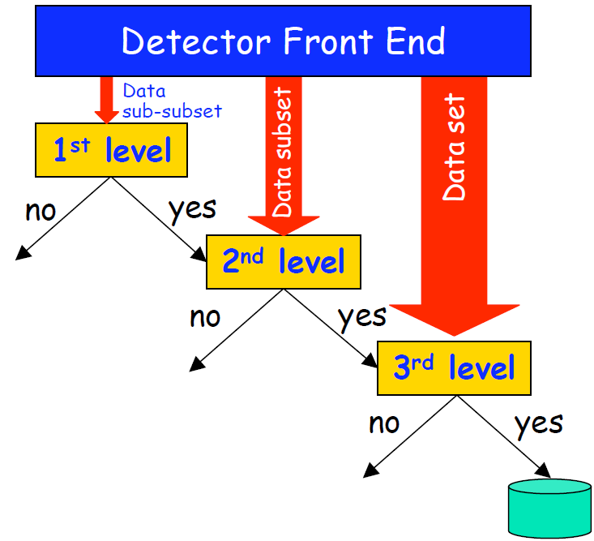
Trigger structure
The general trigger structure consists of several steps.
First step: LV-1 trigger (Hardware trigger)
  Most coarse and using a small subset of the whole data set of all the events.
Second step: LV-2 trigger (a mix of hardware and software trigger)
  Finer than LV-1 and using a little larger data subset .
Final step: LV-3 trigger (Software trigger)
  Finest and using the complete data set of the events which pass through the lower level stages.

Slide 7
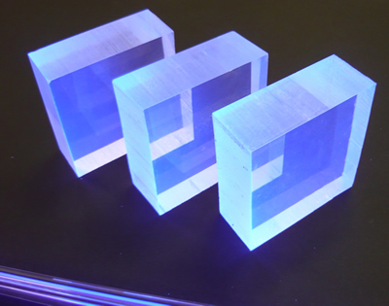
Hardware triggering
Hardware triggering is the first level of event selection.
The hardware trigger must process all the events produced in the detector, it means the hardware trigger should be fast enough to keep up with the event rate and discriminating enough so that small amount of events are allowed to pass.
Some rapid response detectors are usually used for hardware trigger Ex: Scintillator detector.
Easy coincidence logic to determine the particle is used in hardware triggering.

Slide 8

Software triggering
Before events move on to software trigger, sometimes there is a hardware-software trigger, in which information from the slower detector is combined with computer processing.
After events have been selected with a hardware trigger or hardware-software trigger then software trigger take place to select the events.
Software trigger was designed to use commercial computer processors to compute additional event parameters or does partial event reconstruction to decide whether to keep it.
Software trigger is slowest but most comprehensive triggering layer.

Slide 9
Trigger system trend
LV-1 trigger:
  Common usage of programmable units(FPGA)
    We can implement look-up-table that was available only in the computer before.
    Compactness.
    The gap of LV-1 and LV-2 is disappearing.
LV-2 trigger:
  Merged with LV-1.
LV-3 trigger:
  Working at higher and higher rates.
  Data transferring speed become faster and faster.
Notes:
Field-programmable gate array

Slide 10
Trigger rate in some experiment
 | LV1 input rate | LV1 output rate | LV2 output rate | LV3 output rate
CDF | 53MHz* | 50KHz | 200Hz | 80Hz
D0 | 53MHz* | 10KHz | 1KHz | 70Hz
CMS | 40MHz | 100KHz | ?KHz | 100Hz
Atlas | 1GHz | 75KHz | 3KHz | 200Hz
LHCb | 10MHz | 40KHz(Lv0+1) | 5KHz | 100Hz
E906 | 53MHz* | 1KHz?
* Input crossing rate

Slide 11
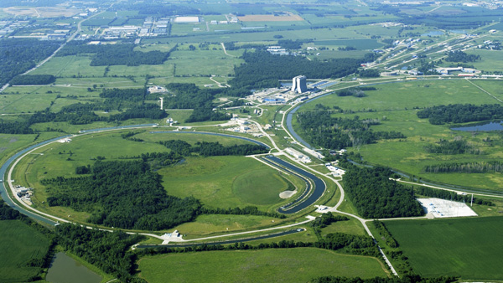
E906 trigger system-motivation
E906 is a fixed target experiment, using Fermilab Main injector to deliver 120GeV proton to collide ¹H, ²H, and nuclear targets.
The antiquark in target proton and quark in incident proton will generate a muon pair via Drell-Yan process
Fixed Target Beam lines
Tevatron 800 GeV
Main Injector 120 GeV

Slide 12
Motivation
The proton beam structure is 5 sec spill of 1*10¹³ protons each minute, it means when the proton comes we will have 2*10¹² protons in each seconds.
Right table shows the simulation results of event rate per second from the E906 fast MC.
There are two major backgrounds of E906, One is the di-muon decay from J/ψ the other is the random single muon coincidence which was decay from hadron. In order to separate the Drell-Yan dimuon from this two background, we need to define a trigger specifically for Drell-Yan process.
 | Target | Dump
Drell-Yan | 3.8 | 99.9
J/ψ | 13.7 | 325.2
Random single muon coincidence | ? | ?
Notes:
An important background was the random coincidence of
two unrelated, oppositely charged muons.
Another possible background is the dual semileptonic
decay of cc¯ or bb¯ to a correlated m1m2. However, both the
mass and acceptance for these muon pairs are low, leading to
a negligible rate in the Drell-Yan mass regions selected
above.

Slide 13
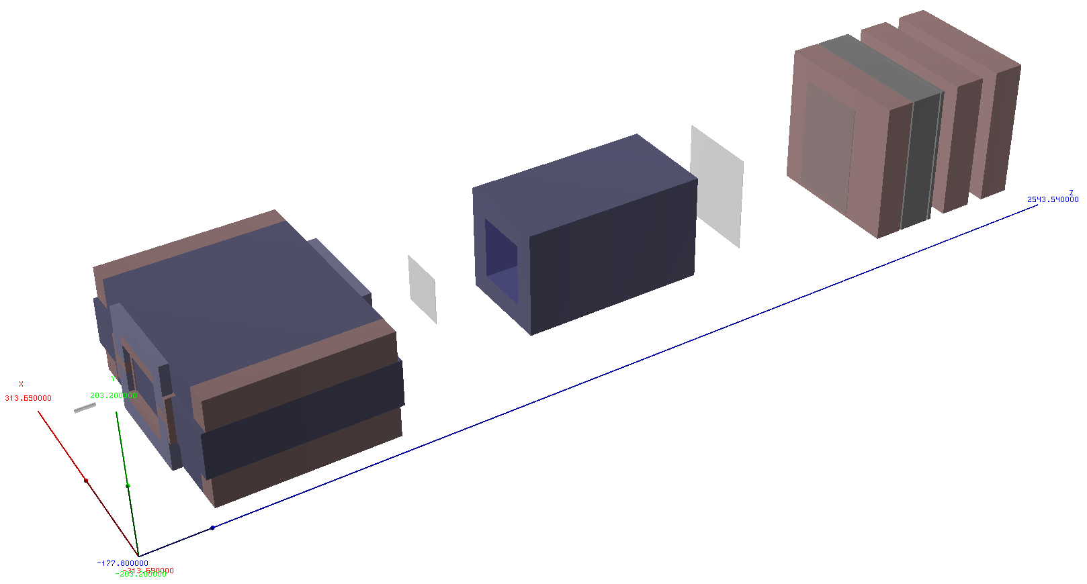
E906 Spectrometer
Station 2 and 3:
Hodoscope array
Drift Chamber tracking
Solid Iron Focusing Magnet, Hadron absorber and beam dump
Station 1:
Hodoscope array
MWPC tracking
Mom. Meas.
(KTeV Magnet)
Station 4:
Hodoscope array
Prop tube tracking
4.9m
25m
Liquid H₂, d₂, and solid targets
Experimental Challenge:
Higher probability of muonic decay for the produced hadrons.
Higher singles rates.
Larger multiple scattering for the muon traveling through hadron absorber and solid magnet.
Solid iron magnet
Sufficient Field with reasonable coils
Beam dumped within magnet

Slide 14
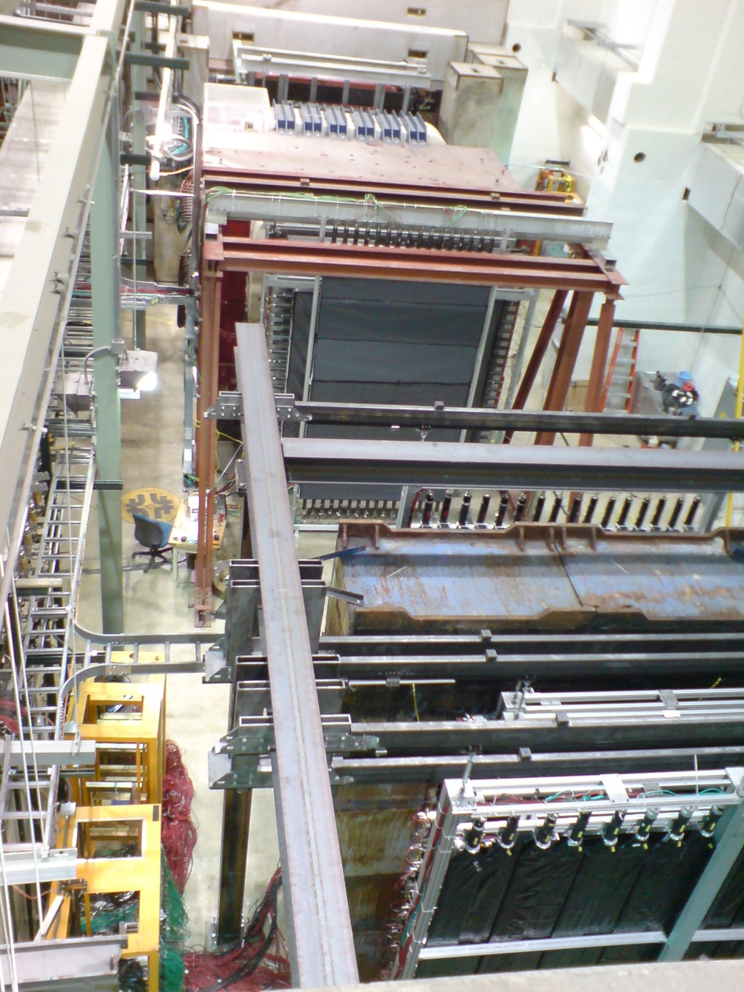
NM4/KTeV Hall
HODO 1
HODO 2
HODO 3
HODO 4

Slide 15
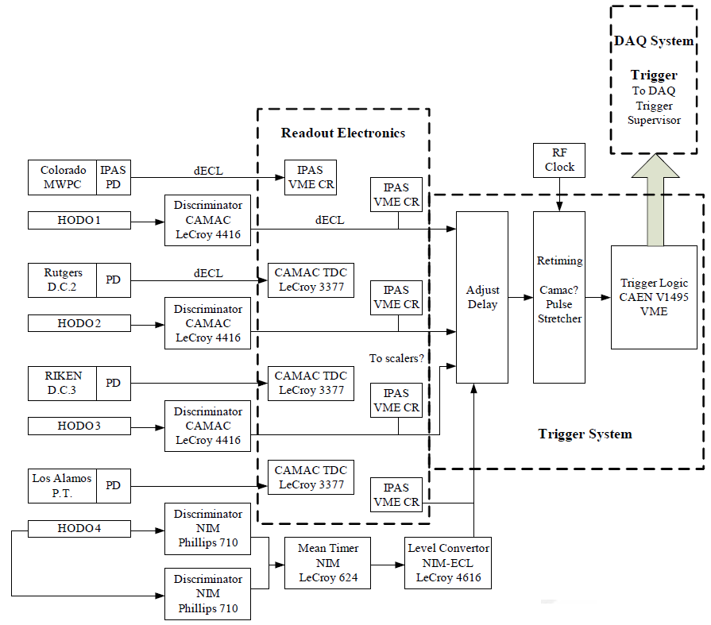
E906 detector readout and trigger system

Slide 16
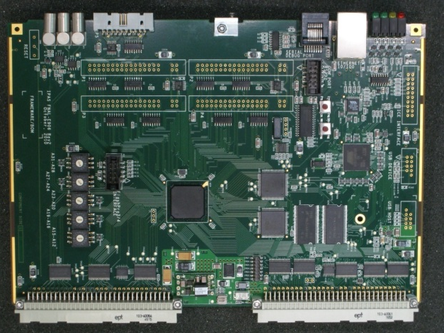
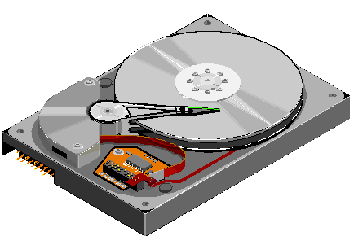
Data flow
The proton beam structure is 5 sec spill of 1*10¹³ protons each minute
53MHz
Four stations fast response hodoscope
Hardware trigger
Commercial FPGA board CAEN V1495
Decision synchronous with RF clock
LV1
All the data from each detectors are caught by this TDC/latch card which was designed by IPAS
Chamber
TDC /Latch by IPAS
~1KHz

Slide 17

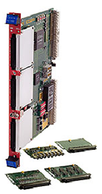
Trigger electronic overview
trigger
supervisor
level shifter
x
h
o
d
o
s
c
o
p
e
y
h
o
d
o
s
c
o
p
e
(“times 4”)
2nd. v1495
TRIGGER
μ
1st.
v1495
1st.
v1495
1st.
v1495
1st.
v1495
discriminator
Online trigger system is composed of 5 CAEN V1495 FPGA modules.

Slide 18

V1495
V1495 is a VME 6U board.
The I/O channel digital interface is composed by seven sections.
Section A and B are data input port, section C is a LVDS output port. D,E,F sections are user expandable port, in our experiment we define it to two input and one output port.
DATA
INPUT
64
PORT
DATA
INPUT
64
PORT
RF INPUT
DATA OUTPUT
32PORT
DATA OUTPUT32PORT

Slide 19
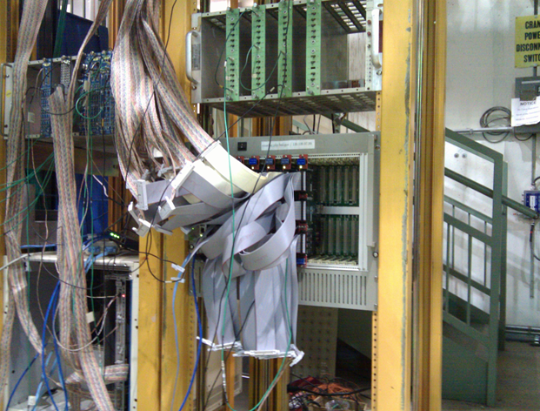
Trigger hardware
Here !

Slide 20
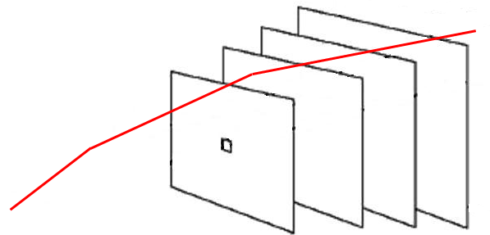

The main trigger
The trigger system searches for hit patterns through 4 station paddles.
All possible hit patterns are implemented into FPGA look-up-table
if(
(A( 1)='1' AND B( 1)='1' AND D( 1)='1' )
OR (A( 1)='1' AND B( 1)='1' AND D( 2)='1' )
. . .
OR (B(32)='1' AND D(32)='1' AND E(32)='1' )
) then
C(3)<='1';
elseif
C(3)<='0';
end if;
B
$$μ$$
B
St.1
St.2
St.3
St.4
Notes:
The hits in the hodoscopes at stations 1, 2, and 4 that
measured the vertical track positions were compared with the
contents of a three-dimensional look-up table. This table was
generated by Monte Carlo studies of dimuon events from the
target. When the hits in the scintillators matched one of the
pre-calculated dimuon trajectories, the trigger fired

Slide 21
FPGA BLOCK diagram
53MHz RF clock
RF input
53MHz
40MHz Local clock
PLL
62.5MHz
Retiming
250MHz/4 Phases
Data input
Sampling unit 1
Retiming
(digitize)
Memory
Subtractor
Look Up Table
(pipeline mode)
Sampling unit 2
Sampling unit 3
Sampling unit 4
Lv1 512*9*8*3
Lv2 512*9*8*4
One channel
Lv1 x96
Lv2 x128
Delay control
Retiming
The block diagram here only shows the main function for trigger construction.
Data output

Slide 22
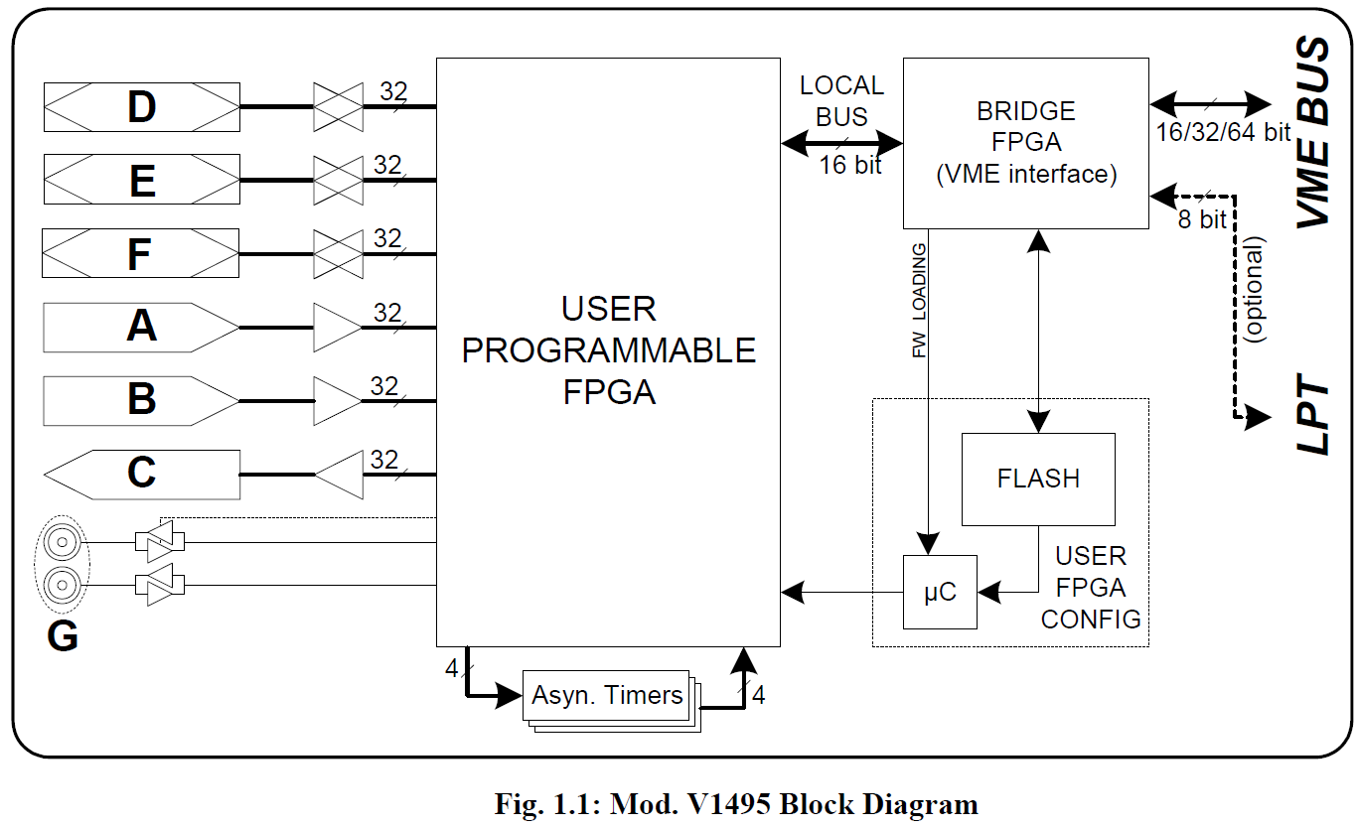
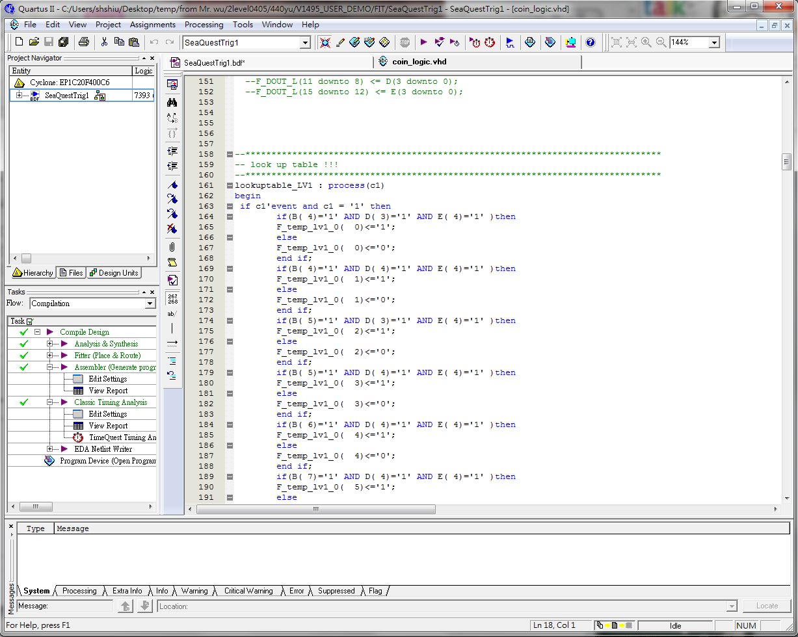
How to program v1495
Two FPGA was built in v1495.
FPGA “Bridge”, which is used for the VME interface and for the connection between the VME interface and the 2nd FPGA ( “USER PROGRAMMABLE FPGA”)
User can use Quartus 2 to write the VHDL code to design the FPGA and generate a user firmware for the “USER PROGRAMMABLE FPGA”. We can upload the FPGA firmware via vme backplane bus without any toolkits.

Slide 23
Highlights of E906 trigger system
The trigger system have a dead time free, 1ns signal resolution.
We can adjust all channel’s delay from 0ns to 2048ns in 1ns step.
We use a subtractor, providing a 16ns jittering acceptable region.
The LV1 input signal rate is 53MHz and reduce to several KHz.

Slide 24

THANK YOU

Slide 25
Backup slides

Slide 26
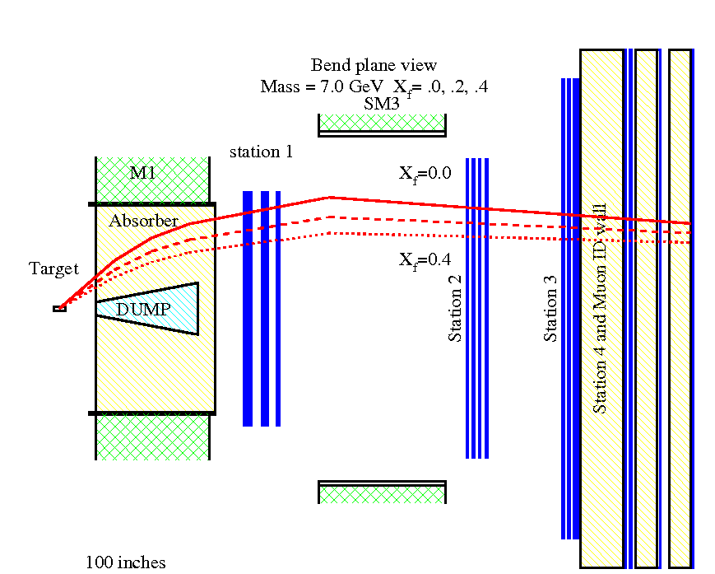
E906 Spectrometer: Bend Plane View
Station 2 & 3
Drift Chambers
1700 Channels
Multi-hit TDC’s
M2
M2
Sta.1
M1
Target
Sta.2
Sta.3
Sta.4 Muon ID wall
MWPC
5500 Channels
256 Hodoscopes
Station 4 Prop
Tubes 400 Channels

Slide 27
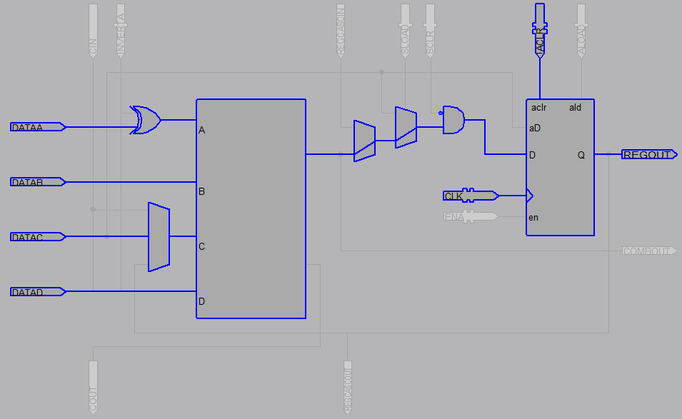
Logic element

Slide 28
What is pipeline step
Data input
Stage1
LUT
Stage2
LUT
Stage3
LUT
Stage4
LUT
Stage5
LUT
Data output
CLOCK
if(F_temp_lv1_0( 0)='1' OR F_temp_lv1_0( 1)='1' OR F_temp_lv1_0( 2)='1' OR F_temp_lv1_0( 3)='1')then
F_temp_lv2_0( 0)<='1';
else
F_temp_lv2_0( 0)<='0';
end if;
if(F_temp_lv1_0( 4)='1' OR F_temp_lv1_0( 5)='1' OR F_temp_lv1_0( 6)='1' OR F_temp_lv1_0( 7)='1')then
F_temp_lv2_0( 1)<='1';
else
F_temp_lv2_0( 1)<='0';
end if;
if(A( 0)='1' AND B( 0)='1' AND D( 0)='1' )then
F_temp_lv1_0( 0)<='1';
else
F_temp_lv1_0( 0)<='0';
end if;
if(A( 0)='1' AND B( 0)='1' AND D( 8)='1' )then
F_temp_lv1_0( 1)<='1';
else
F_temp_lv1_0( 1)<='0';
end if;
Stage1
Stage2

Slide 29
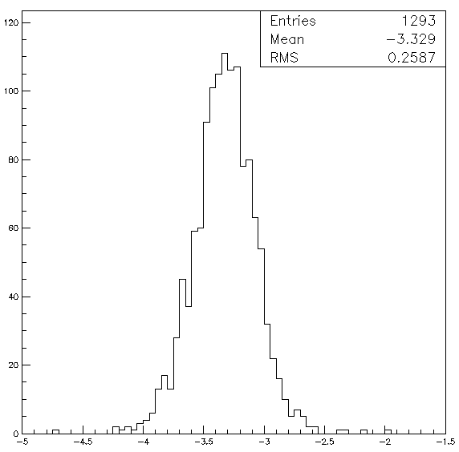
p_{Tx example}
St2 No.7
St3 No.8
St4 N0.8
Mean p_{Tx = -3.329}

