Slide 1
Weekly Journal Club for Medium Energy Physics
Institute of Physics, Academia Sinica
Time-Of-Flight
Resistive Plate Chamber
Collaborators ( * : Faculty )
Hiroaki Ohnishi * (RIKEN)
Masayuki Niiyama * (Kyoto University)
Natsuki Tomida (Kyoto University)
Wen-Chen Chang * (Institute of Physics, Academia Sinica)
Chia-Yu Hsieh (National Central University)
Jia-Ye Chen (Institute of Physics, Academia Sinica)
Jia-Ye Chen
2011/03/07

Slide 2
Outlines
Motivation
  Particle Identification at SPring-8/LEPS2
Introduction
  History & Advantage
  Detector Physics
  Construction
Beam Test at SPring-8(Japan)
Beam-Test Results
Future Studies

Slide 3
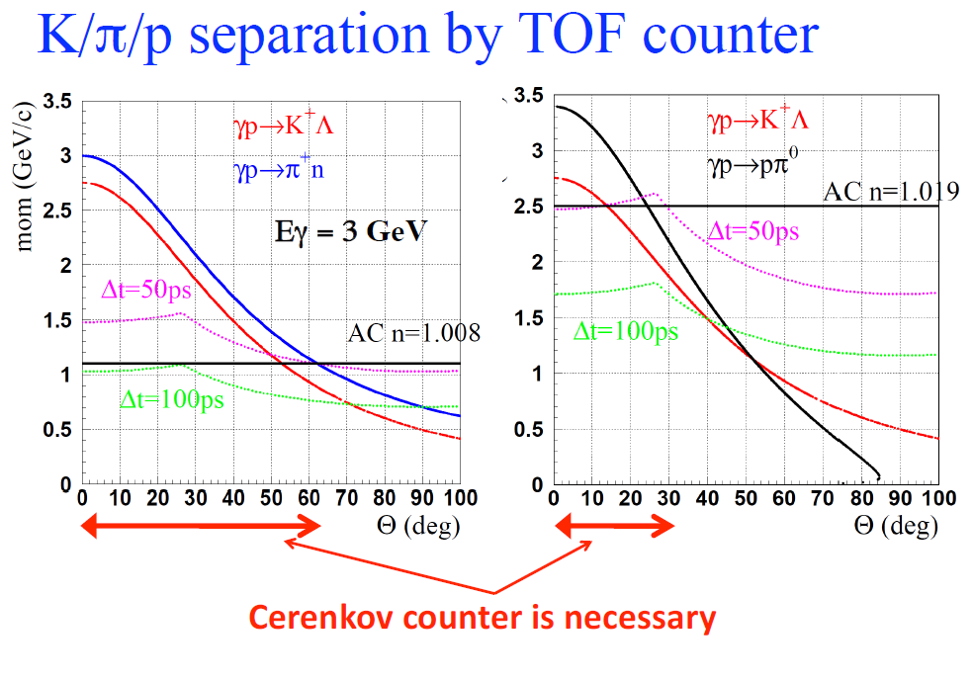
Motivation (Particle Identification)

Slide 4
Before Resistive Plate Chamber (1)
Spatial resolution
  DC operating gaseous detectors of ionizing particles, such as wire/drift chambers and streamer tubes have successfully replaced the order technique of the scintillator coupled to photomultipliers in experiments requiring a high spatial resolution.

Slide 5
Before Resistive Plate Chamber (2)
Time resolution
  The fluctuation of time needed by electrons liberated in the gas by an ionizing particle, to drift up to the multiplication region, very close to the wire, where avalanches and eventually streamer are produced.
  Scintillator, the most commonly utilized technique for high time resolution, before 1990.
  A higher time resolution is clearly achievable if an uniform and intense electric field is used instead of that produced by a charged wire. The sequence of transitions, “free electrons → avalanche → streamer”, can occur in a very short time and with minimal fluctuations.

Slide 6
Advantages of RPC
Time resolution is down to 50 ps.
Larger covering areas up to a few thousand square meters.
Robustness and simplicity of construction.
Inexpensive industrial production.

Slide 7
Principle of RPC (1)
An RPC is a particle detector utilizing a constant and uniform electric field produced by two parallel electrode plates. When the gas (Freon) is ionized by a crossing charged particle, an electric discharge is initiated by the liberated electrons. This discharge is quenched by the following mechanisms:
  The discharge is prevented from propagating through the whole gas, because of the high resistivity (~10¹⁰ Ωm) of electrodes. The electric field is suddenly switched off around the discharge point, out of this area (~0.1 cm²) the sensitivity of RPC remains unaffected.
  UV photons produced by the discharge were absorbed by the isobutane/butane to avoid secondary discharges from gas photoionization.
  Capture of outer electrons of the discharge due to the Freon affinity, which reduces the size of the discharge and possibly its transversal dimensions.

Slide 8
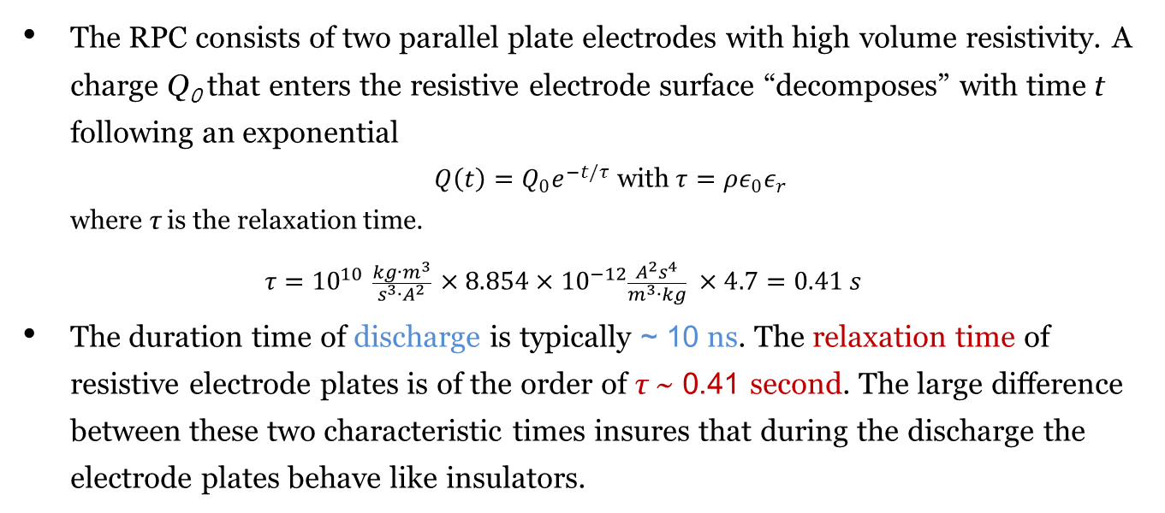
Principle of RPC (2)
The RPC consists of two parallel plate electrodes with high volume resistivity. A charge Q₀ that enters the resistive electrode surface “decomposes” with time t following an exponential
  ${Q\left(t\right)=Q_{0}e}^{−t/τ}$ with $τ=ρε_{0}ε_{r}$
  where τ is the relaxation time.
  $$τ={10}^{10} \frac{kg∙m^{3}}{s^{3}∙A^{2}} ×8.854×{10}^{−12}\frac{A^{2}s^{4}}{m^{3}∙kg} ×4.7=0.41 s$$
The duration time of discharge is typically ~ 10 ns. The relaxation time of resistive electrode plates is of the order of τ ~ 0.41 second. The large difference between these two characteristic times insures that during the discharge the electrode plates behave like insulators.

Slide 9
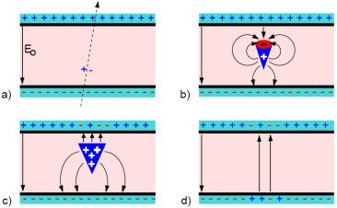
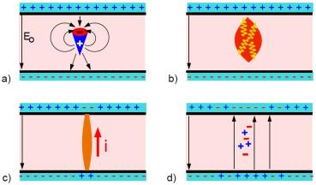
RPC Operation Modes
avalanche mode
some gas atoms are ionized by the passage of a charged particle. An avalanche is started.
The avalanche size is sufficiently large to influence the electric field in the gas gap.
The electrons reach the anode. The ions drift much slower.
The ions reach the cathode.
streamer mode
An avalanche is developing.
The avalanche charges lead to a high field deterioration in the gas gap. Moreover, photons start to contribute to the avalanche development and cause a rapid spread of the avalanche : A streamer evolves.
A weak spark may be created. The local electrode area is discharged.
The electric field is strongly decreased around the spot of the avalanche.

Slide 10
Comparison of RPC Operation Modes
Streamer mode
  Providing large signals, which simplifies read-out electronics and gap uniformity requirement, but having the aging issue and low detected rate.
Avalanche mode
  The signal generated in avalanche mode is not large enough and the amplifier device is usually required.
  High-rate application and the detector aging problem were facilitated by the development of highly quenching C₂F₄H₂-based gas mixtures with the addition of small contents of SF₆.

Slide 11
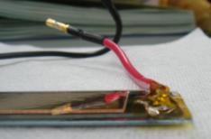
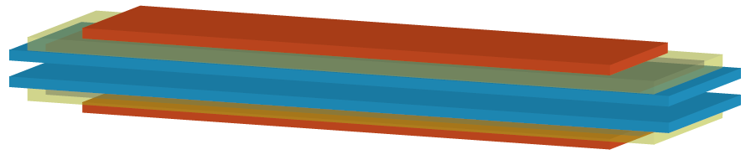
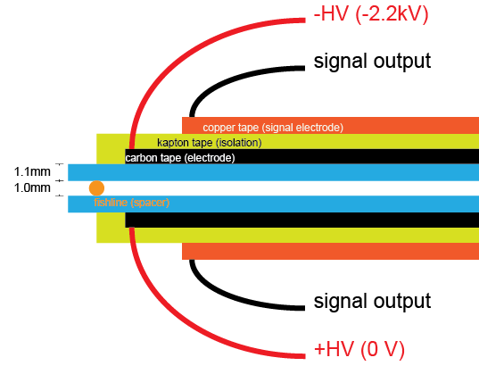
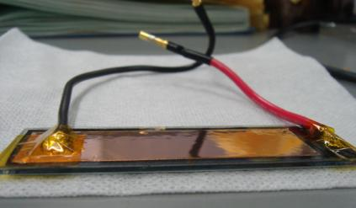
Single-gap RPC Configuration

Slide 12
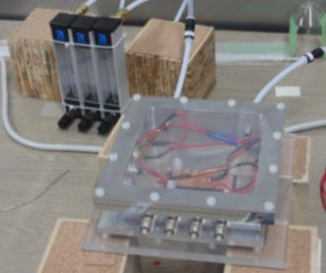
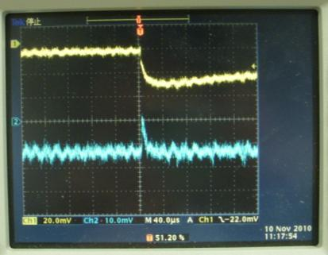
Single-gap RPC Test
2010/11/09 @ RIKEN, Japan
signals taken by using 10-MΩ probe
up signal electrode
→ ions collection
down signal electrode
→ electrons collection
Gas Mixtures
R134A (Freon/C₂F₄H₂) : 90%
  Ionization
Isobutane : 5%
  UV photons absorption
SF₆ : 5%
  Avalanche mode
HV (up) : -2.2 KV HV (down) : 0 V

Slide 13
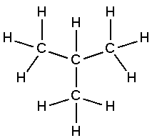

RPC Performance Factors
Operation HV (10~11 KV/1mm)
Gas component
  Isobutane/Butane : expensive/cheaper, higher/lower efficiency
RPC # of layers
  more layers : better efficiency, larger pulse height, much noiser to calorimeter
Gas gap : Creating the primary ionization clusters, Gas gain
  narrower : better time resolution, lower efficiency
  wider : larger signal (especially in avalanche mode), worse time resolution (larger arrival-time fluctuation), therefore the multi-gap RPC was proposed.
Butane
Isobutane

Slide 14
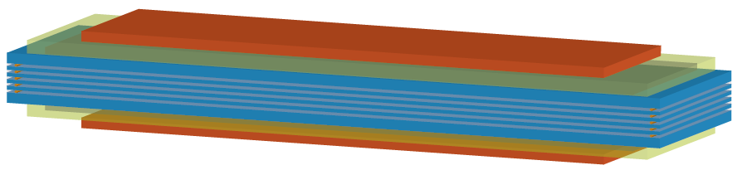
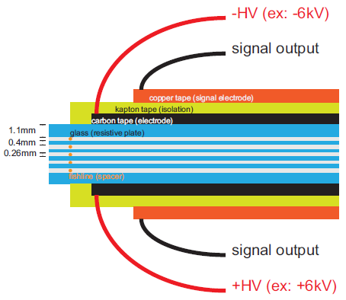
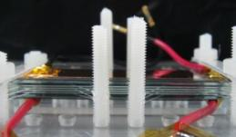
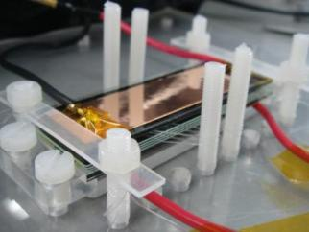
Multi-gap RPC Configuration (5 gaps)
Multi-gap RPC consists of resistive plates and gas gaps stacked alternatively, and electrodes are placed on the outer surface of the most outer resistive plates.

Slide 15
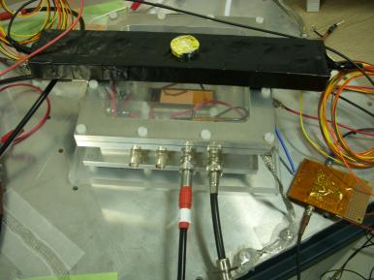
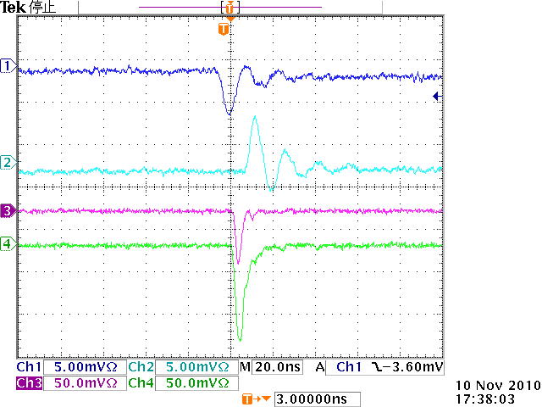
Multi-gap RPC Test
Sr (β source)
Signal(UP)
Signal(down)
PMT1
PMT2
1 Scintillator with 2 PMT outputs Coincidence
HV_{up} = -3.6KV
HV_{down} = 0 V

Slide 16
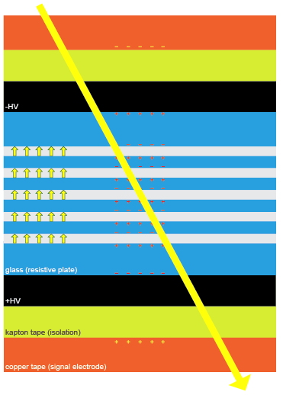
Multi-gap RPC
The HV is applied by a resistive layer only to the external surfaces of the external plates; all the internal resistive plates are all electrically floating, the time jitter are reduced by small size of sub-gaps.
Pickup electrodes are located outside the stack and insulated from the HV electrodes.
The resistive plates act as “dielectrics”, that is, the resistive plates are transparent to the fast signal generated by the avalanches inside each gas gap. Induced signal can be caused by the movement of charge in anywhere of gas gaps between 2 pickup electrodes. Therefore, the observed induced signal is the sum of the individual avalanche signal.
charged particle

Slide 17

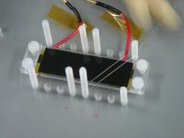
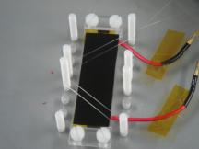
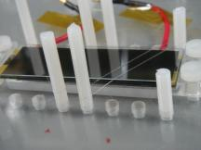
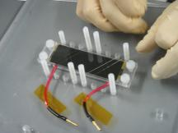
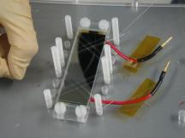
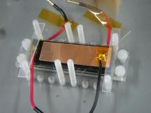
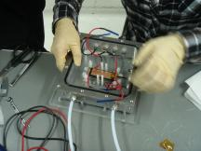
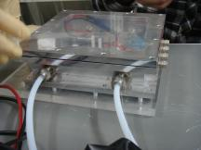
Multi-gap RPC Construction
(1)
(2)
(3)
(4)
(5)
(6)
(7)
(8)

Slide 18
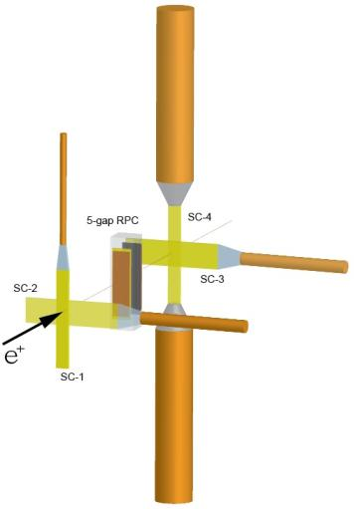
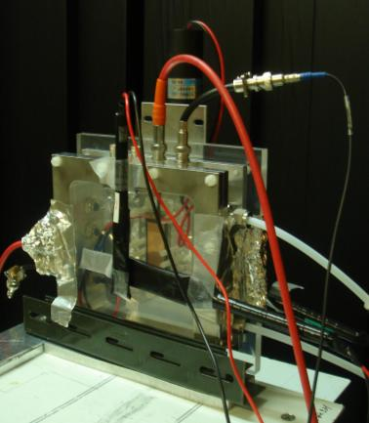
MRPC Beam Test Setup
1 amplifier
3 amplifiers

Slide 19
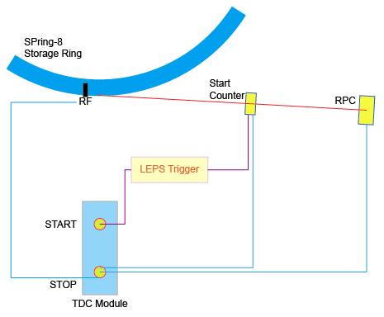
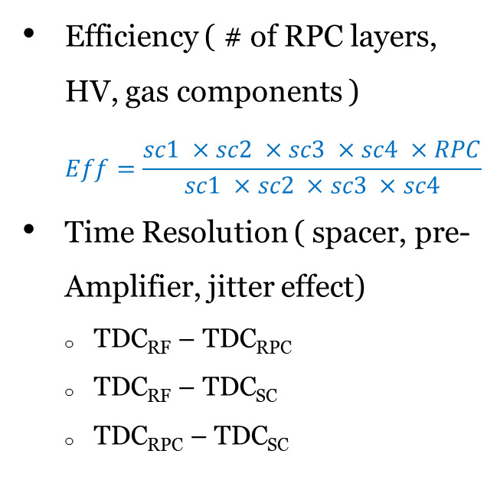



Studies of MRPC Time Resolution
Efficiency ( # of RPC layers, HV, gas components )
  $$Eff=\frac{sc1 ×sc2 ×sc3 ×sc4 ×RPC}{sc1 ×sc2 ×sc3 ×sc4}$$
Time Resolution ( spacer, pre-Amplifier, jitter effect)
  TDC_{RF} – TDC_{RPC}
  TDC_{RF} – TDC_{SC}
  TDC_{RPC} – TDC_{SC}
${δ_{RF}}^{2}$+${δ_{RPC}}^{2}$
${δ_{RF}}^{2}$+${δ_{SC}}^{2}$
${δ_{RPC}}^{2}$+${δ_{SC}}^{2}$

Slide 20
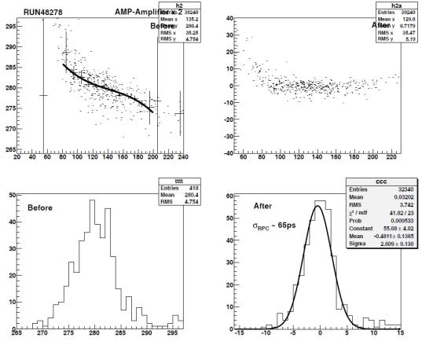
MRPC Beam Test Result (1)
Each TDC bin is 25 ps.
Efficiency
  Isobutane > 95%
  Butane > 90 %
First time-resolution result was studied by Ohnishi-san, after applying the slewing correction.
  σ_{t} ~ 65 ps

Slide 21
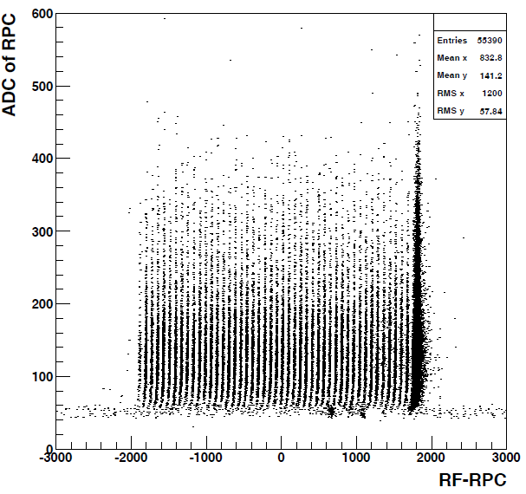
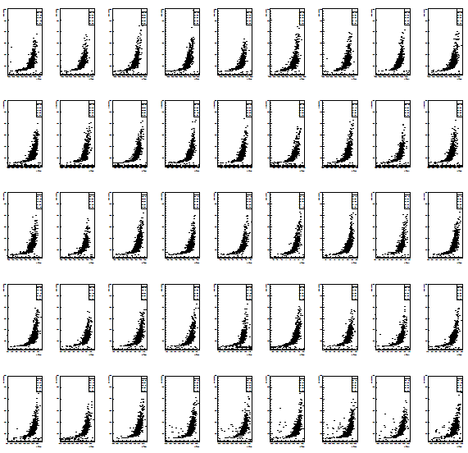
MRPC Beam Test Result (2)

Slide 22
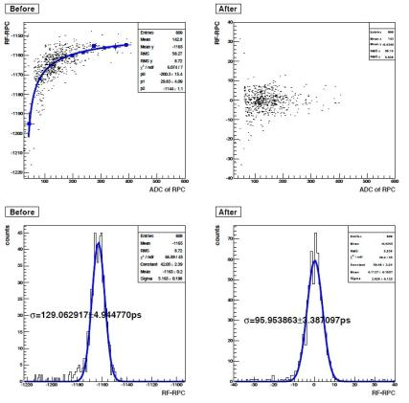
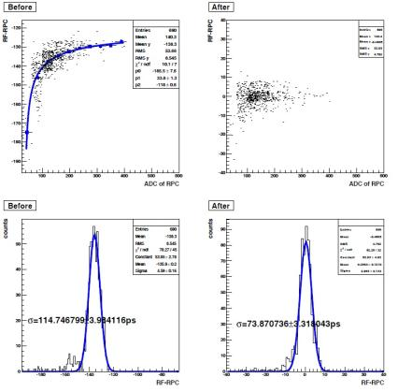
MRPC Beam Test Result (3)
Bunch 8
Bunch 21

Slide 23
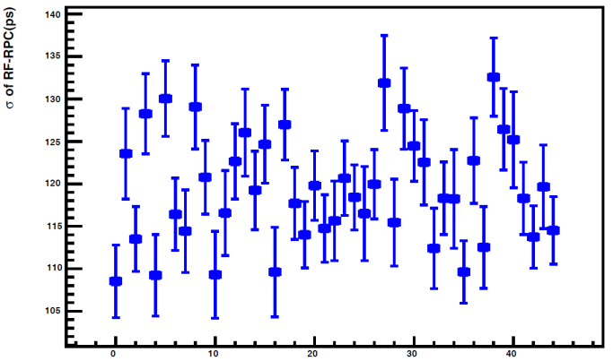
MRPC Beam Test Result (Before Slewing Correction)
bunch number

Slide 24
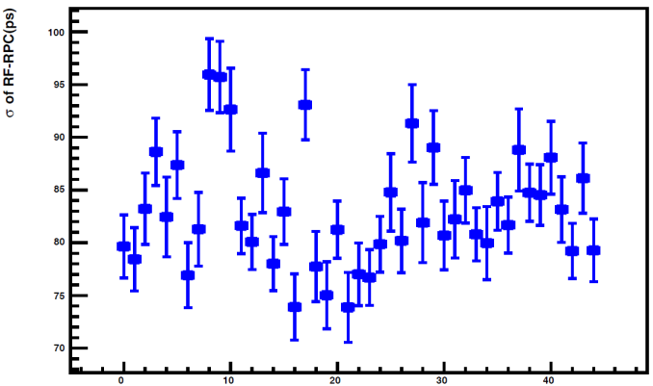
MRPC Beam Test Result (After Slewing Correction)
bunch number

Slide 25
Future Studies
MRPC Construction Uniformity
Efficiency
  single rate of RPC
  improve the efficiency by using Butane, after considering the cost.
Time resolution
  time resolution of Start Counter
    σ_{SC}=90ps is different from previous LEPS results, 180 ps.
  RF bunch dependence (must be non-dependence)
  build suitable pre-Amplifier (refer to RHIC PHENIX experiment)

Slide 26
Backup Slices

Slide 27
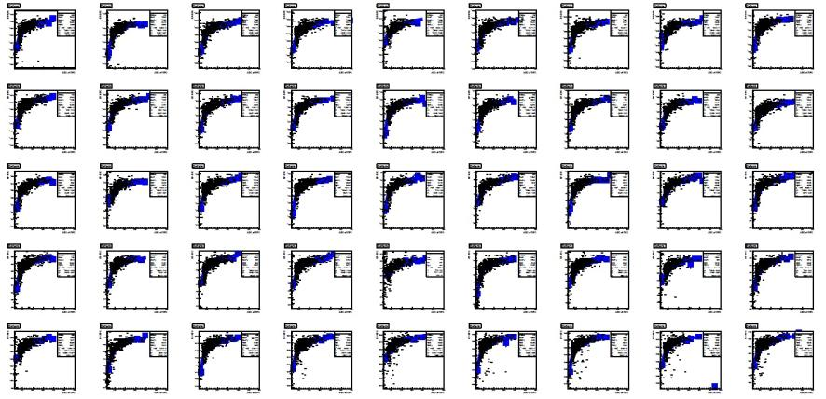
MRPC Beam Test Result

Slide 28
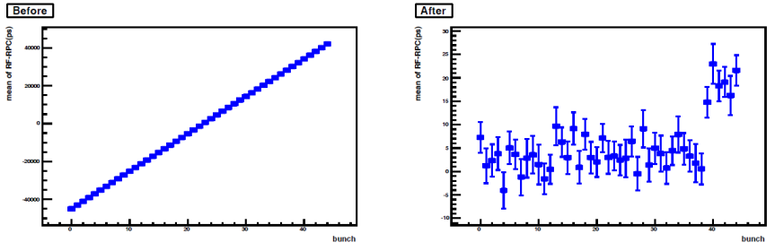
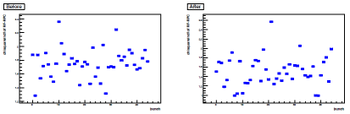
Mean Position After Slewing Correction
x²

Slide 29
Dielectric
A dielectric is an electrical insulator that can be polarized by an applied electric field. When a dielectric is placed in an electric field, electric charges do not flow through the material, as in a conductor, but only slightly shift from their average equilibrium positions causing dielectric polarization. Because of dielectric polarization, positive charges are displaced toward the field and negative charges shift in the opposite direction. This creates an internal electric field that partly compensates the external field inside the dielectric.
If a dielectric is composed of weakly bonded molecules, those molecules not only become polarized, but also reorient so that their symmetry axis align to the field.

