Slide 1
FPGA Application on DAQ
2011/5/23
CYC

Slide 2
Outline
Basic FPGA introduction
NI FPGA modules application on our DAQ
Other information

Slide 3
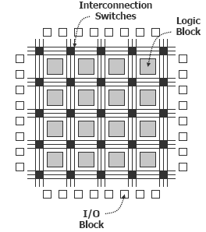
FPGA
Field-Programmable Gate Array

Slide 4
Traditional ASIC Chipset
design=>layout => user
=>single purpose
FPGA Chipset
(design=>write program=>complie)^{n}=>user
=>multi purpose

Slide 5
FPGA chipset are widely using in various devices
=> ie. CAEN FADC V1724
FPGA program required
=> Verilog or VDHL
NI FPGA program required
=> LabView

Slide 6
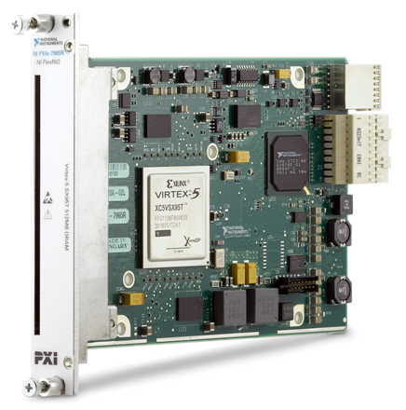
NI FPGA Products
Model | Bus | FPGA Slices | FPGA DSP Slices | Memory (Block RAM) | OnBoard Memory (DRAM)
7965R | PXI-E | 14720 | 640 | 8784Kb | 512MB
7962R | PXI-E | 8160 | 288 | 4752Kb | 512MB
7961R | PXI-E | 8160 | 288 | 4752Kb | 0
7954R | PXI | 17280 | 64 | 4608Kb | 128MB
7953R | PXI | 12960 | 48 | 3456Kb | 128MB
7952R | PXI | 7200 | 48 | 1728Kb | 128MB
7951R | PXI | 4800 | 32 | 1152Kb | 0

Slide 7
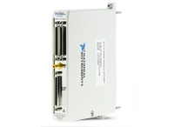
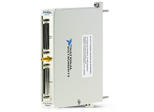
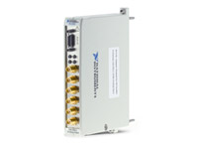
NI-5752 32 Analog In Channels
50 MS/s Sampling Rate
12 bit Resolution
NI-5751 16A I, 8D I/O
50 MS/s Sampling Rate
14 bit Resolution
NI-5761 4A I, 8D I/O
250 MS/s Sampling Rate
14 bit Resolution

Slide 8
FPGA in DAQ
1. Online PSD
2. Replacing mutli devices

Slide 9
OnLine PSD
Shrinking HDDs required
=> 30~50Hz data taking Rate
=> 250~450GB/day
Increasing data efficiency
Faster than software online PSD
=> Purely Hardware operation

Slide 10
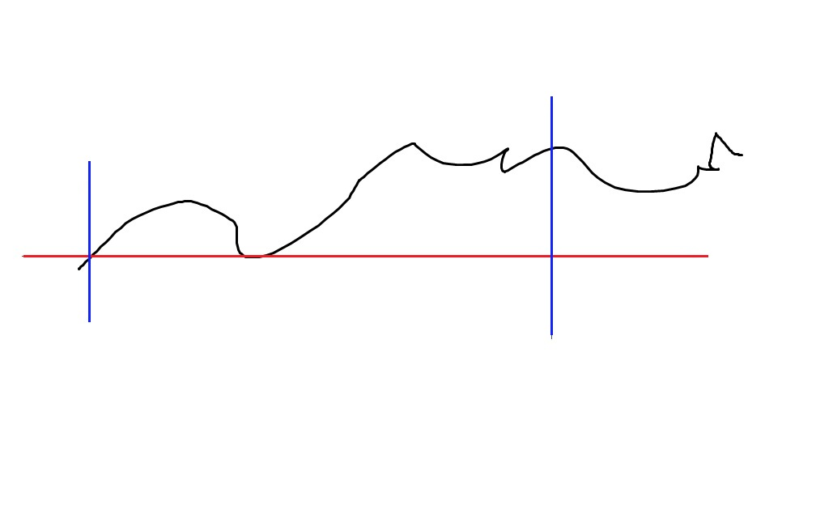
Trigger out(or not)
Depending on us
Over Threshould
Data Analysing Q&A (parallel Operation)
Q:sumation
A:Max

Slide 11
Replacing multi Devices
TDC, Scalar, Hitpttern, Discriminatior

Slide 12
PMTs(Vetos)
FPGA Modules
Discriminators(multi devices)
Logic Operation(AND, OR….etc)
Hitpattern
TDC
Scalar

Slide 14
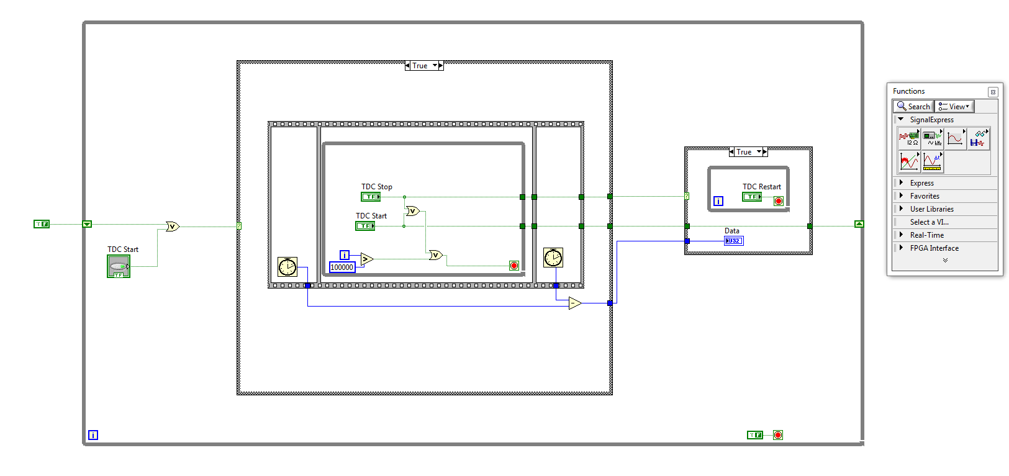
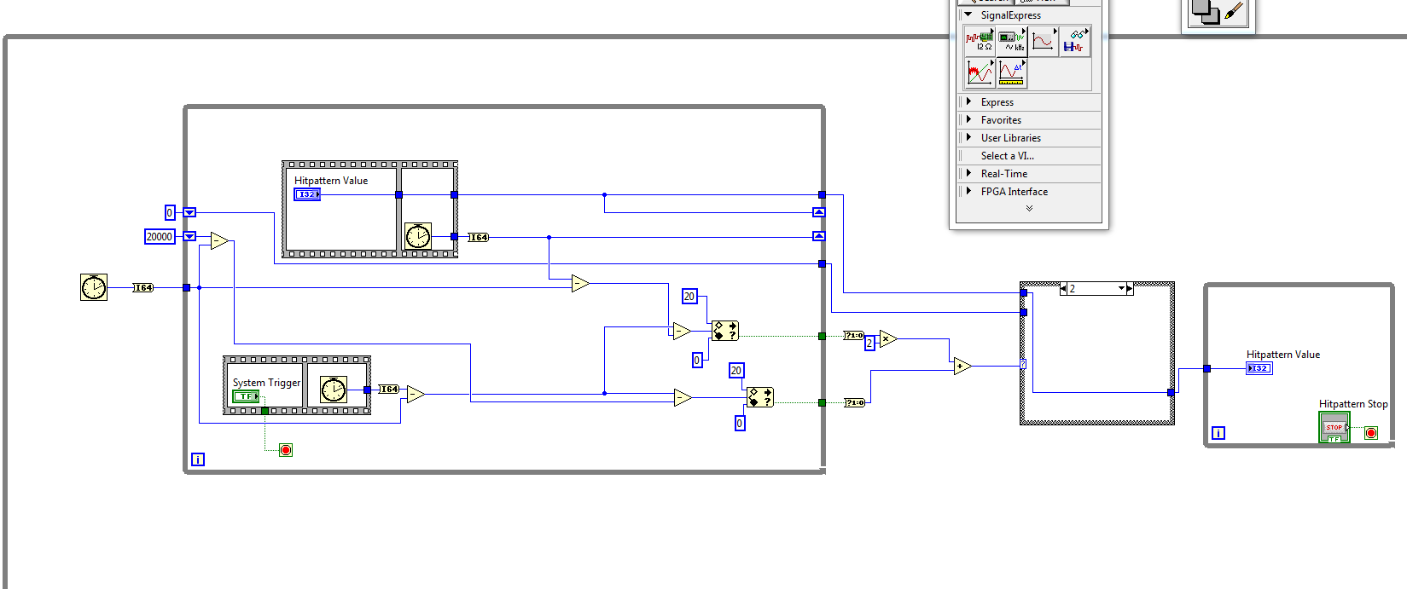

Slide 15
Peer to Peer Communication
40 PMTs for veto,2 inner veto, NaI signal
44 channels separates 2~3 FPGA modules

Slide 16
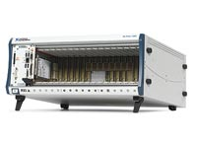
PXI-Express Slots

Slide 17
Additional Information : Design Your Own FPGA Adaptors
Basic XML
VDHL
LabView-FPGA
PCB layout

Slide 18
End

