Slide 1
Introduction of DAQ system:
E906 as an example
Su-Yin Wang (Grass)
2011/06/20

Slide 2
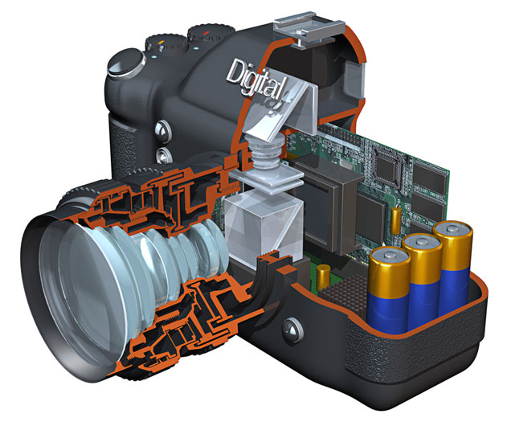

Data Acquisition System
trigger
Front End Electronic
Decoder
Physics Event
Detector

Slide 3
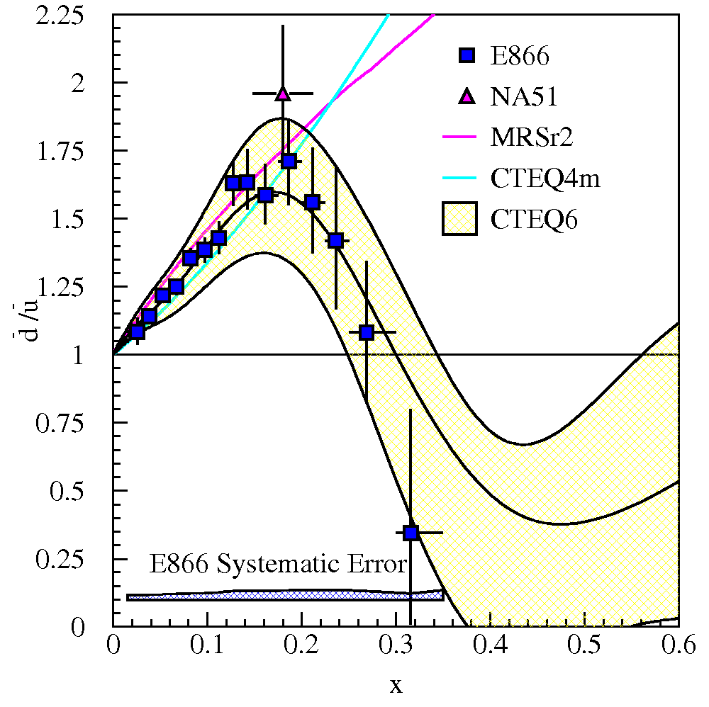
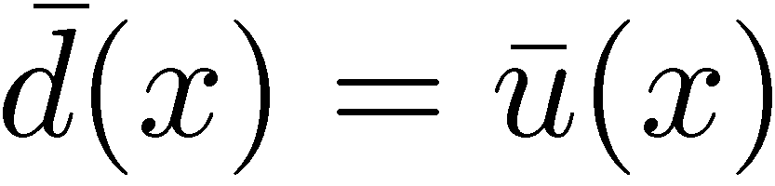
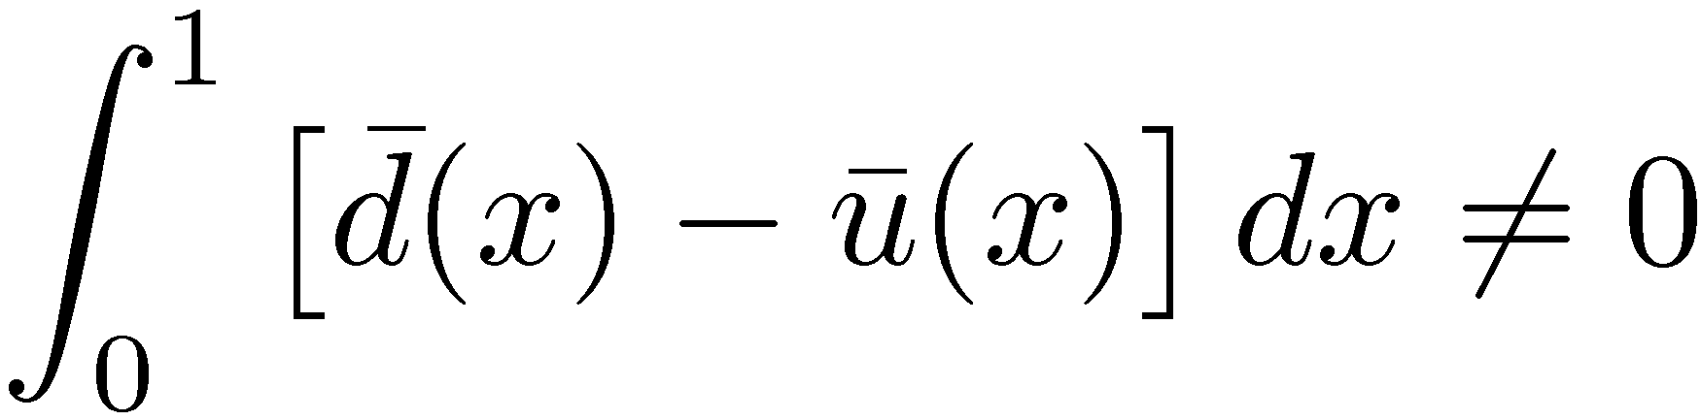
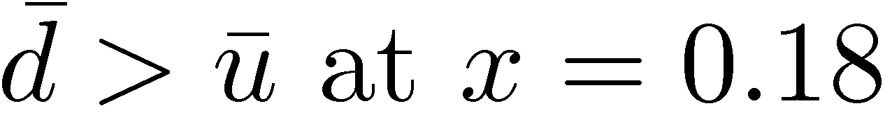
Light Antiquark Flavor Asymmetry: Brief History
Naïve Assumption:
NMC (Gottfried Sum Rule)
NA51 (Drell-Yan, 1994)
E866/NuSea (Drell-Yan, 1998)

Slide 4
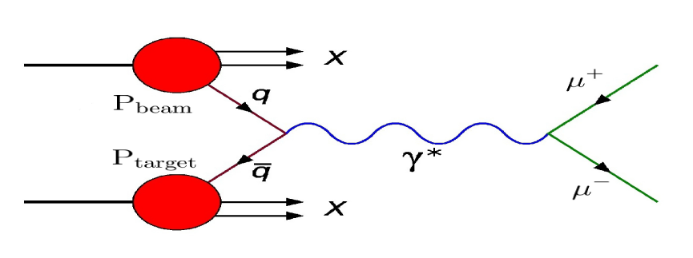

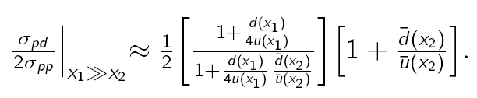
Why Drell-Yan?
To lowest order:
Experimental measurements (E866, CERN NA51 and E906):

Slide 5
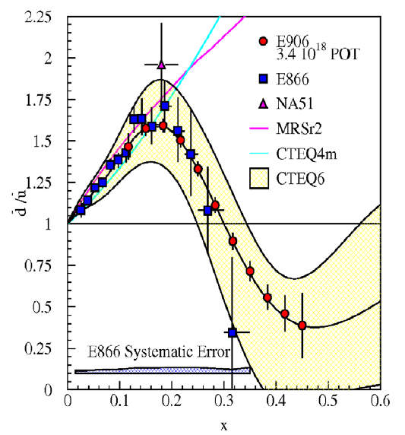
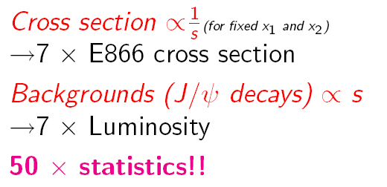
Extracting d-bar/-ubar From Drell-Yan Scattering
E906 in NM4 will extend the DY measurements done in E866 120 GeV proton beam (MI) vs 800 GeV proton beam (E866)
E906 expects systematic uncertainty to remain at approx. 1% in cross section ratio.

Slide 6
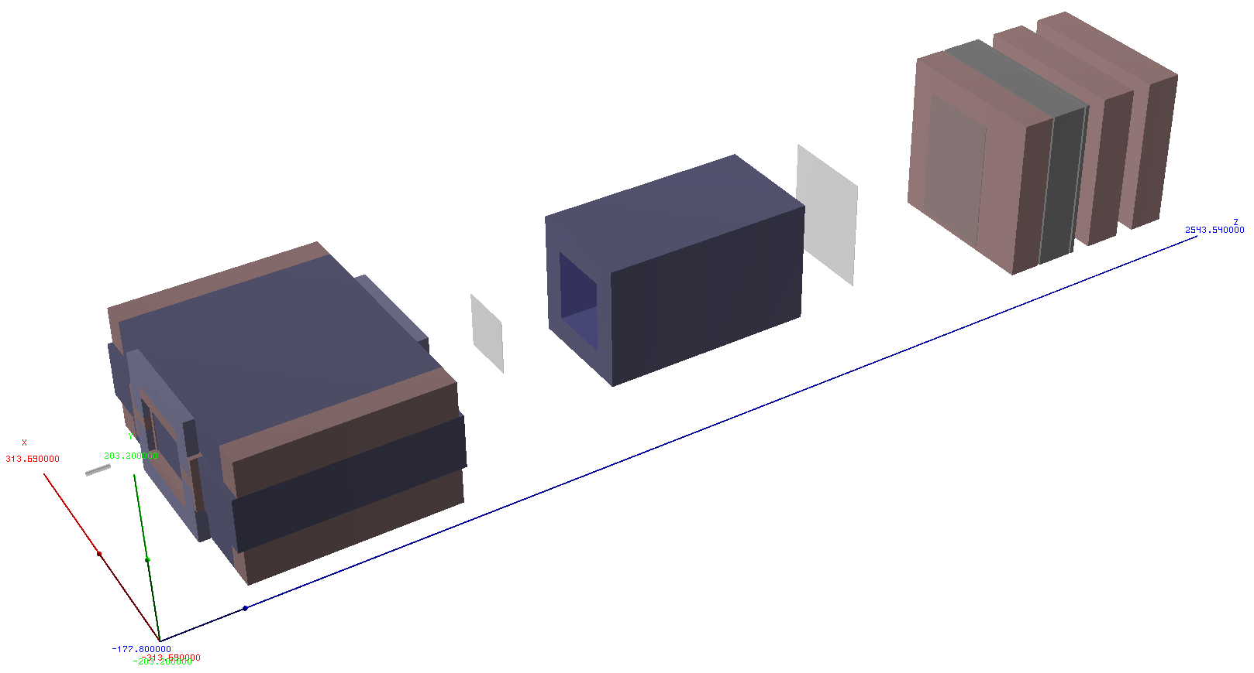
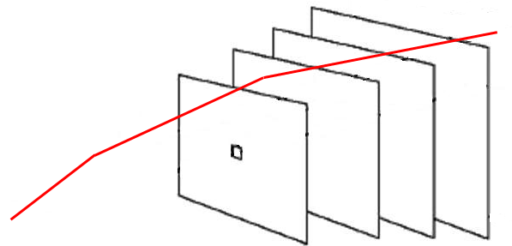
E906 Spectrometer
E906 Spectrometer
Station 2 and 3:
Hodoscope array
Drift Chamber tracking
Hadron Absorber
Solid Iron Focusing Magnet, Hadron absorber and beam dump
Station 1:
Hodoscope array
MWPC tracking
Mom. Meas.
(KTeV Magnet)
Station 4:
Hodoscope array
Prop tube tracking
4.9m
25m
Liquid H₂, d₂, and solid targets

Slide 7
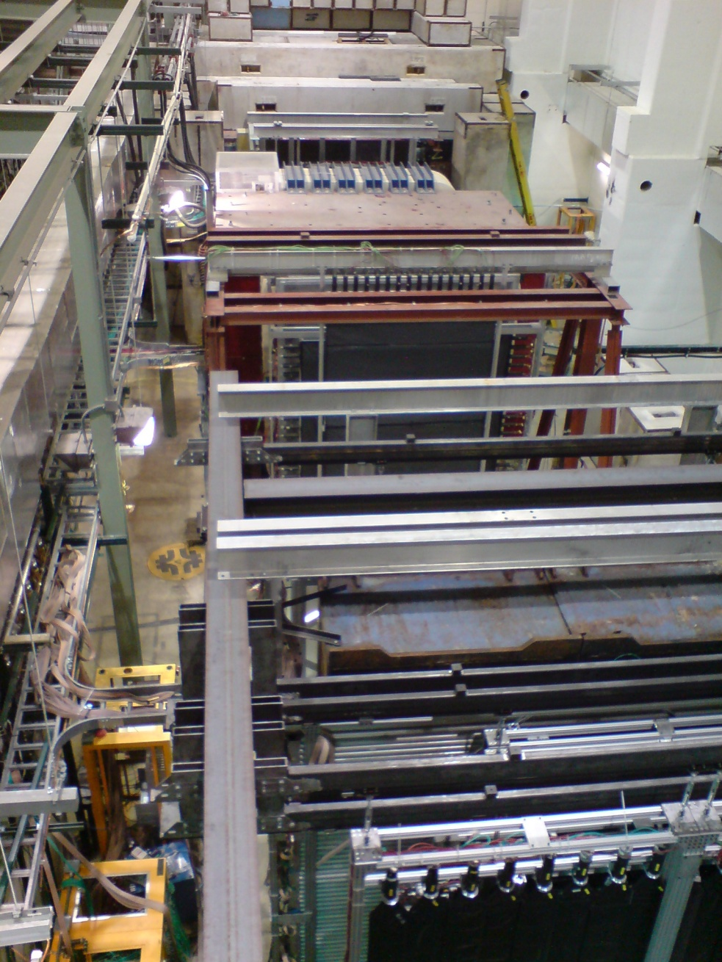
NM4/KTeV Hall (after installation)
HODO 1
HODO 2
Station 3:
Drift Chamber
HODO 3
Station 4:
Proportional Tubes
HODO 4

Slide 8
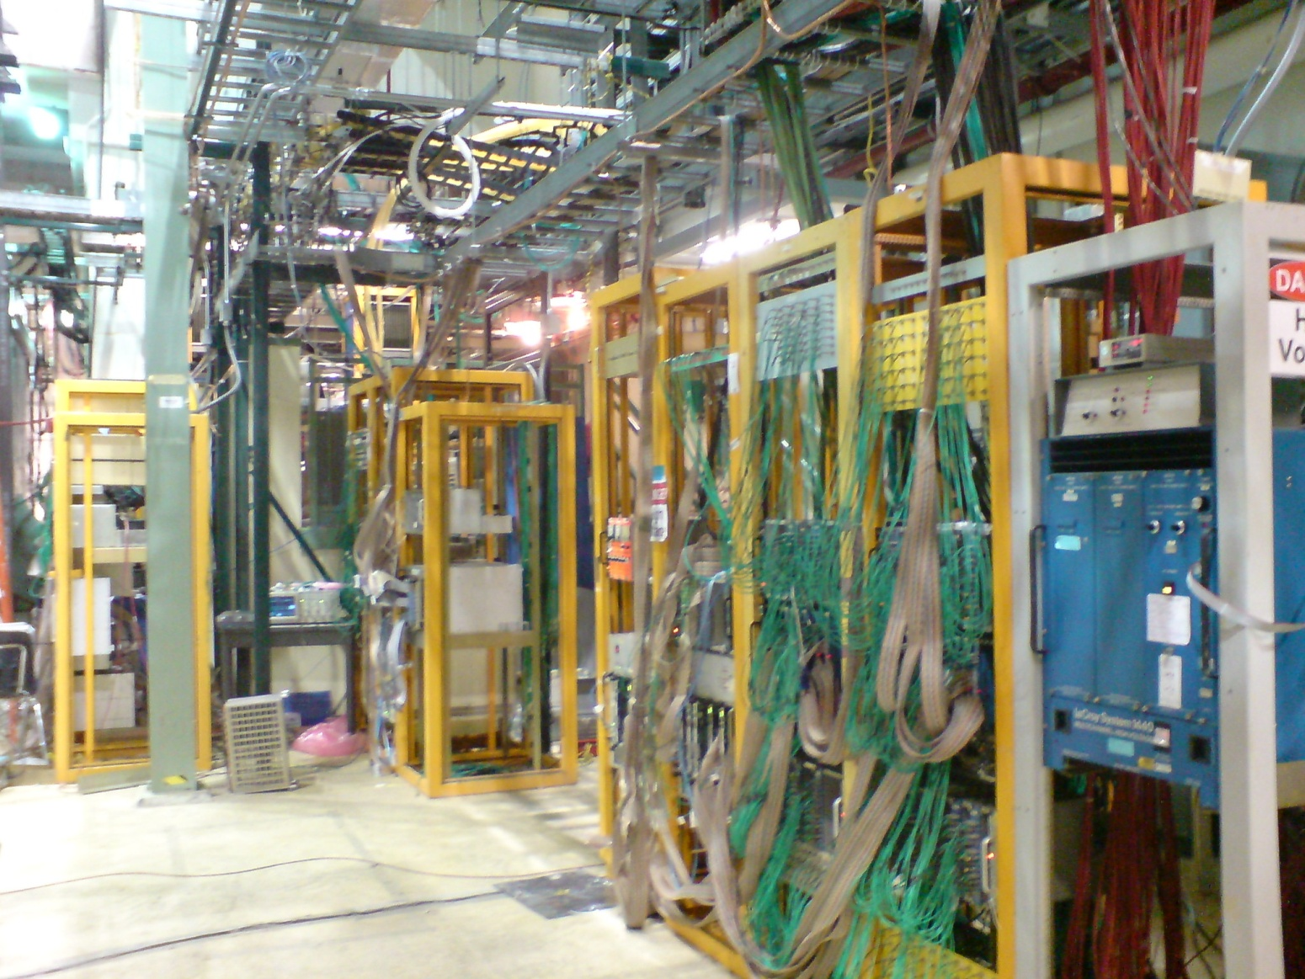
Readout Electronics
HODO signal
Amplifier
High voltage
Latch cards
Discriminator

Slide 9
Overview
TRIG
(~600 ns delay)
ROC
Latch
Hodo
ROC
TI
CPU
CODA
TS
Beam start
Beam stop
ROC
CPU
TI
St1, St2, St3, St4
TDC
Data
Trigger
Slow Control
MySQL
Control by CODA
We are able to read all Hodo and slowcontrol events now

Slide 10
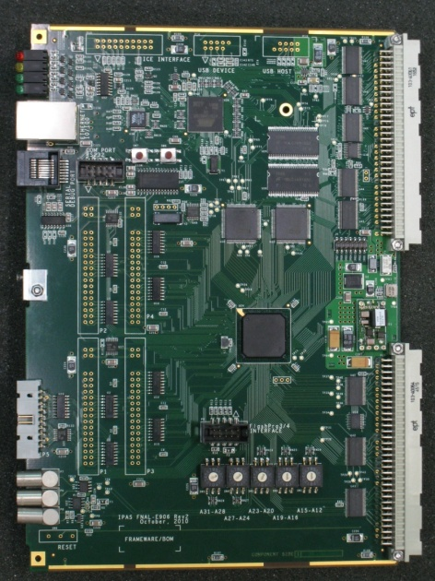
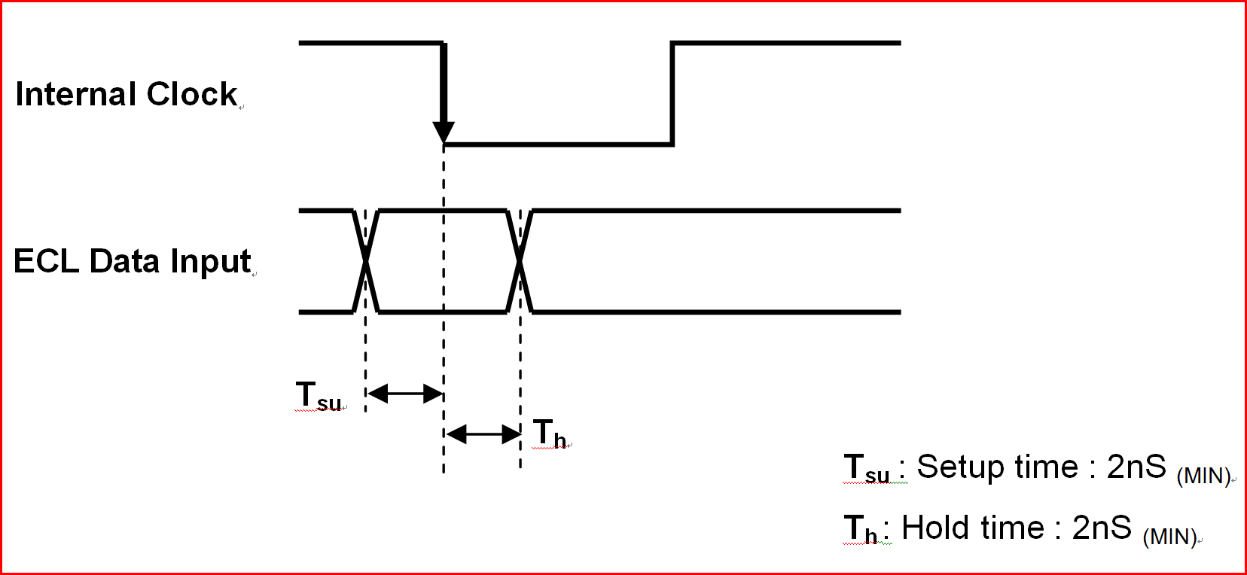
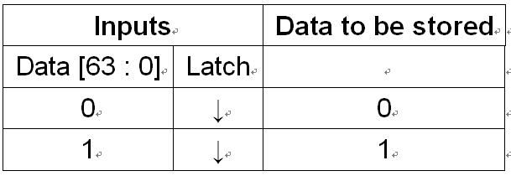
Front End Electronic
Latch Card as an Example

Slide 11
Setup:
CSR2(13-8) =11
CSR2(5-0) =bin (001110)
Adjustable Delay
  64 clocks * 8 ns = 512 ns
  Delay=0, earliest signal (default)
  Delay=3f, edge signal
Shift register | 0 | 1 | 2 | 3 | 4 | 5 | 6 | 8 | 9 | 10 | 11 | 12 | … | 60 | 61 | 62 | 63
OR operation CSR2(5-0) |  |  |  |  |  | 0 | 0 | 1 | 1 | 1 | 0
Real data Latch card get 0 | ? | ? | ? | 1 | 1 | 1 | 0 | 0 | 0 | 0 | 0 | ? | ? | ? | ? | ? | ?
Real data Latch card get 1 | 0 | 0 | 0 | 0 | 0 | 1 | 1 | 1 | 0 | 0 | 0 | ? | ? | ? | ? | ? | ?
Real data Latch card get 1 | 0 | 0 | 0 | 0 | 0 | 0 | 0 | 1 | 0 | 0 | 0 | ? | ? | ? | ? | ? | ?
Real data Latch card get 1 | 0 | 0 | 0 | 0 | 0 | 0 | 0 | 0 | 0 | 1 | 0 | ? | ? | ? | ? | ? | ?
Trigger
8*(63-11)=8*52=416 ns

Slide 12
Latch Card Data Decoding
0x18ffff32 0xfe000045
D31 | D30 | D29 | D28 | D27 | D26 | D25 | D24 | … | D7 | D6 | D5 | D4 | D3 | D2 | D1 | D0
Ch31 0 | Ch30 0 | Ch29 0 | Ch28 1 | Ch27 1 | Ch26 0 | Ch25 0 | Ch24 0 | … ffff | Ch7 0 | Ch6 0 | Ch5 1 | Ch4 1 | Ch3 0 | Ch2 0 | Ch1 1 | Ch0 0
1 |  |  |  | 8 |  |  |  | ffff | 3 |  |  |  | 2
D31 | D30 | D29 | D28 | D27 | D26 | D25 | D24 | … | D7 | D6 | D5 | D4 | D3 | D2 | D1 | D0
Ch63 1 | Ch62 1 | Ch61 1 | Ch60 1 | Ch59 1 | Ch58 1 | Ch57 1 | Ch56 0 | … 0000 | Ch39 0 | Ch38 1 | Ch37 0 | Ch36 0 | Ch35 0 | Ch34 1 | Ch33 0 | Ch32 1
f |  |  |  | e |  |  |  | 0000 | 4 |  |  |  | 5

Slide 13
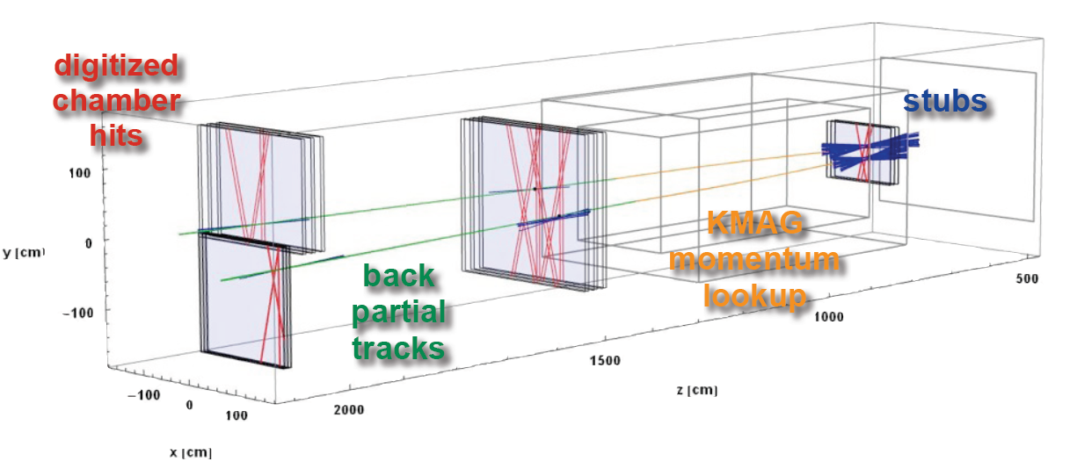
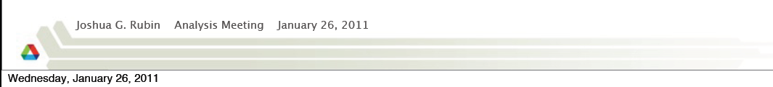
Tracking Example
It’s NOT from the Hodos…

Slide 14
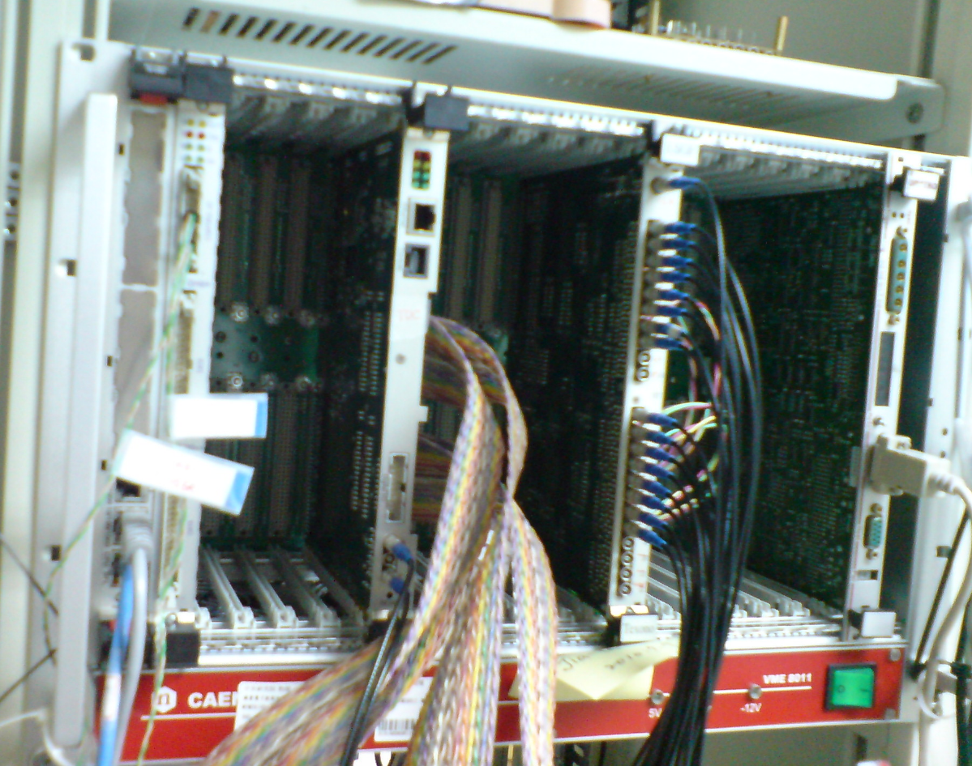
But… How to Get Data?
There are two actions though VME bus
  Read and Write
  Address is the key
All communications are controlled by CPU
Latch Card
Interrupting Module
CPU
VME Crate
Notes:
The bus is controlled by a set of nine lines, known as the arbitration bus. All communications are controlled by the card in slot one of the Eurocard chassis, known as the arbiter module. Two arbitration modes are supported - Round Robin and Prioritized.
Regardless of the arbitration mode, a card can attempt to become the bus master by holding one of the four Bus Request lines low. With round robin arbitration, the arbiter cycles amongst Bus Request lines BR0-BR3 to determine which of the potentially-simultaneous requesters will be granted the bus. With priority arbitration, BR0-BR3 use a fixed priority scheme (BR0 lowest, up to BR3 highest) and the arbiter will grant the bus to the highest priority requestor.
When the arbiter has determined which of the bus requests to grant, it asserts the corresponding Bus Grant line (BG0 - BG3) for the level that won bus mastership. If two masters simultaneously request the bus using the same BR line, a bus grant daisy-chain effectively breaks the tie by granting the bus to the module closest to the arbiter. The master granted the bus will then indicate that the bus is in use by asserting Bus Busy (BBSY*).
At this point, the master has gained access to the bus. To write data, the card drives an address, an address modifier and data onto the bus. It then drives the address strobe line and the two data strobe lines low, to indicate the data is ready, and drives the write pin to indicate the transfer direction. There are two data strobes and an *LWORD line, so the cards can indicate if the data width is 8, 16, or 32 bits (or 64 in VME64). The card at the bus address reads the data and pulls the data transfer acknowledge low line when the transfer can complete. If the transfer cannot complete, it can pull the bus error line low. Reading data is essentially the same but the controlling card drives the address bus, leaves the data bus tri-stated and drives the read pin. The slave card drives read data onto the data bus and drives the data strobe pins low when the data is ready. The signalling scheme is asynchronous, meaning that the transfer is not tied to the timing of a bus clock pin (unlike synchronous buses such as PCI).

Slide 15
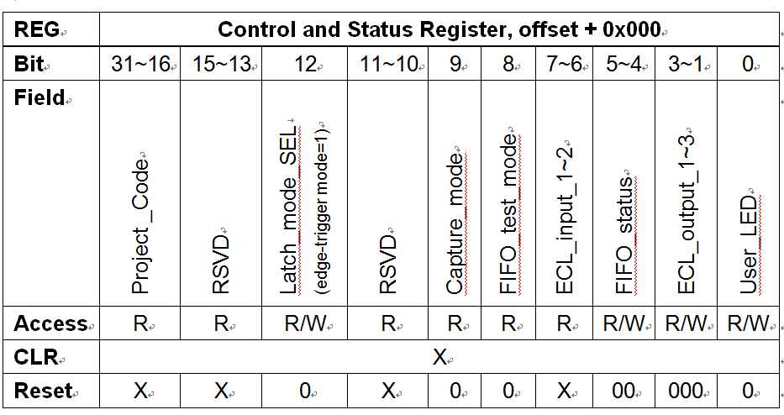
Write ‘X’→ Offset + 0x00C. Set up the user-defined delay range and combination of OR-windows in CSR2.
Write ‘X’→ Offset + 0x028. Trigger enabled. LED Red_L should be on. Write ‘X’→ Offset + 0x02C. Trigger disabled.
Write ‘X’→ Offset + 0x000. Set proper FIFO status mode.
Read ← Offset + 0x008. Access information of number of events in FIFO.
Read ← Offset + 0x100. Read Data. Data access 或 Block transfer (BLT).

Slide 16
Now, How Do We Know There is a Tigger Coming?
An interrupting module asserts one of the interrupt request lines.
The interrupter responds by transferring a status/ID on the data bus to describe the interrupt.
The interrupt handling module (usually a CPU) will usually use this status/ID number to identify and run the appropriate software interrupt service routine.
Latch Card
Interrupting Module
CPU
VME Crate
Notes:
VME also decodes all seven of the 68000's interrupt levels onto a 7-pin interrupt bus. The interrupt scheme is one of prioritized vectored interrupts. The interrupt request lines (IRQ1 - IRQ7) prioritize interrupts. An interrupting module asserts one of the interrupt request lines. Any module on the bus may potentially handle any interrupt. When an interrupt handling module recognizes an interrupt request at a priority it handles, it arbitrates for the bus in the usual fashion described above. It then performs a read of the interrupt vector by driving the binary version of the IRQ line it handles (e.g. if IRQ5 is being handled, then binary 101) onto the address bus. It also asserts the IACK line, along with the appropriate data transfer strobes for the width of the status/ID being read. Again, LWORD*, DS0* and DS1* allow status/ID read cycles to be 8, 16, or 32 bit wide transfers but most existing hardware interrupters use 8 bit status/IDs. The interrupter responds by transferring a status/ID on the data bus to describe the interrupt. The interrupt handling module (usually a CPU) will usually use this status/ID number to identify and run the appropriate software interrupt service routine.

Slide 17
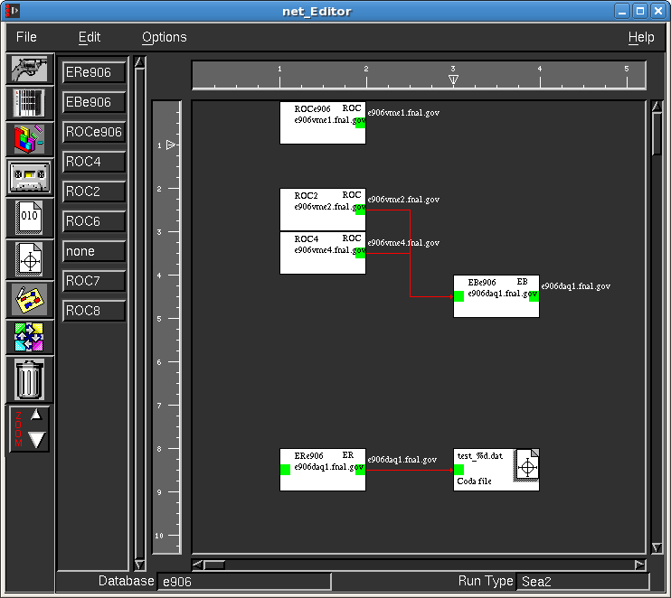
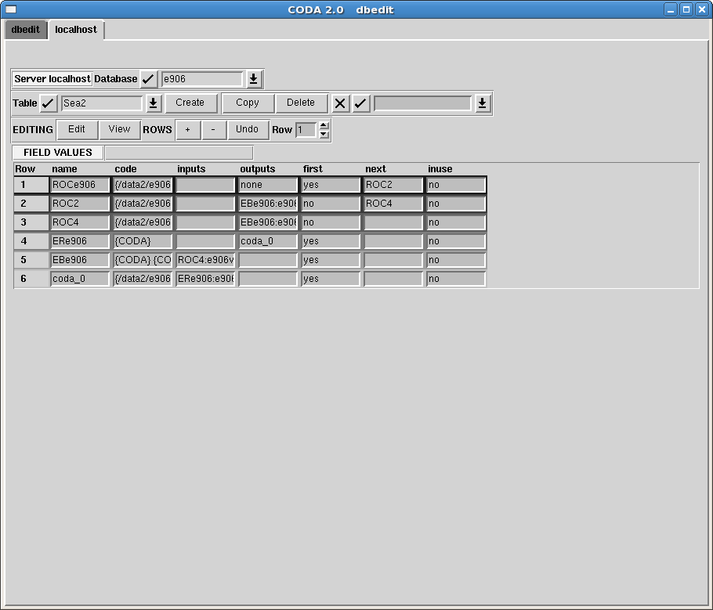
Edit the Control Diagram

Slide 18
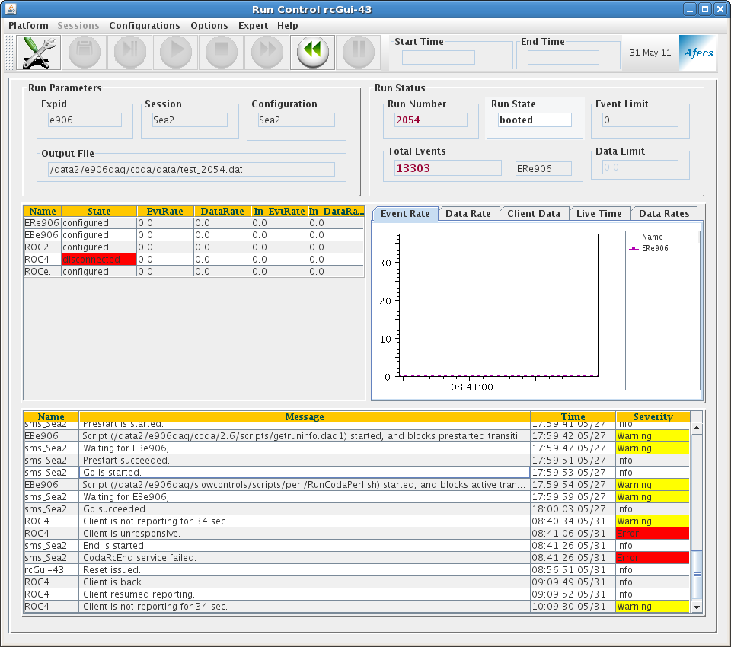
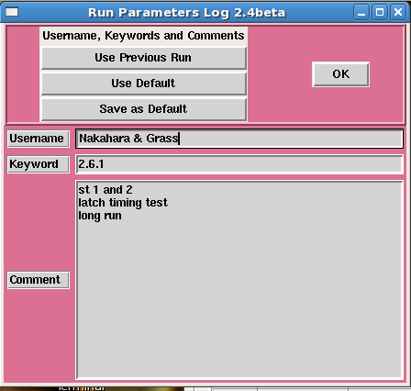




User Friendly Interface- CODA

Slide 19
CONTROL
Detector
(Hodoscopes,
MWPC,
Prop-tube)
particle
data
computer 3
VME crate
CPU
Trigger system
computer 2
Recorder system
Offline analyzer
Latch
TDC
Latch
TDC
Online
analyzer
Latch
TDC
Slow Control
PAW
or
ROOT
Buffer
computer 1
CODA
ROOT
Collector
Offline Analyzer
Online
Analyzer
deCODA
Hard disk
TCP/IP
TPC/IP
MySQL

Slide 20


Slide 22
The bus is controlled by a set of nine lines, known as the arbitration bus. All communications are controlled by the card in slot one of the Eurocard chassis, known as the arbiter module. Two arbitration modes are supported - Round Robin and Prioritized.
Regardless of the arbitration mode, a card can attempt to become the bus master by holding one of the four Bus Request lines low. With round robin arbitration, the arbiter cycles amongst Bus Request lines BR0-BR3 to determine which of the potentially-simultaneous requesters will be granted the bus. With priority arbitration, BR0-BR3 use a fixed priority scheme (BR0 lowest, up to BR3 highest) and the arbiter will grant the bus to the highest priority requestor.
When the arbiter has determined which of the bus requests to grant, it asserts the corresponding Bus Grant line (BG0 - BG3) for the level that won bus mastership. If two masters simultaneously request the bus using the same BR line, a bus grant daisy-chain effectively breaks the tie by granting the bus to the module closest to the arbiter. The master granted the bus will then indicate that the bus is in use by asserting Bus Busy (BBSY*).
At this point, the master has gained access to the bus. To write data, the card drives an address, an address modifier and data onto the bus. It then drives the address strobe line and the two data strobe lines low, to indicate the data is ready, and drives the write pin to indicate the transfer direction. There are two data strobes and an *LWORD line, so the cards can indicate if the data width is 8, 16, or 32 bits (or 64 in VME64). The card at the bus address reads the data and pulls the data transfer acknowledge low line when the transfer can complete. If the transfer cannot complete, it can pull the bus error line low. Reading data is essentially the same but the controlling card drives the address bus, leaves the data bus tri-stated and drives the read pin. The slave card drives read data onto the data bus and drives the data strobe pins low when the data is ready. The signalling scheme is asynchronous, meaning that the transfer is not tied to the timing of a bus clock pin (unlike synchronous buses such as PCI).

Slide 23
