Slide 1
Spin distribution studies of incomplete fusion reactions in ¹⁶O + ¹²⁴Sn system

Slide 2
Plan of Presentation
Introduction: CF and ICF…
Experimental Details….
Measurements…
Results and Discussions…
Conclusions…

Slide 3
Britt and Quinton first reported the observation of energetic light particles in heavy ion induced reactions at energies about 8 to 10 MeV/nucleon. They pointed out the break-up of projectiles like ¹²C, ¹⁴N and ¹⁶O in an interaction with the surface of target nucleus.
In Heavy Ion Induced Reaction (HI), Complete and Incomplete Fusion are the dominant modes of the reaction at energy above the Coulomb barrier.
The most distinct feature of ICF reaction is that relatively high angular momentum states may be populated which is not accessible in complete fusion process.

Slide 4
Complete Fusion (CF)….
Input angular momentum: 0 <  ≤ _{crit}
¹³⁶Ba
α
p
¹⁶O
¹²⁴Sn
¹⁴⁰Ce
¹³⁹La
n
¹³⁹Ce
At smaller values of impact parameter incident projectile completely fuses with the target nucleus to form an excited compound nucleus. In this process, entire linear and angular momentum of the projectile is transferred to the composite nucleus and highly excited nuclear system decays by evaporating low energy nucleons and α-particles at equilibrium stage.

Slide 5
Incomplete Fusion (ICF) ….
¹³²Xe
Input angular momentum: _{crit} < ≤ _{max}
α
¹⁶O
p
¹²C
¹²⁴Sn
¹³⁶Ba
¹³⁵Cs
α
n
¹³⁵Ba
α
At relatively large value of impact parameter, only a part of the projectile fuses with the target nucleus and remaining part of HI moves in the beam direction with almost same velocity as that of incident ion beam. Hence, incomplete momentum transfer takes place.

Slide 6
Objective of the work
Measurement of ‘relative level yields’ from the intensities of gamma transitions in the rotational levels for the system ¹⁶O + ¹²⁴Sn at 100 MeV energy, using particle-gamma coincidence technique.

Slide 7
Why study the projectile target system ¹⁶O + ¹²⁴Sn :
The projectile-target system ¹⁶O + ¹²⁴Sn was chosen for the following main reasons:
It covers the most of the mass region of the periodic table, thereby giving a better idea of CF and ICF in various mass regions.
The radionuclides produced in these reactions, in general, have convenient half- lives and sufficient γ-intensity required for the measurement, using activation technique.

Slide 8
No experimental data are available in literature for the above projectile-target systems in the energy region of 4-8 MeV/nucleon, hence new experimental data have been extracted.

Slide 9
Techniques Used
  ON-Line Measurements:
  Particle-gamma coincidence measurements.
System studied and measured quantities
System studied | Measurements | Energy range | Coulomb barrier
¹⁶O+¹²⁴Sn → ¹⁴⁰Ce* | Relative level yield | ≈100 MeV | ≈ 53 MeV

Slide 10
ON-LINE MEASUREMENTS
In the present work, spin distribution of ER’s have been measured for ¹⁶O+¹²⁴Sn system at projectile energy 100 MeV and ICF dynamics have been studied.
Experimental Details
The experiment has been performed using Gamma Detector Array (GDA) along with Charged Particle Detector Array (CPDA) set-up at Inter-University Accelerator Centre (IUAC), New Delhi, India.
Self-supporting Target: ¹²⁴Sn (enrichment ≈ 97.2%)
Prepared by Rolling Machine
Thickness: 2mg/cm²
Projectile: ¹⁶O⁺⁷ at 100MeV
Beam Current: ≈3pnA

Slide 11
Gamma Detector Array (GDA)
GDA consists of 12 Compton suppressed HPGe detectors at angles 45⁰, 99⁰, 153⁰ with respect to the beam direction and there are 4 detectors at each of these angles
The full view of the GDA set-up at IUAC, New Delhi

Slide 12
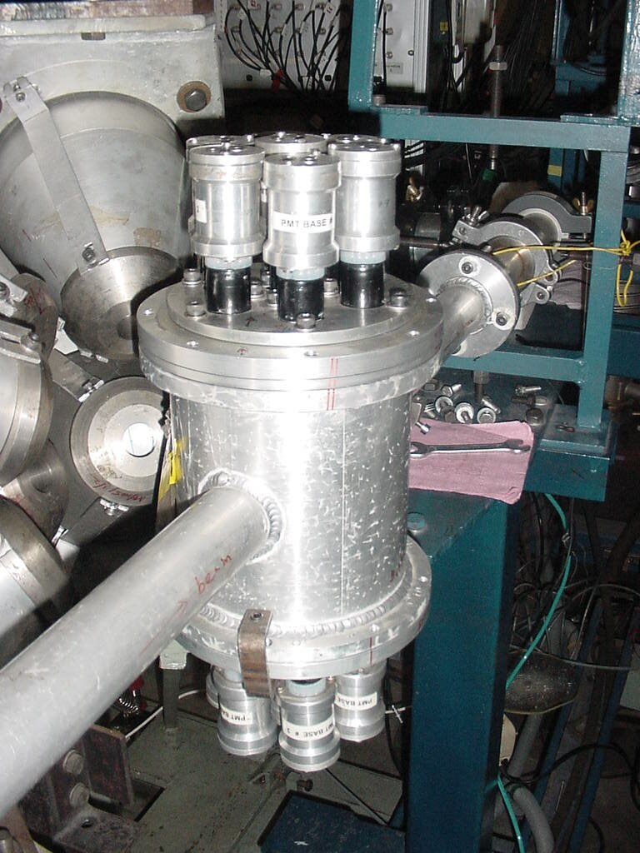
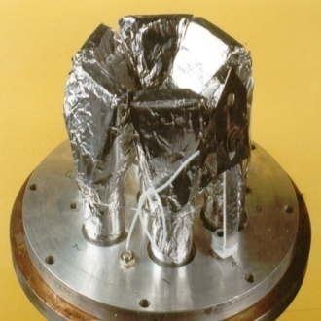
Charged Particle Detector Array (CPDA)
The CPDA is a group of 14 Phoswich detectors.
14 Phoswich detectors of CPDA have divided in three zones
♣Four detectors in the forward cone (10-60⁰)
♣Four detectors in backward cone (120-170⁰)
♣ Six detectors at 90⁰
The full view of the CPDA set-up at IUAC, New Delhi

Slide 13
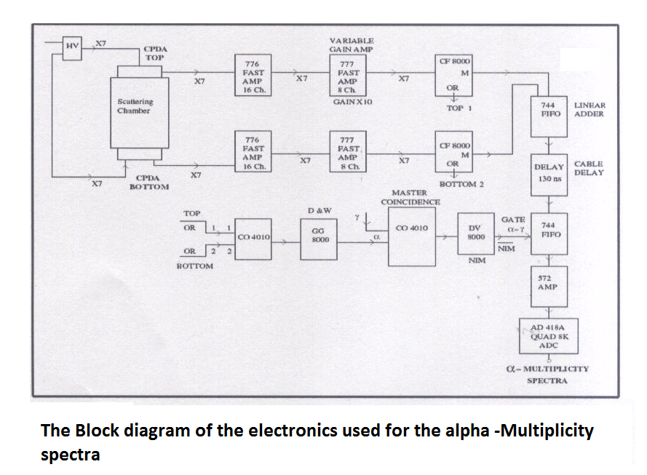

Slide 14
Gamma Detector Array (GDA) + Charged Particle Detector Array (CPDA)
T: Target Position
S: Phoswitch Plastic Scintillator
N: NaI (Tl) detector
G: Germanium Crystal
B: BGO Compton Shield
P: Photo-multiplier Tube
LN: Liquid Nitrogen Dewar
.

Slide 15
Data Analysis
Data Analysis have been carried
by using six gating conditions.
♠ Data have been analyzed by INGASORT, CANDLE and RADWARE-Softwares.
♠Residues have been indentified by their prompt gamma-rays.
♠ Area under the photo peaks of the gamma rays of interest and corresponding efficiencies have been noted and finally relative yields have been found.
♠ Relative yield have been plotted against spin.
Six Gating condition
CPDA-AF
CPDA-PF
Forward direction
CPDA-A90⁰
CPDA-P90⁰
Sideways (90⁰)
Backward direction
CPDA-AB
CPDA-PB

Slide 16
Fig. Gamma ray energy spectra observed from the ¹⁶O+ ¹²⁴Sn system at 100 MeV (a) A singles spectrum used for neutron channel identification, photo-peaks corresponding to some characteristic γ-transitions in ¹³⁴Ce are indicated, (b) Gamma-ray energy spectrum in coincidence with “compound” α−particle emitted in the backward direction, (c) Gamma-ray energy spectrum in coincidence with “fast” α−particle emitted in the forward direction. In the spectra (b) and (c) photo-peaks corresponding to some characteristic γ-transitions in ¹³³Ba and ¹³²Ba are indicated.

Slide 17
Fig. Gamma ray energy spectra observed from the ¹⁶O+ ¹²⁴Sn System at 100 MeV (a) in coincidence with α−particle (P-gated) emitted in the backward direction, (b) in coincidence with “fast” α−particle (P-gated) emitted in the forward direction. In the spectra (a) and (b) photo-peaks corresponding to some characteristic γ-transitions in ¹³¹Cs are indicated.

Slide 18
3.3 Measurement of Relative Level Yields for ¹⁶O+¹²⁴Sn system

Slide 19
Table : Measured relative yield of γ-transitions for evaporation
residues ¹³³Ba, ¹³²Ba and ¹³¹Ba in coincidence with α-particles in
forward direction (α-Forward) spectra.

Slide 20
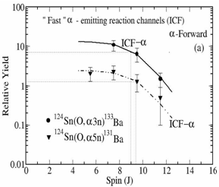
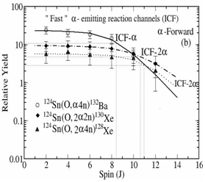
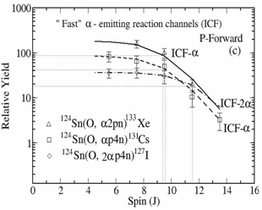
Results and Discussion
ICF ………..
The ICF reaction channels identified by the γ-ray in coincidence with forward cone ‘fast’ α-particles are:
¹²⁴Sn(O, α3n)¹³³Ba, ¹²⁴Sn(O, α4n)¹³²Ba, ¹²⁴Sn(O, α5n)¹³¹Ba, ¹²⁴Sn(O, αp4n)¹³¹Cs, ¹²⁴Sn(O, α2pn)¹³³Xe, ¹²⁴Sn(O, 2α2n)¹³⁰Xe, ¹²⁴Sn(O, 2α4n)¹²⁸Xe & ¹²⁴Sn(O, 2αp4n)¹²⁷I.
♠ Relative yield of evaporation residues produced via ICF is constant up to certain value of spin and decreases exponentially with high spin states indicating the presence of strong side feeding in the higher member of the yrast line transition like CF.

Slide 21
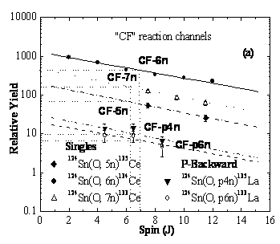
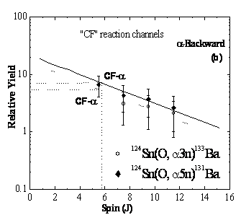
CF ………..
♣The CF reaction channels identified in backward direction are:
¹²⁴Sn(O, p4n)¹³⁵La, ¹²⁴Sn(O, p6n)¹³³La ¹²⁴Sn(O, α3n)¹³³Ba, ¹²⁴Sn(O, α4n)¹³²Ba, ¹²⁴Sn(O, α5n)¹³¹Ba, ¹²⁴Sn(O, 2α2n)¹³⁰Xe, ¹²⁴Sn(O, αp4n)¹³¹Cs, ¹²⁴Sn(O, 2αp4n)¹²⁷I.
♣In addition to these, three CF neutron channels have also been identified from the singles spectrum and are confirmed from their gamma decay lines.
¹²⁴Sn(O, 7n)¹³³Ce, ¹²⁴Sn(O, 6n)¹³⁴Ce
& ¹²⁴Sn(O, 5n)¹³⁵Ce
♣Relative yield of evaporation residues produced via CF, decreases exponentially with high spin states indicating the strong side feeding in the lower member of the yrast line transition.

Slide 22
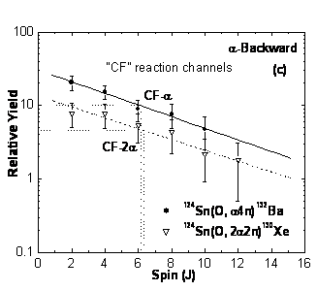
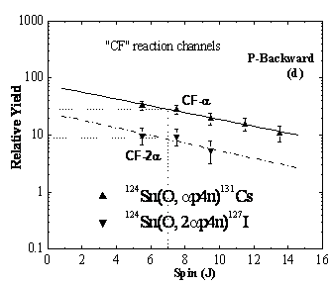
CF ………..
Prompt γ-rays recorded in coincidence with particles in backward direction also show a similar spin distribution with a sharp exponential fall with high spin indication of strong side feeding.

Slide 23
The spin at half yield for these CF channels is found to be around J=7ħ, while the spin at half yield for “direct” α and 2α-emitting channels (associated with ICF) comes out to be around J= 9ħ and J=12ħ respectively. This clearly shows that the production of “fast” forward PLFs are at high input angular momentum and hence leads to peripheral interaction.

Slide 24

Spin distribution of residues produced in xn, pxn, αxn, αpxn, α2pxn, 2αxn, and 2αpxn emission channels have been measured at 100 MeV energy for the system ¹⁶O+¹²⁴Sn.
It is observed that spin distribution of ICF-channel is distinctly different from that of CF-channel.
Side feeding to the lower spin states is found to be strong in case of CF channels as compared to ICF channels.
The study shows that in ICF the yields are almost constant up to a maximum angular momentum and then falls unlike in CF where the yield falls exponentially with spin.
It is also observed that the average input angular momentum increases with decrease in the degrees of linear momentum transfer from projectile- to- target nucleus.
The present measurements may also be of use in developing a model for ICF dynamics.
SUMMARY AND CONCLUSIONS
Particle-Gamma Coincidence…………….

Slide 25
CF of ²⁰Ne
CF
²⁰Ne+¹⁶⁵Ho
¹⁸⁵Ir* (Completely fused Compound system)
2αn
¹⁷⁶Ta
(residue)
ICF of ²⁰Ne (Fusion of fragment ¹⁶O of ²⁰Ne)
ICF
²⁰Ne(¹⁶O + ⁴He) + ¹⁶⁵Ho
⁴He + ¹⁸¹Re*
(Incompletely fused Composite system)
(α as spectator)
αn
¹⁷⁶Ta
(residue)
ICF of ²⁰Ne (Fusion of fragment ¹²C of ²⁰Ne)
ICF
²⁰Ne(¹²C + ⁸Be) + ¹⁶⁵Ho
⁸Be + ¹⁷⁷Ta*
(Incompletely fused Composite system)
n
(⁸Be as spectator)
¹⁷⁶Ta
(residue)

