Slide 1


A brief Introduction to sonoluminescence and what we are doing now
Fong-Kai Lin (林楓凱)

Slide 2
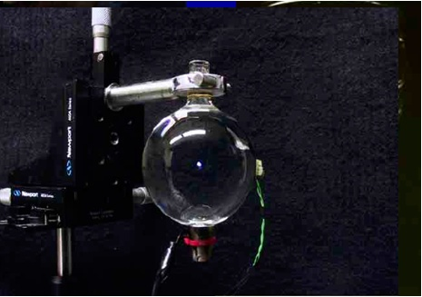
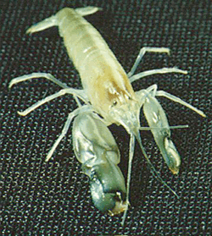
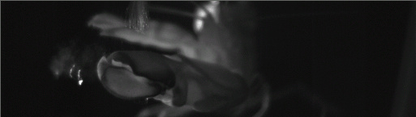
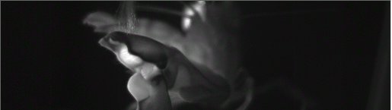
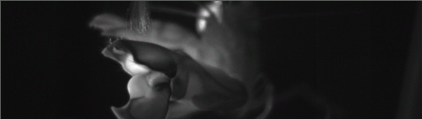
Introduction
Single-Bubble Sonoluminescence (SL) is a phenomenon occurs when an acoustically trapped and periodically driven gas bubble collapse so strongly that the energy focusing at collapse leads to light emission.
The blackbody assumption has been proved (vol26,No.9,Optical Letter). Base on this property , we build a method to measure temperature and radii of this bubble event by event.
SL in nature : snapping shrimp

Slide 3
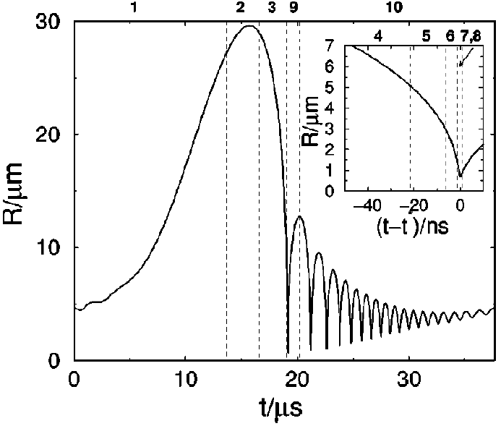
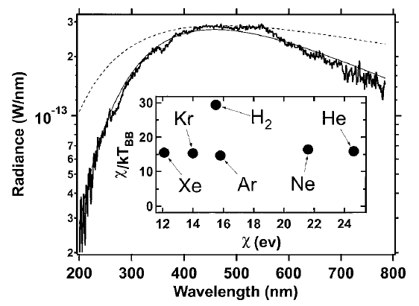
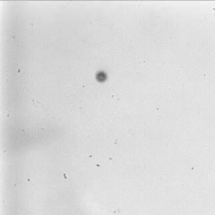
Sonoluminescence:
Nature’s smallest Blackbody
1. The upper figure shows one oscillation cycle of R(t).
-> Expansion
-> Collapse
-> Light Emission
-> Afterbounces
2. The solid curve fit to a blackbody at 6230K.
Light Emits
<- Simulation of bubble motion

Slide 4
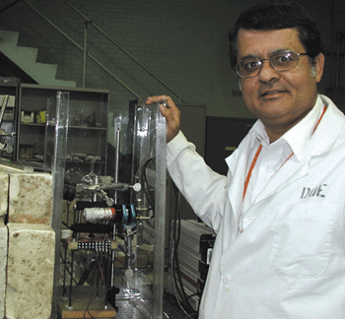
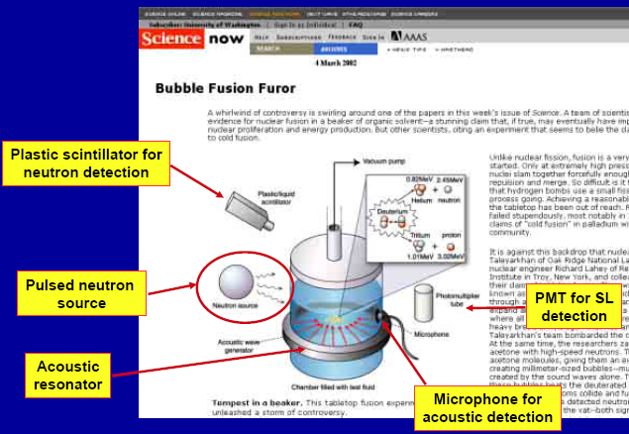
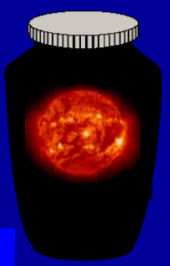
Bubble Fusion Furor
Taleyarkhan

Slide 5
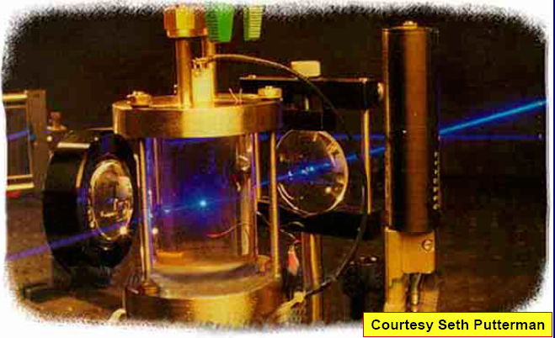
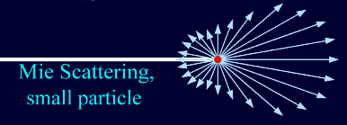
Mie scattering measurement of bubble radius

Slide 6
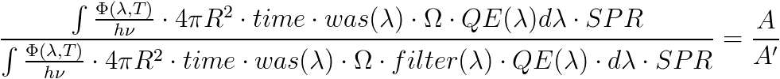
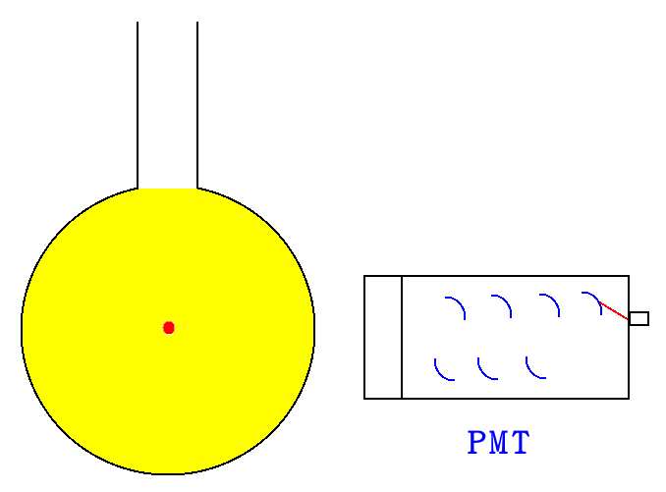
Experiment Design(1)
Blackbody Formula
“time” : time interval of light emission, an uncertain number. (typically, ).
is water absorption spectrum, a well-known term.
e

Slide 7
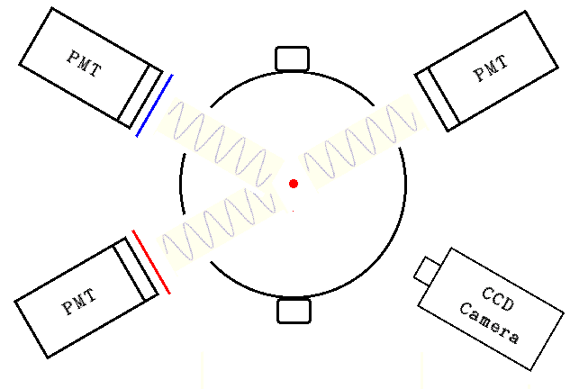
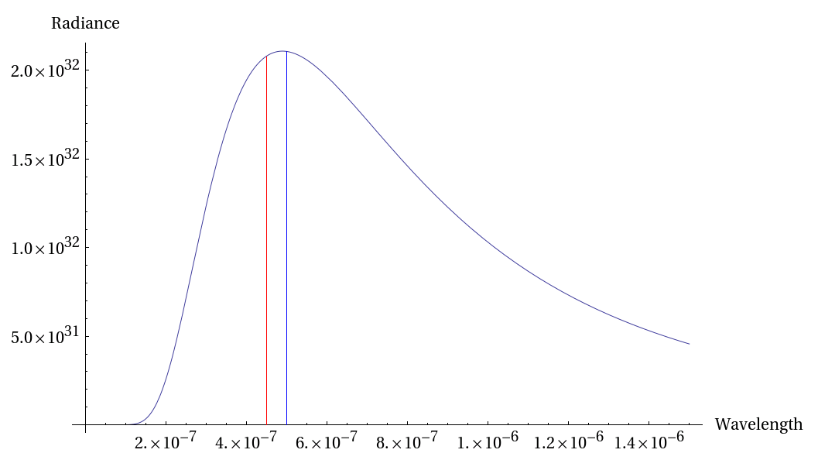
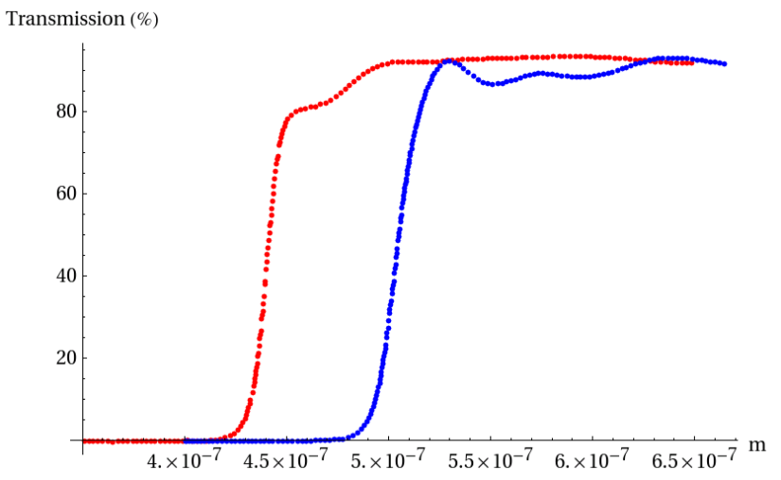
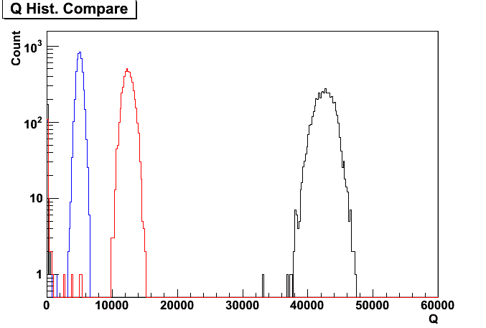
Experiment Design (3)
Instrument Setup
By adding filters of different transmission rate , these three PMTs will have distinct spectrum response.
Transmission Curve of 450 and 500 nm band-pass filter

Slide 8
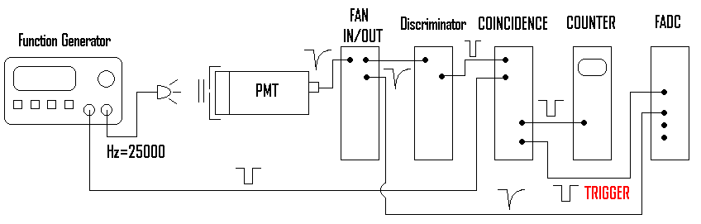
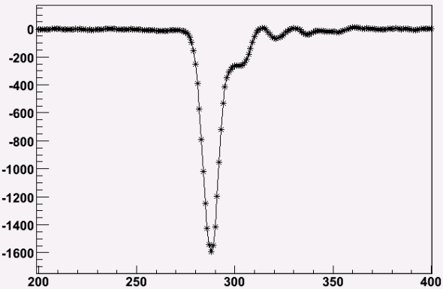
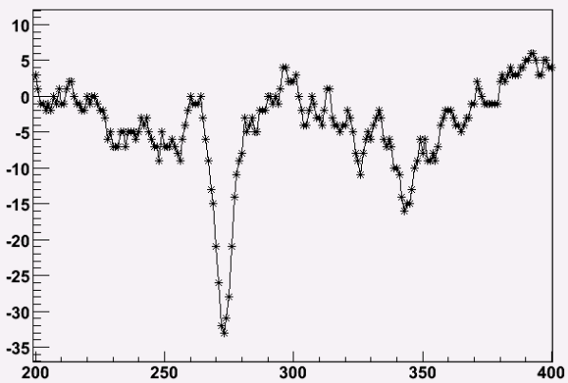
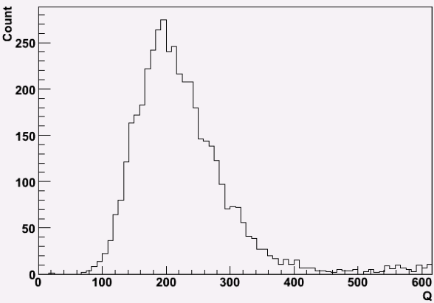
Experiment Design (2)
Single Photon Response

Slide 9
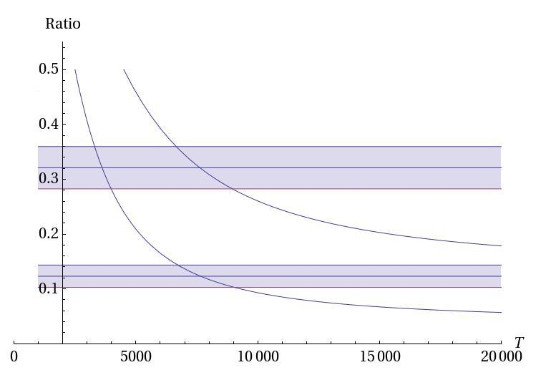
Analysis Result -- Temperature
We intersect two T results for consistence.
This temperature doesn’t be affected by light intensity of bubble. (!!)

Slide 10
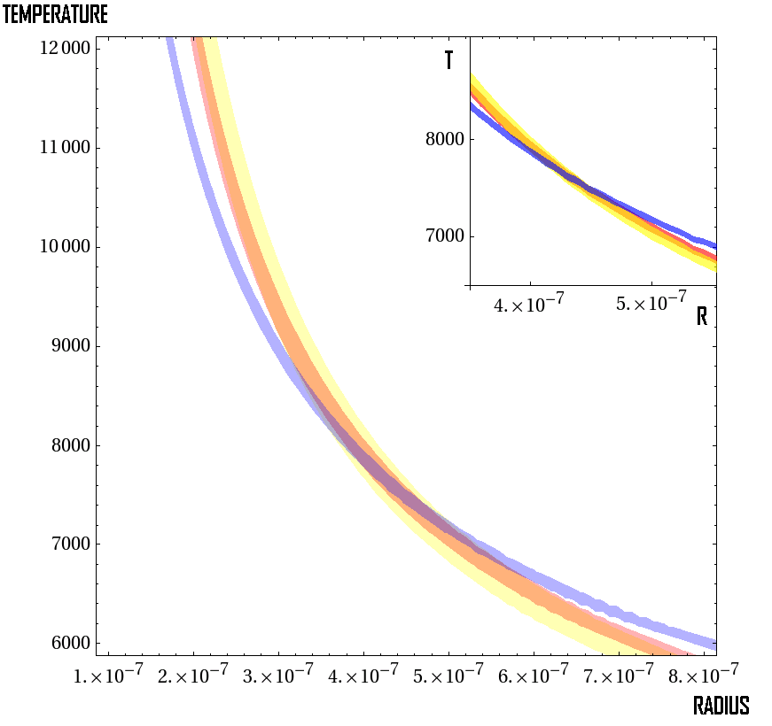
Analysis Result -- Radius
The intersection region provides reliable value of radius , and double-check validity of temperature.
Allow Region of Temperature and Radius

Slide 11
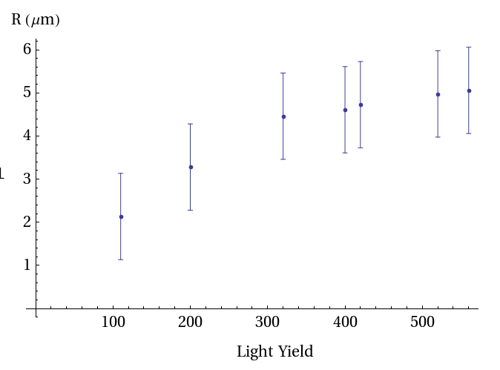
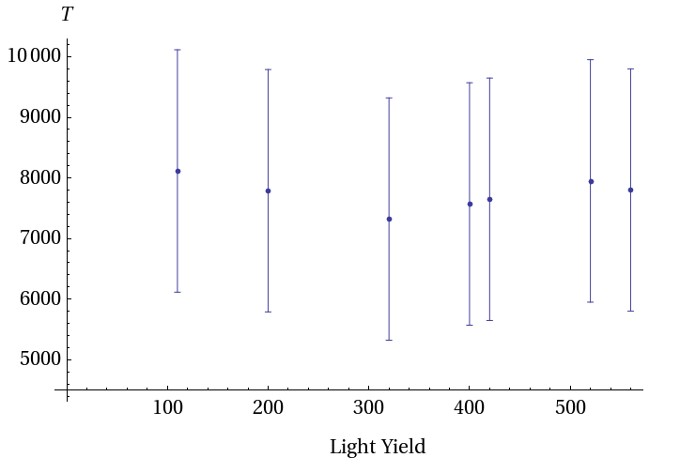
Analysis Result –
Light Yield, Radius and Temperature
From blackbody’s point of view, there’re three effects can make bubble brighter:
1. higher temperature ?
2. bigger size ?
3. or both ?
The two plots shown here answer this question clearly : The brighter the bubble,
the bigger the size.

Slide 12
Conclusion
This research shows that the bubble becomes lighter by expand its volume, not by increases its temperature.
This new approach measures the most important two parameters of sonoluminescence directly and individually and the result is comparable with previous work.
In other liquid(acid , base and noble gas dopped), bubble has quiet different behaviors than in water. There must be some interesting phenomenon.

