Slide 1
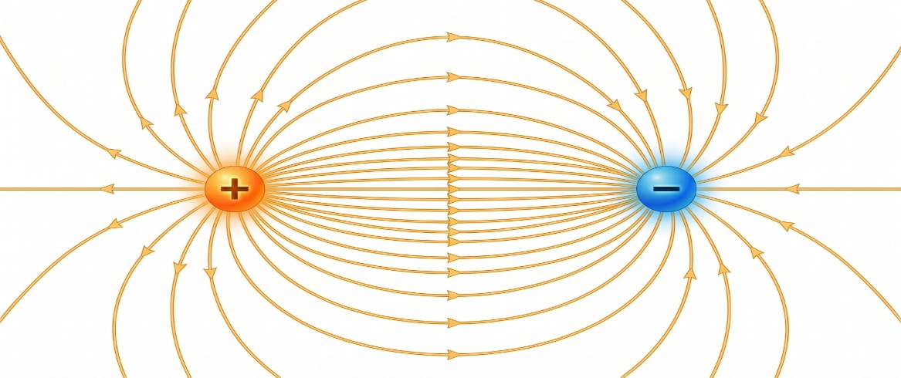




Quantum Anomaly in a Topological Weyl Ferromagnet
Fermionic zero modes emerge at all length scales in various physical systems, such as the electroweak Z-string, ³He vortices, and cosmic strings, unveiling the secrets of quantum fluctuations in the vacuum and quantum anomalies associated with non-conserved particles, charges, and chiralities. Such zero modes manifest as the unique n = 0 Landau level in a topological Weyl ferromagnet, giving rise to non-conserved chiral charges and a consequently enhanced conductivity under parallel electric and magnetic fields – a phenomenon referred to as the chiral anomaly.
In a collaborative study led by Dr. Wei-Li Lee’s group at IoPAS and Prof. Guang-Yu Guo’s group at NTU, the chiral anomaly and its angular dependence were rigorously examined in a patterned device fabricated from thin films of the ferromagnetic topological Weyl metal SrRuO₃ (SRO). The thin films were grown using a cutting-edge oxide molecular beam epitaxy technique and exhibited exceptionally low residual resistivity at low temperatures, enabling the observation of unusual angular magnetoconductivity and Hall behaviors under various applied electric- and magnetic-field orientations. These results not only provide strong evidence for the dominance of the chiral anomaly effect but also demonstrate intriguing magnetic-field-tunable Weyl nodes in ferromagnetic Weyl SRO thin films. The complete data and analysis have been published in npj Quantum Materials (https://www.nature.com/articles/s41535-026-00882-8 ).
Topological Weyl ferromagnet
$$ε(\overset{⃑}{k})$$
2
1
n = 0
$\overset{⃑}{E}∥$ $\overset{⃑}{B}$
$$\overset{⃑}{k}$$
$$α$$
Fermionic
zero modes

Slide 2
拓撲Weyl磁鐵
拓撲Weyl磁鐵中的量子異常現象
費米子零能態（Fermionic zero modes）出現於各種不同物理系統與尺度中，例如弱電場 Z 弦（electroweak Z-string）、氦-3渦旋（³He vortices）以及宇宙弦（cosmic strings），從而揭示了真空量子漲落（quantum fluctuations）以及與不守恆粒子、電荷及螺旋性（chirality）相關的量子異常（quantum anomalies）的奧秘。此類零能態在拓撲Weyl鐵磁中表現為獨特的 n = 0 朗道能階（Landau level），而產生不守恆的螺旋性電荷，進而導致在平行電場與磁場條件下特殊的電導率增強效應—此現象被稱為螺旋性異常（chiral anomaly）。
在一項由中研院物理所李偉立博士研究團隊與國立臺灣大學物理系郭光宇教授研究團隊合作的研究中，在由鐵磁拓撲Weyl金屬 SrRuO₃（SRO）薄膜製成的電子元件中，嚴格檢驗了螺旋性異常及其角度依賴性。 該薄膜運用尖端的氧化物分子束磊晶 (oxide molecular beam epitaxy) 技術生長，並在低溫下表現出極低的殘餘電阻率，使得在各種施加的電場和磁場方向下，能夠從實驗發現磁電導率和霍爾效應中極不尋常的角度依賴性行為。這些發現不僅為螺旋性異常效應的主導地位提供了強有力的證據，更揭露其獨特磁場可調控之Weyl節點（Weyl nodes）的特性。完整的數據和分析已發表於《npj Quantum Materials》期刊。
https://www.nature.com/articles/s41535-026-00882-8
$$ε(\overset{⃑}{k})$$
2
1
n = 0
$\overset{⃑}{E}∥$ $\overset{⃑}{B}$
$$\overset{⃑}{k}$$
$$α$$
費米子零能態

Slide 3
