Slide 1
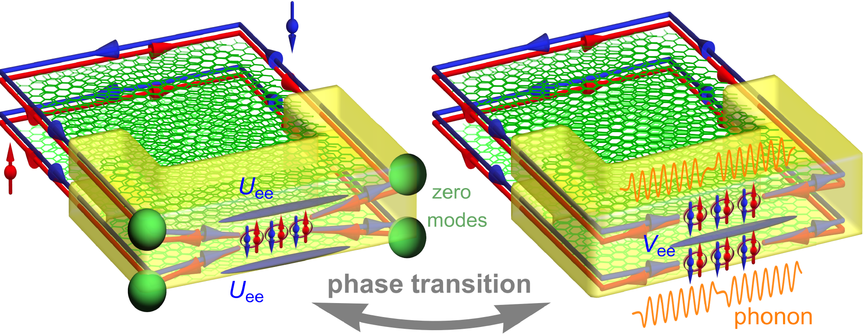
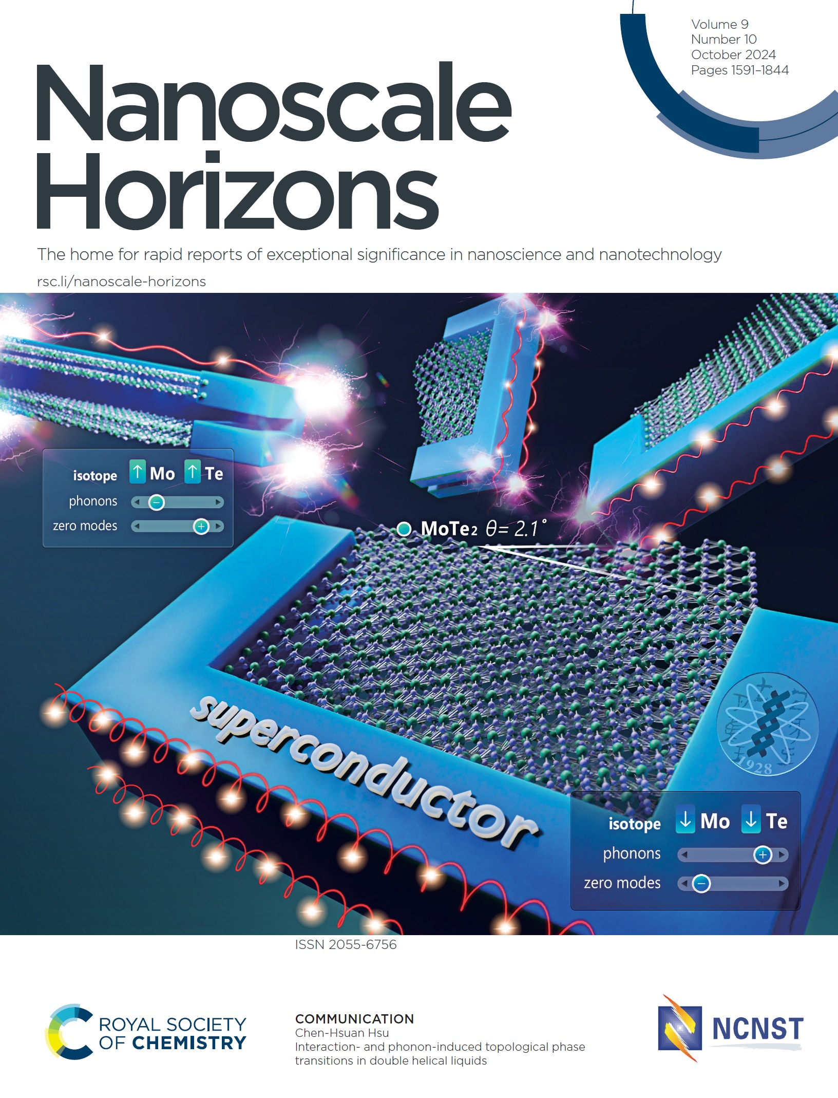
Unveiling New Topological Phase Transitions in Helical Liquids
Helical liquids in topological materials provide a basis for topological zero modes crucial for topological quantum computing. Dr. Chen-Hsuan Hsu from the Institute of Physics has demonstrated via nonperturbative analysis that Coulomb interactions among electrons and electron-phonon coupling can induce new phase transitions between topological and trivial phases, reaching different conclusions from those of earlier perturbative studies. Considering the omnipresence of electron-electron interactions and phonons, these discoveries not only pave the way for electrically tunable topological transitions but also underscore the significant challenges in creating stable devices for topological quantum computing.
This research has been published in Nanoscale Horiz. 9, 1725 (2024) and was featured on the front cover in the latest issue of the journal.

Slide 2
揭示螺旋液體中的新拓撲相變
在拓樸材料中存在的螺旋液體可供實現拓樸零模態的平台，並提供將來實現拓樸量子計算的基礎。物理所徐晨軒博士通過非微擾分析證明，電子之間的庫侖相互作用和電子-聲子耦合可以引發拓樸與非拓樸相間的新相變，得出與先前微擾研究不同的結論。考慮到電子間交互作用和聲子在自然界中的普遍存在，這些發現不僅揭示電性調控拓樸相變的可能性，也突顯使用此類系統在實現拓樸量子計算上可能面臨的挑戰。
此研究已發表於《Nanoscale Horizons》期刊，並且被選為該期刊最新一期的封面前頁。

