Slide 1
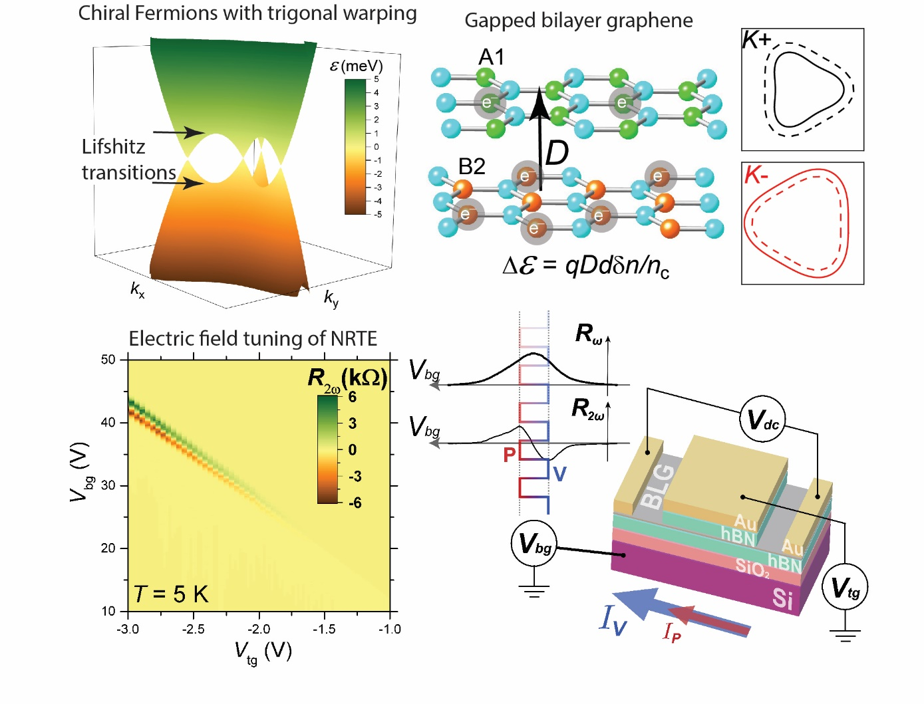
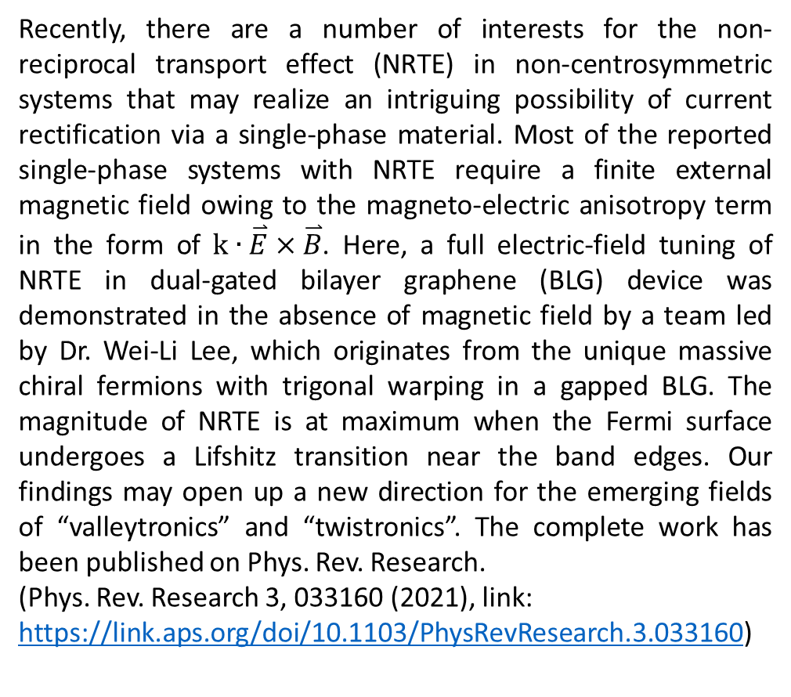
Full electric field tuning of the nonreciprocal and nonlinear charge transport in massive chiral Fermions with trigonal warping
Recently, there are a number of interests for the non-reciprocal transport effect (NRTE) in non-centrosymmetric systems that may realize an intriguing possibility of current rectification via a single-phase material. Most of the reported single-phase systems with NRTE require a finite external magnetic field owing to the magneto-electric anisotropy term in the form of $k∙\overset{⃑}{E}×\overset{⃑}{B}$. Here, a full electric-field tuning of NRTE in dual-gated bilayer graphene (BLG) device was demonstrated in the absence of magnetic field by a team led by Dr. Wei-Li Lee, which originates from the unique massive chiral fermions with trigonal warping in a gapped BLG. The magnitude of NRTE is at maximum when the Fermi surface undergoes a Lifshitz transition near the band edges. Our findings may open up a new direction for the emerging fields of “valleytronics” and “twistronics”. The complete work has been published on Phys. Rev. Research.
(Phys. Rev. Research 3, 033160 (2021), link: https://link.aps.org/doi/10.1103/PhysRevResearch.3.033160)

Slide 2
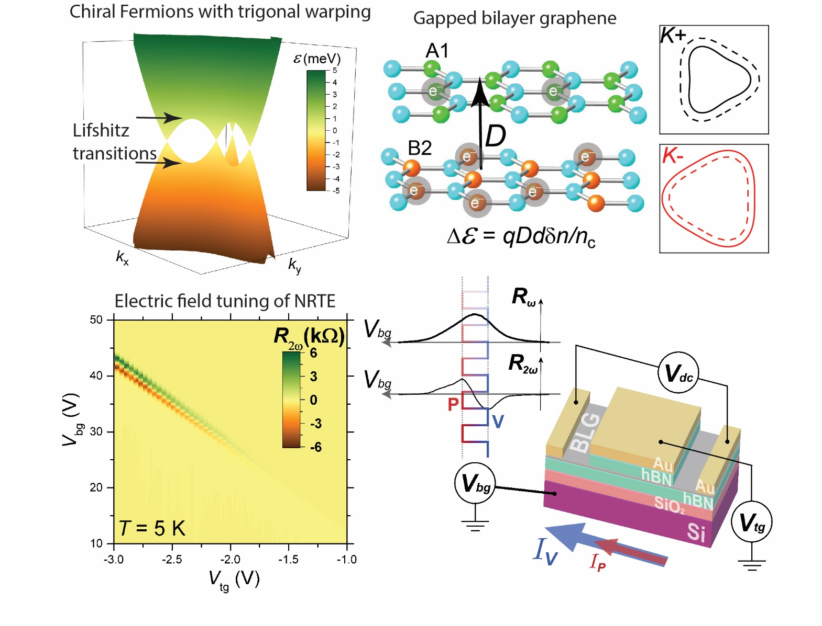
全電場調控非線性及不可逆的電荷輸運效應
近期固態物理領域一重要的議題為非中心對稱物質系統的非線性及不可逆的電荷輸運效應(NRTE)，進而產生獨特的單一物質相之整流效應。過去此效應相關的研究報導多數須仰賴外加磁場以達到NRTE，然而最近李偉立博士研究團隊在雙柵極雙原子層石墨烯(BLG)中，實驗驗證了於零磁場環境下的全電場調控NRTE，模擬計算顯示此現象與BLG螺旋性費米子能帶具有三方扭曲性有直接關聯。此發現對於新興電子元件領域如valleytronics與 twistronics提供了未來可能運用方向。完整的研究報告已刊登於Phy. Rev. Research.
(Phys. Rev. Research 3, 033160 (2021), link: https://link.aps.org/doi/10.1103/PhysRevResearch.3.033160)

