Slide 1
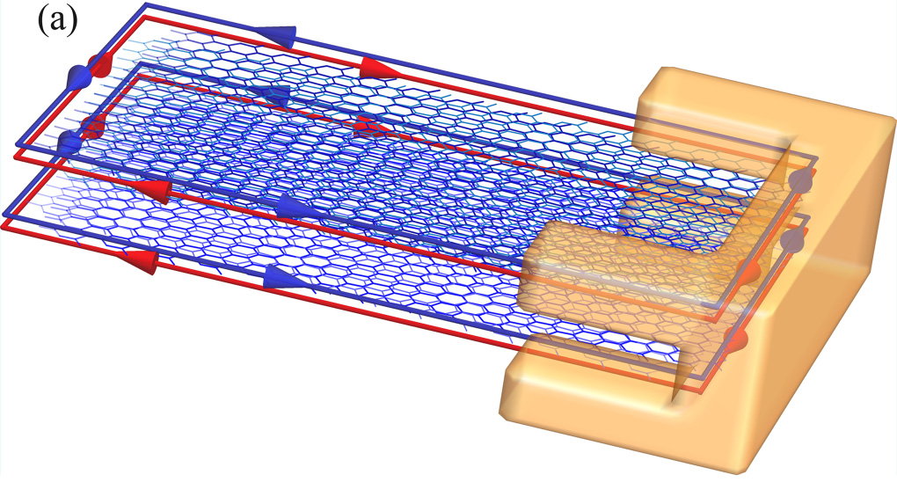
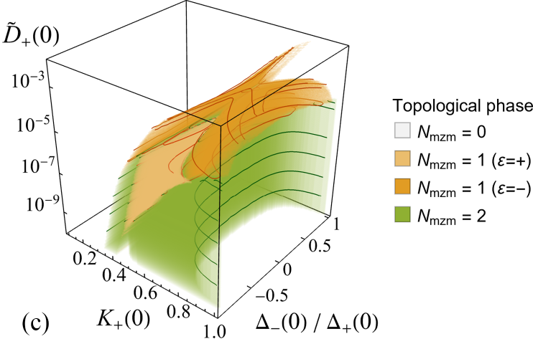
不完美中的拓樸超導：馬約拉納零能模的消失與再現
無序與不均勻性通常被視為實現拓樸超導的障礙。本所徐晨軒博士與大學生(當時) Anna Ohorodnyk 的理論研究指出，這些不完美也能促成新的拓樸相。團隊研究兩條與超導體接觸的平行螺旋邊緣通道，結合解析推導與重整化群分析，探討電子交互作用、通道間不對稱性與隨機自旋翻轉散射的影響。結果顯示，自旋翻轉散射可使兩個零能模的存在條件分離，產生每個角落僅有一個馬約拉納零能模的新相。當兩通道的配對或庫侖交互作用不對稱時，調整交互作用可引發一連串拓樸相變，使消失的零能模再度出現。特定條件下，無序甚至能使原本拓樸平凡的系統進入拓樸相。此研究指出透過電性屏蔽調控零能模的可能途徑，為在真實元件中實現拓樸超導提供理論依據。成果已發表於 Physical Review B。
拓樸絕緣體（藍）與超導體（橙）
期刊論文
Anna Ohorodnyk and Chen-Hsuan Hsu
Cascade of topological phase transitions and revival of topological zero modes in imperfect double helical liquids
三維拓樸相圖：每個角落可有 0、1 或 2 個零能模
Physical Review B 114, 235415 (2026) | DOI: 10.1103/5cgn-yll2
Notes:
Research highlight based exclusively on Anna Ohorodnyk and Chen-Hsuan Hsu, Physical Review B 114, 235415 (2026), DOI: 10.1103/5cgn-yll2. Scientific content: Abstract; Secs. V B, VI and VIII. Fig. 1(a) is cropped from the published setup schematic on article page 2. Fig. 8(c) and its shared legend are cropped from article page 10. No scientific content, axes, colors or data are modified. The findings are theoretical predictions, not an experimental demonstration. No ASGC acknowledgment is added because it is not stated in this paper.

Slide 2
Majorana Modes Can Disappear and Return
in Imperfect Superconducting Devices
Disorder and nonuniformity are usually viewed as obstacles to topological superconductivity. A theoretical study by Anna Ohorodnyk (then an undergraduate student) and Dr. Chen-Hsuan Hsu at the Institute of Physics, Academia Sinica, shows that these imperfections can also enable new topological phases. The team studied two parallel helical edge channels in contact with a superconductor, combining analytical calculations with renormalization-group analysis to examine electron interactions, channel asymmetries, and random spin-flip scattering. Spin-flip scattering separates the conditions for the two Majorana zero modes, allowing an additional phase with a single mode at each corner. When the channels have unequal pairing or interaction strengths, tuning electron interactions can drive a cascade of topological transitions in which a mode disappears and reappears. Under suitable conditions, disorder can also induce a topological phase in a system that is trivial in the clean limit. The results identify a possible route to electrical control through screening of electron interactions and provide guidance for realizing topological superconductivity in realistic devices. This work has been published in Physical Review B.
REFERENCE
Anna Ohorodnyk and Chen-Hsuan Hsu
Cascade of topological phase transitions and revival of topological zero modes in imperfect double helical liquids
Physical Review B 114, 235415 (2026) | DOI: 10.1103/5cgn-yll2
Notes:
English companion to the Traditional Chinese illustrated highlight on slide 1. Scientific content is based on the published article, especially Abstract; Secs. V B, VI and VIII. Publication metadata from article page 1. The wording distinguishes predictions from experimental results.

