Slide 1
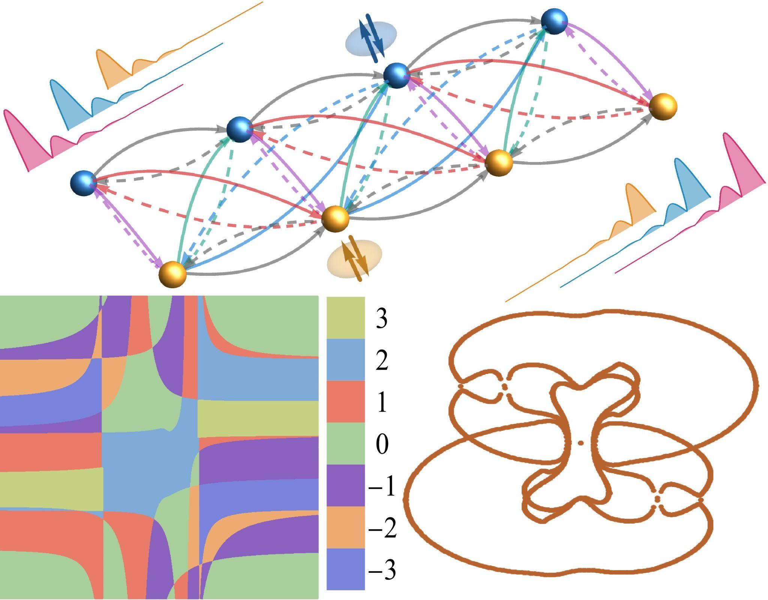
超越能譜計算：解析複雜非厄米拓撲相的新方法
在非厄米系統中，拓樸相變與能譜的繞圈數密切相關，因此通常透過能譜來判定拓樸性質。突破這類傳統方法的限制，本所徐晨軒博士研究團隊發展出一套高效率的解析方法，能夠在不計算能譜的情況下直接求得一維非厄米拓樸超導體的相邊界與拓樸不變量，為辨識高繞圈數拓樸相與馬約拉納零能模提供更有效率的途徑。研究團隊將此方法應用於數個模型。即使模型包含多達 10 個參數，仍可解析求得包含超過一萬項的相邊界表達式，顯示此方法在研究具有大量參數與複雜交互作用的非厄米量子系統上具有相當潛力。本研究與京都大學塩崎謙教授合作完成，研究成果已發表於J. Appl. Phys.，並獲期刊編輯選為精選論文( Featured Article) 。部分數值計算使用中央研究院網格計算中心( ASGC)所提供的計算資源完成。
期刊連結：
Yung-Yeh Chang, Xiang-Yu Li, Ken Shiozaki, and Chen-Hsuan Hsu, Higher-winding phases in one-dimensional non-Hermitian topological superconductors, J. Appl. Phys. 140, 064301 (2026); https://doi.org/10.1063/5.0344650.

Slide 2
A New Analytical Route to Higher-Winding Non-Hermitian Topological Phases
Topological phase transitions in non-Hermitian systems can be associated with spectral winding numbers and are often inferred from the energy spectrum. Beyond this conventional approach, Dr. Chen-Hsuan Hsu’s team at the Institute of Physics has developed an efficient method for analytically determining phase boundaries and for computing topological invariants in one-dimensional non-Hermitian topological systems. By avoiding direct calculation of the energy spectrum, the approach provides a practical route to identifying higher-winding topological superconducting phases and robust Majorana zero modes. The method was demonstrated in several tight-binding models, including a highly complex system with more than 10 parameters. Even for a case with 10 parameters, analytical phase-boundary expressions containing more than 10,000 terms can be obtained, illustrating the potential of this approach for studying complex non-Hermitian quantum systems. In collaboration with Prof. Ken Shiozaki at Kyoto University, this work has been published in J. Appl. Phys. and selected as a Featured Article by the editors. Some of the numerical calculations in this work were carried out using computational resources provided by the Academia Sinica Grid Computing Centre (ASGC).
Reference: Yung-Yeh Chang, Xiang-Yu Li, Ken Shiozaki, and Chen-Hsuan Hsu, Higher-winding phases in one-dimensional non-Hermitian topological superconductors, J. Appl. Phys. 140, 064301 (2026); https://doi.org/10.1063/5.0344650.

