Slide 1
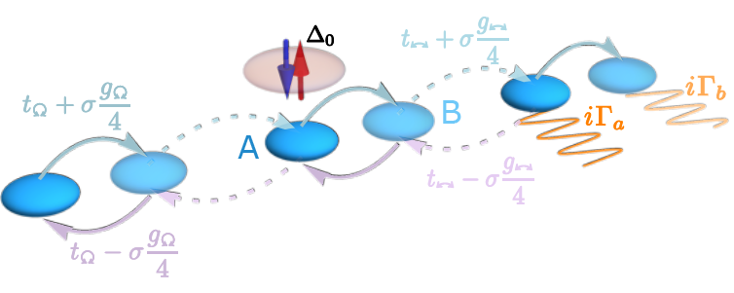
厄米性消失，馬約拉納現身：當對稱性與非厄米在拓樸超導體中相遇
近年的研究已知對稱性與拓樸能深刻改變電子系統性質，並催生多樣的量子態與物理現象。將這些概念延伸至非厄米體系後，本所徐晨軒博士的研究團隊建立了一個拓樸超導模型，完整納入非厄米系統中所有可能的內部對稱性，包括時間反轉、粒子-電洞、次晶格與手徵對稱，以及偽厄米性。該模型展現出由這些對稱性所引起的各種豐富能譜與波函數結構，包括複數扁平能帶與馬約拉納零模態，並呈現出相當豐富的相圖。本研究發表於 Physical Review Research，並與九州工業大學大熊信之教授及臺灣師範大學高賢忠教授合作完成，同時獲得中研院網格中心（ASGC）的計算資源支援。
Reference:
Chuo-Kai Chang, Kazuma Saito, Nobuyuki Okuma, Hsien-Chung Kao, and Chen-Hsuan Hsu,
Non-Hermitian topological superconductivity with symmetry-enriched spectral and eigenstate features
Physical Review Research 8, 013167 (2026),
https://doi.org/10.1103/v5k2-1vj9

Slide 2
Losing Hermiticity, Obtaining Majorana: When Symmetry Meets Non-Hermiticity in Topological Superconductivity
Symmetry and topology are known to reshape electronic systems and give rise to diverse quantum states and phenomena. Extending these concepts to the non-Hermitian regime, Dr. Chen-Hsuan Hsu’s team at the Institute of Physics has developed a topological superconducting model that incorporates all internal symmetries allowed in non-Hermitian systems, including time-reversal, particle–hole (and their daggered counterparts), sublattice and chiral symmetries, as well as pseudo-Hermiticity. The model exhibits rich spectral and eigenstate structures enabled by these symmetries, including complex flat bands and Majorana zero modes, together with a rich phase diagram. This work, published in Physical Review Research, was carried out in collaboration with Prof. Nobuyuki Okuma (Kyushu Institute of Technology) and Prof. Hsien-Chung Kao (National Taiwan Normal University), with support from the Academia Sinica Grid Centre (ASGC).
Reference:
Chuo-Kai Chang, Kazuma Saito, Nobuyuki Okuma, Hsien-Chung Kao, and Chen-Hsuan Hsu,
Non-Hermitian topological superconductivity with symmetry-enriched spectral and eigenstate features
Physical Review Research 8, 013167 (2026),
https://doi.org/10.1103/v5k2-1vj9

