Slide 1
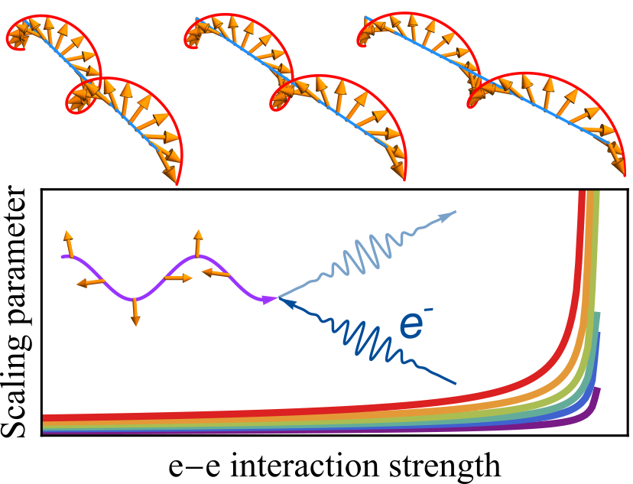
扭轉雙層石墨烯中的新穎磁性結構與磁振子誘發的奇異性
結合 Luttinger 液體物理與近藤效應，本所張永業博士後研究員、Kazuma Saito博士生與徐晨軒研究員，預測扭轉雙層石墨烯可形成準二維自旋螺旋態，並首次揭示磁振子誘發的奇異性。這種新穎量子態及其奇異性可藉由電場或扭轉角調控，並可透過磁共振與順磁磁化率加以檢測。此成果深化了我們對強關聯電子體系的理解，並為更廣泛的扭轉凡德瓦耳斯結構中類似的關聯現象提供了新的見解。相關研究成果已以 Letter 形式刊登於Physical Review Research。
Yung-Yeh Chang, Kazuma Saito, and Chen-Hsuan Hsu, Quasi-two-dimensional spin helix and magnon-induced singularity in twisted bilayer graphene, Phys. Rev. Research 7, L032066 (2025).
期刊連結：https://link.aps.org/doi/10.1103/h5sd-v51h

Slide 2
Novel magnetic ordering and the magnon-induced singularity in twisted bilayer graphene
By integrating the concepts of Luttinger liquid physics and Kondo physics, Dr. Yung-Yeh Chang, Mr. Kazuma Saito and Dr. Chen-Hsuan Hsu at the Institute of Physics predict the formation of a spatially coherent two-dimensional spin helix state and, for the first time, reveal a magnon-induced singularity in twisted bilayer graphene. This novel quantum phase and its singularity can be tuned by electric fields or twist angle, and can be detected through magnetic resonance and paramagnetic susceptibility measurements. The results deepen our understanding of strongly correlated electron systems and provide new insights into similar correlated phenomena in a broader class of twisted van der Waals structures. The research has been published in Physical Review Research as a Letter.
Yung-Yeh Chang, Kazuma Saito, and Chen-Hsuan Hsu, Quasi-two-dimensional spin helix and magnon-induced singularity in twisted bilayer graphene, Phys. Rev. Research 7, L032066 (2025).
Link：https://link.aps.org/doi/10.1103/h5sd-v51h

