Slide 1


Rheometry of Concentrated Suspension of Soft Particles
初探軟顆粒懸浮液流變學：自製流變儀
研究生：
周明叡 Ming-Ruey Chou
指導教授：
蔡日強 博士、黃仲仁 博士 與 陳義裕 博士
Jih-Chiang Tsai, Ph.D. and Jung-Ren Huang, Ph.D. Yih-Yuh Chen, PhD

Slide 2
Outline
Introduction
Apparatus
Material
Experiment Results
Summary

Slide 3
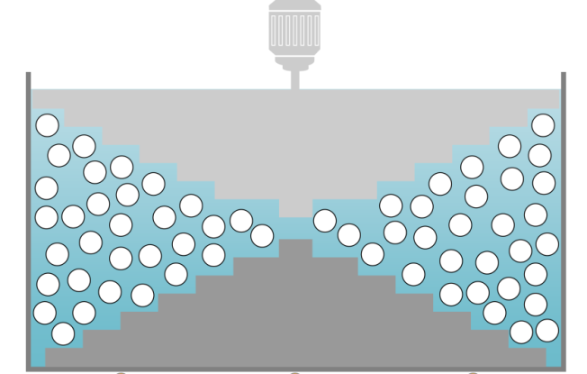
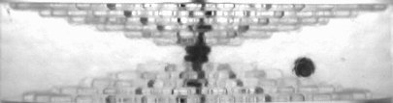
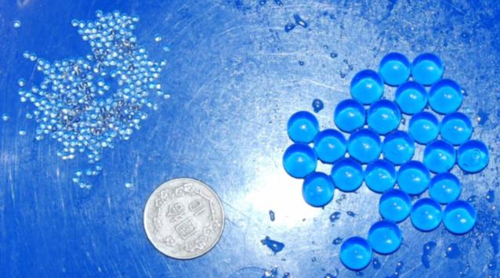
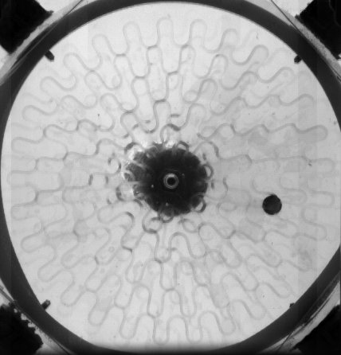
Introduction
L
: Load cells
Hydrogel spheres / aq. PVC solution
Volume Fraction: φ = 0.47-0.64)
rotating
Side View
13°
5.3 cm
stationary
L
L
23 cm
L
L
L
Bottom View

Slide 4
Chapter2.
Apparatus

Slide 5
Chapter2.
Apparatus
Force Sensors and Boundaries
Stress Measurement
Driving Motor Control

Slide 6
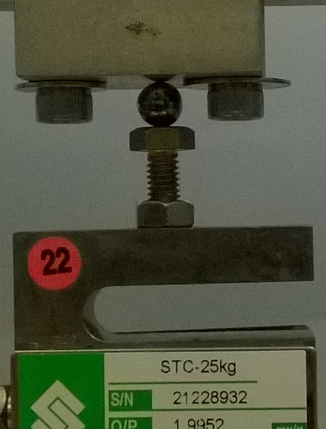
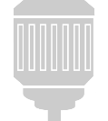
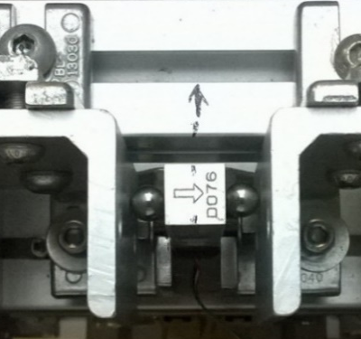
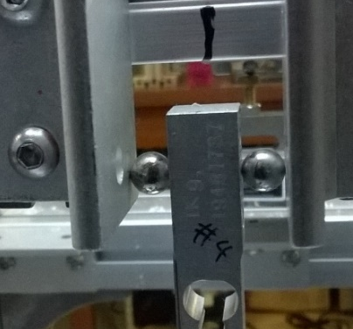


Force Sensors
2.5 Kgw/volt
0.225 cm
$$\hat{x}$$
$$\hat{z}$$
0.053 m
0.1 Kgw/volt
F₃
F₁
F₂
F₄
+
-
F₁
F₂
-
r4
F₅
+
F₆
r5=r6
-
-
+
+

Slide 7
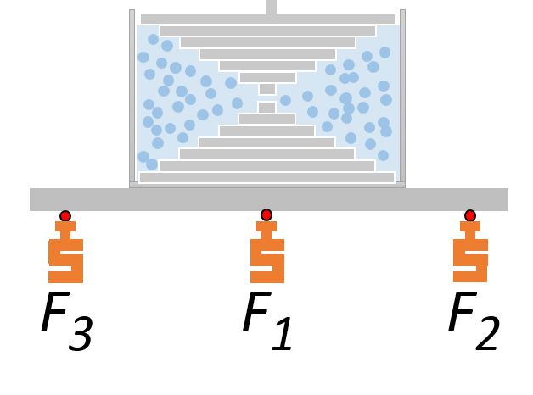
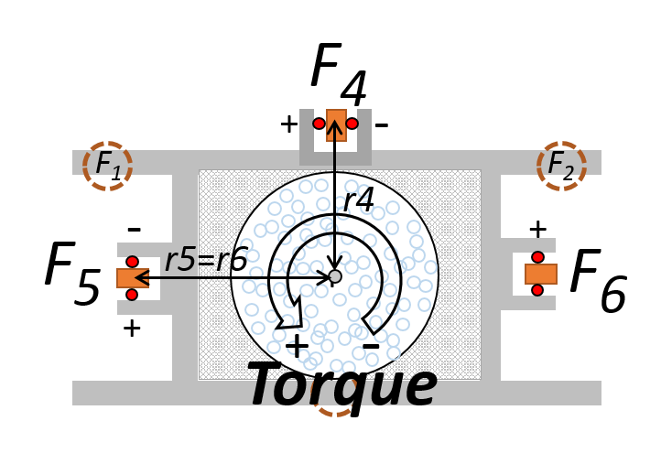


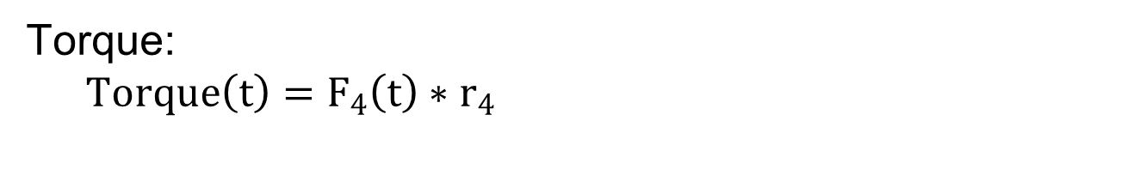
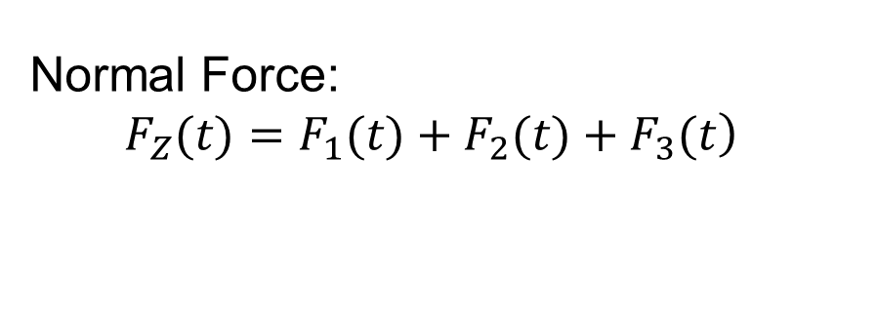
Reference points of force measurement:
While top boundary NOT contacting the material yet,
Define: F₁＝ F₂＝ F₃＝ F₄＝ F₅＝ F₆ ≡ 0
Normal Force:
$\left.F_{Z}(t)=F_{1}(t)+F_{2}(t)+F_{3}(t\right)$
Torque:
$Torque\left(t\right)=F_{4}\left(t\right)∗r_{4}$
$$+{ F}_{5}\left(t\right)∗r_{5}$$
$$+ F_{6}\left(t\right)∗r_{6}$$
# r4=0.138m, r5=r6=0.211m

Slide 8
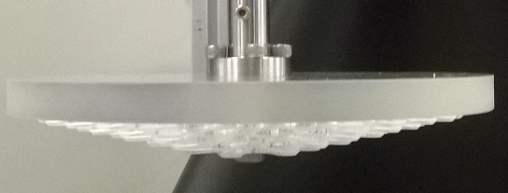
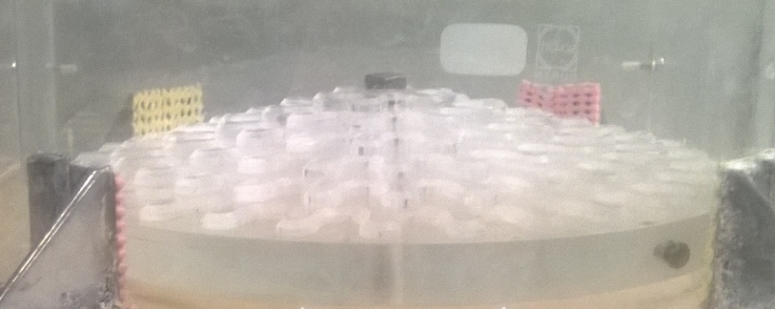
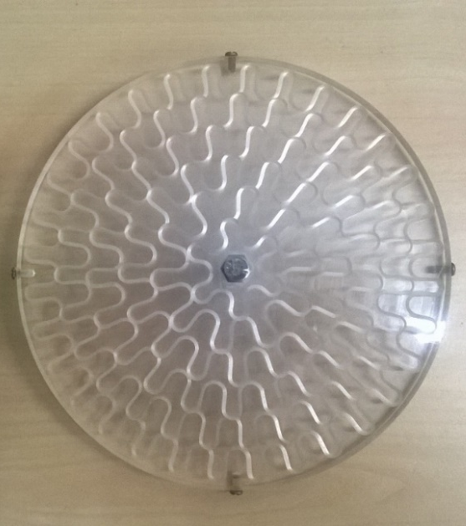
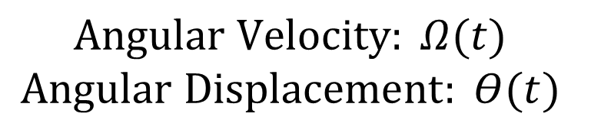


Boundaries
$\text{β}≅{13}^{∘}$
1mm, Distance between boundaries
1cm
Acrylic Plates
Ω(t)
R = 0.1125m
$$Angular Velocity: Ω(t)$$
$$Angular Displacement: Θ(t)$$
#Total Volume: $1565ml±20ml$

Slide 9
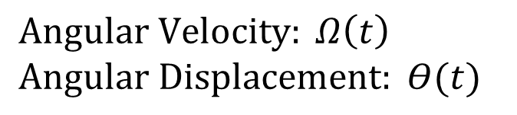
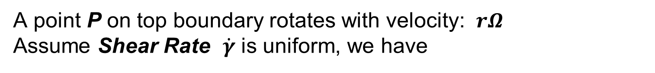
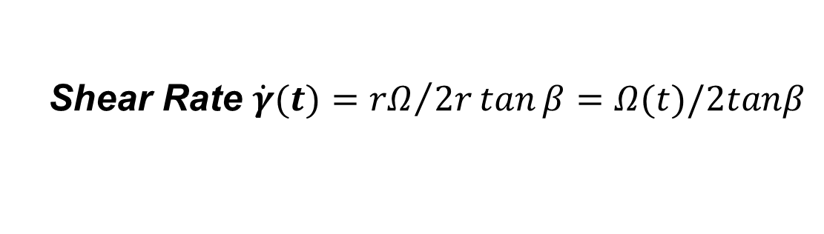
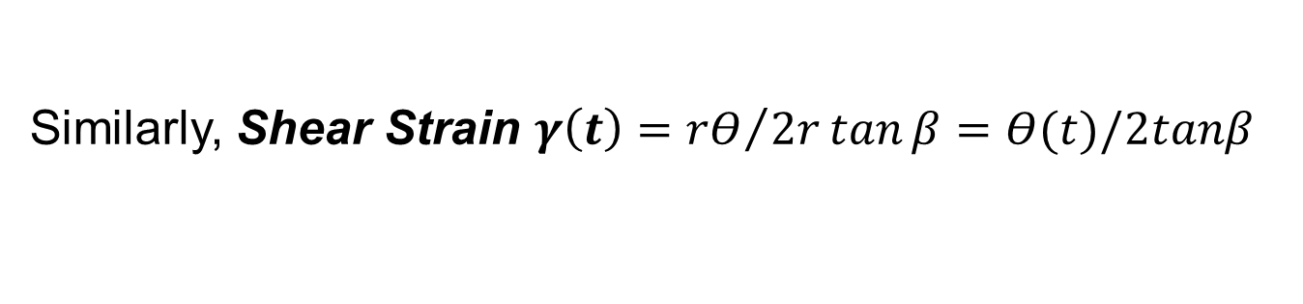
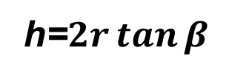

Charateristic Shear Rate,
Shear Strain & Stress
$$Angular Velocity: Ω\left(t\right)$$
$$Angular Displacement: Θ(t)$$
R = 0.1125m
r
P
$\text{β}≅{13}^{∘}$
h=$2r\tan{β}$
A point P on top boundary rotates with velocity: $rΩ$
Assume Shear Rate $\dot{γ}$ is uniform, we have
Shear Rate $\dot{γ}(t)={rΩ}/{2r\tan{β}}=Ω(t)/2tanβ$
Similarly, Shear Strain $γ\left(t\right)={rΘ}/{2r\tan{β}}=Θ(t)/2tanβ$

Slide 10
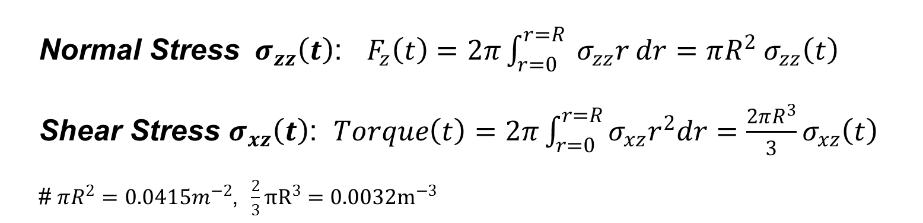
Charateristic Shear Rate,
Shear Strain & Stress
R = 0.1125m
r
P
Also, assume stress is uniform, we have:
Normal Stress ${ σ}_{zz}\left(t\right)$: $F_{z}\left(t\right)=2π\int_{r=0}^{r=R}{{ σ}_{zz}r dr}=πR^{2}{ σ}_{zz}\left(t\right)$
Shear Stress $σ_{xz}\left(t\right)$: $Torque\left(t\right)=2π\int_{r=0}^{r=R}{σ_{xz}r^{2}dr}=\frac{2πR^{3}}{3}σ_{xz}\left(t\right)$
# $πR^{2}=0.0415m^{−2}$, $\frac{2}{3}πR^{3}=0.0032m^{−3}$

Slide 11
Chapter2.
Apparatus
Force Sensors and Boundaries
Stress Measurement
Driving Motor Control

Slide 12
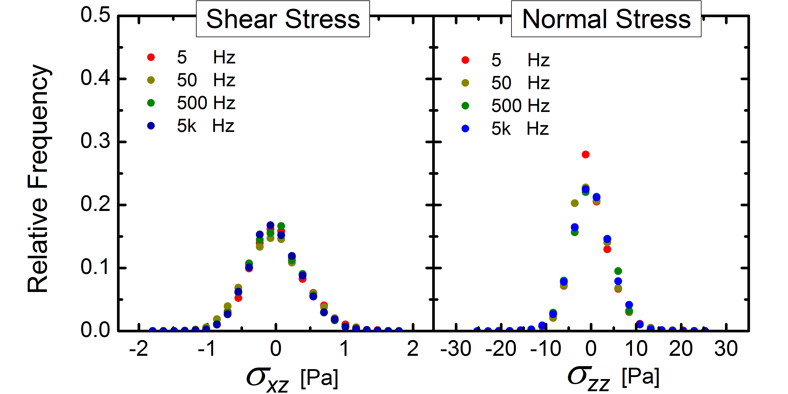
On Stress Measurement
- Noise of a Single Data Point
4 different sample rates, 5000 data points each

Slide 13
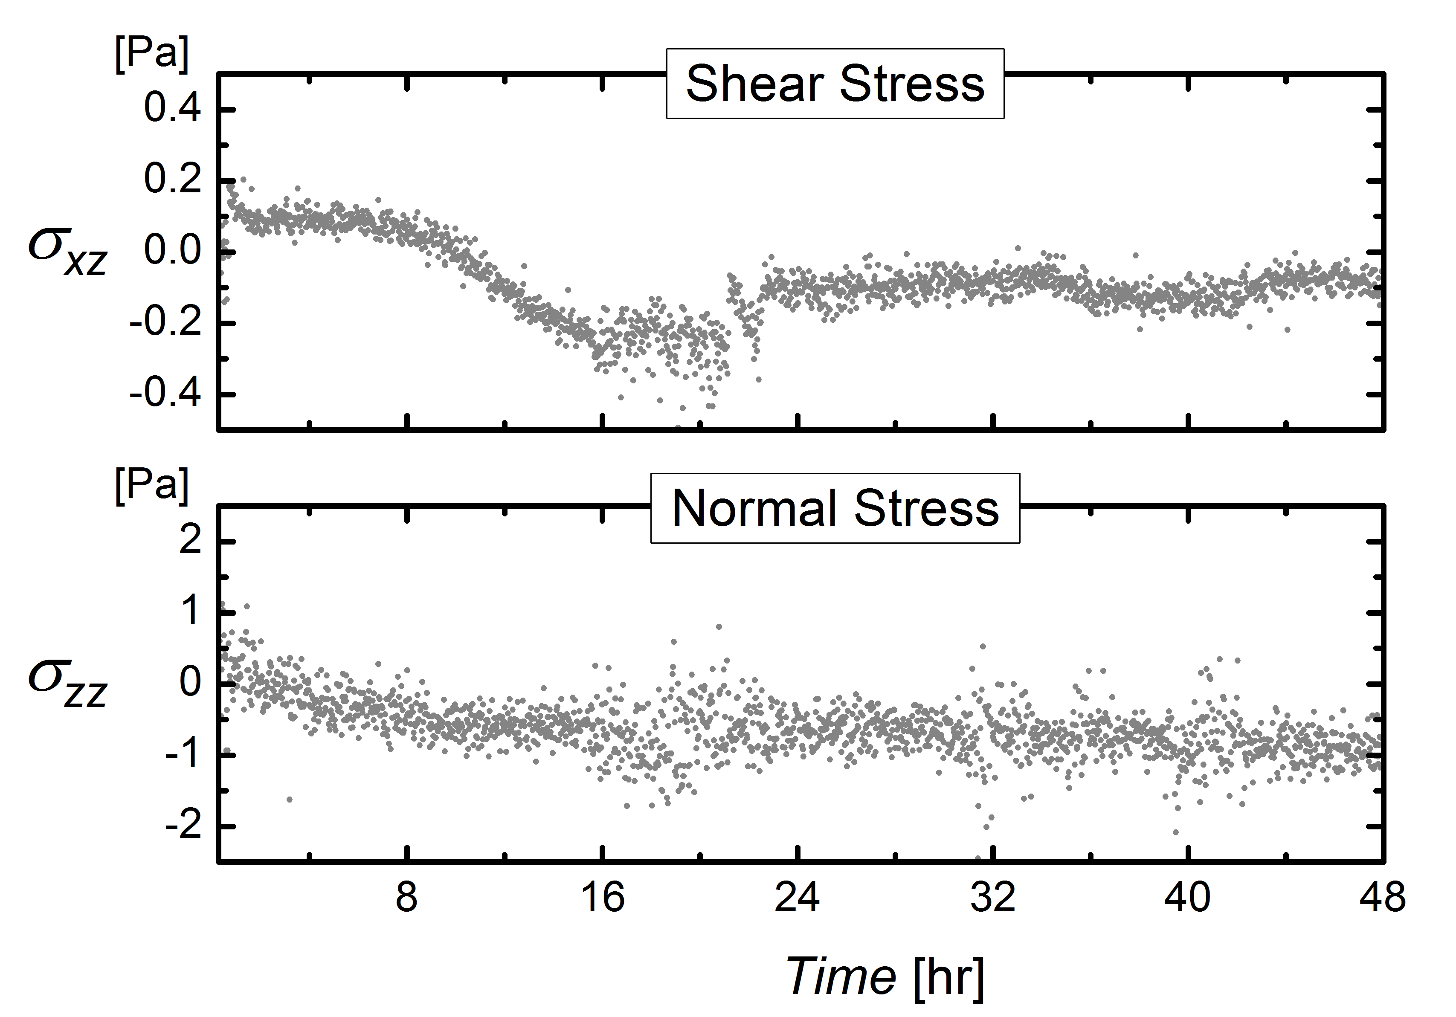
On Stress Measurement
- Long Time Stability
Without Load, measure stress over 2+ days

Slide 14
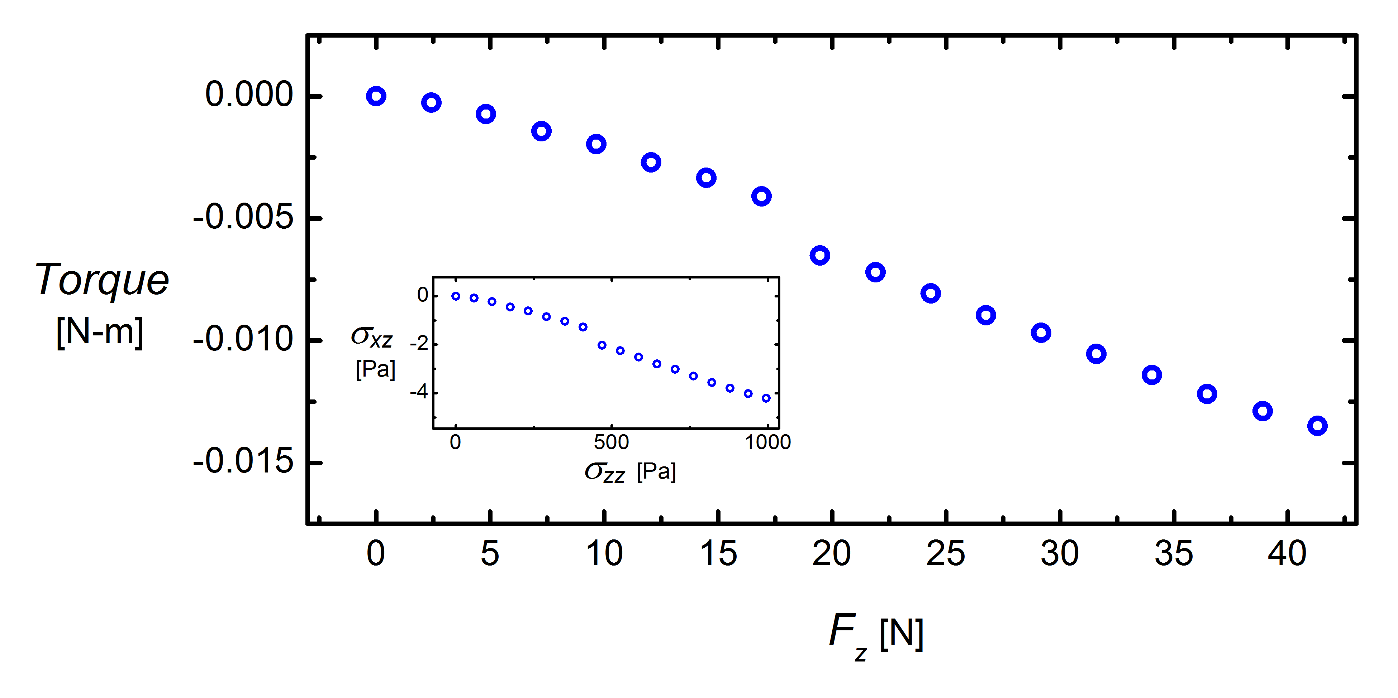
On Stress Measurement -
Reference Point Independence of
Two Components
(*Taped water)
Impose system with Normal Force Only, see how Torque change

Slide 15
Chapter2.
Apparatus
Force Sensors and Boundaries
Stress Measurement
Driving Motor Control

Slide 16

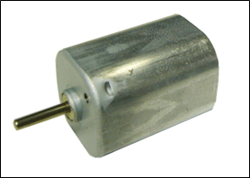
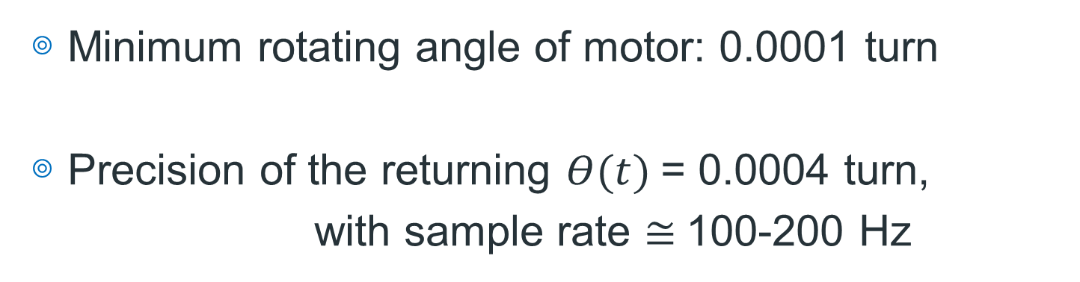
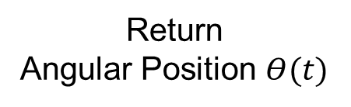
Motor Control Overview
Command
Controller
Return
Angular Position $Θ(t)$
Minimum rotating angle of motor: 0.0001 turn
Precision of the returning $Θ(t)$= 0.0004 turn,
with sample rate $≅$100-200 Hz

Slide 17
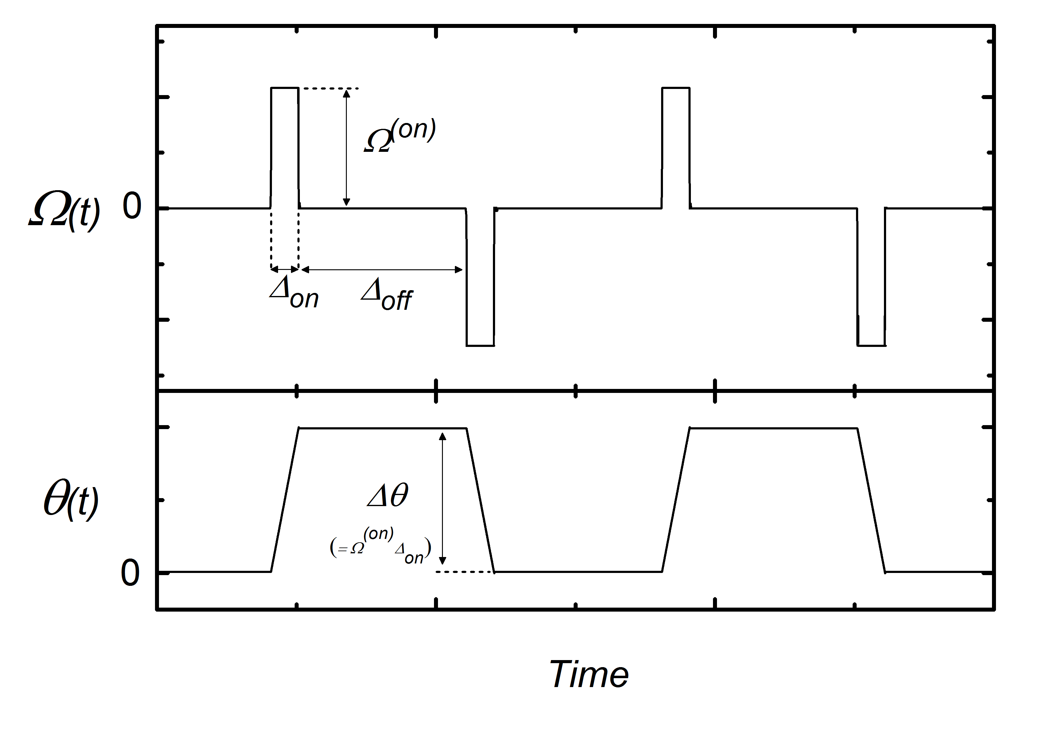
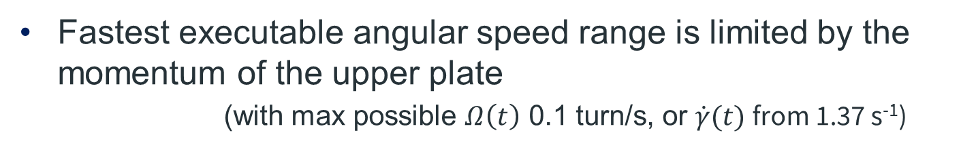
Motor Motion- Seesaw Mode
Fastest executable angular speed range is limited by the momentum of the upper plate
(with max possible $Ω\left(t\right)$ 0.1 turn/s, or $\dot{γ}(t)$from 1.37 s⁻¹)

Slide 18
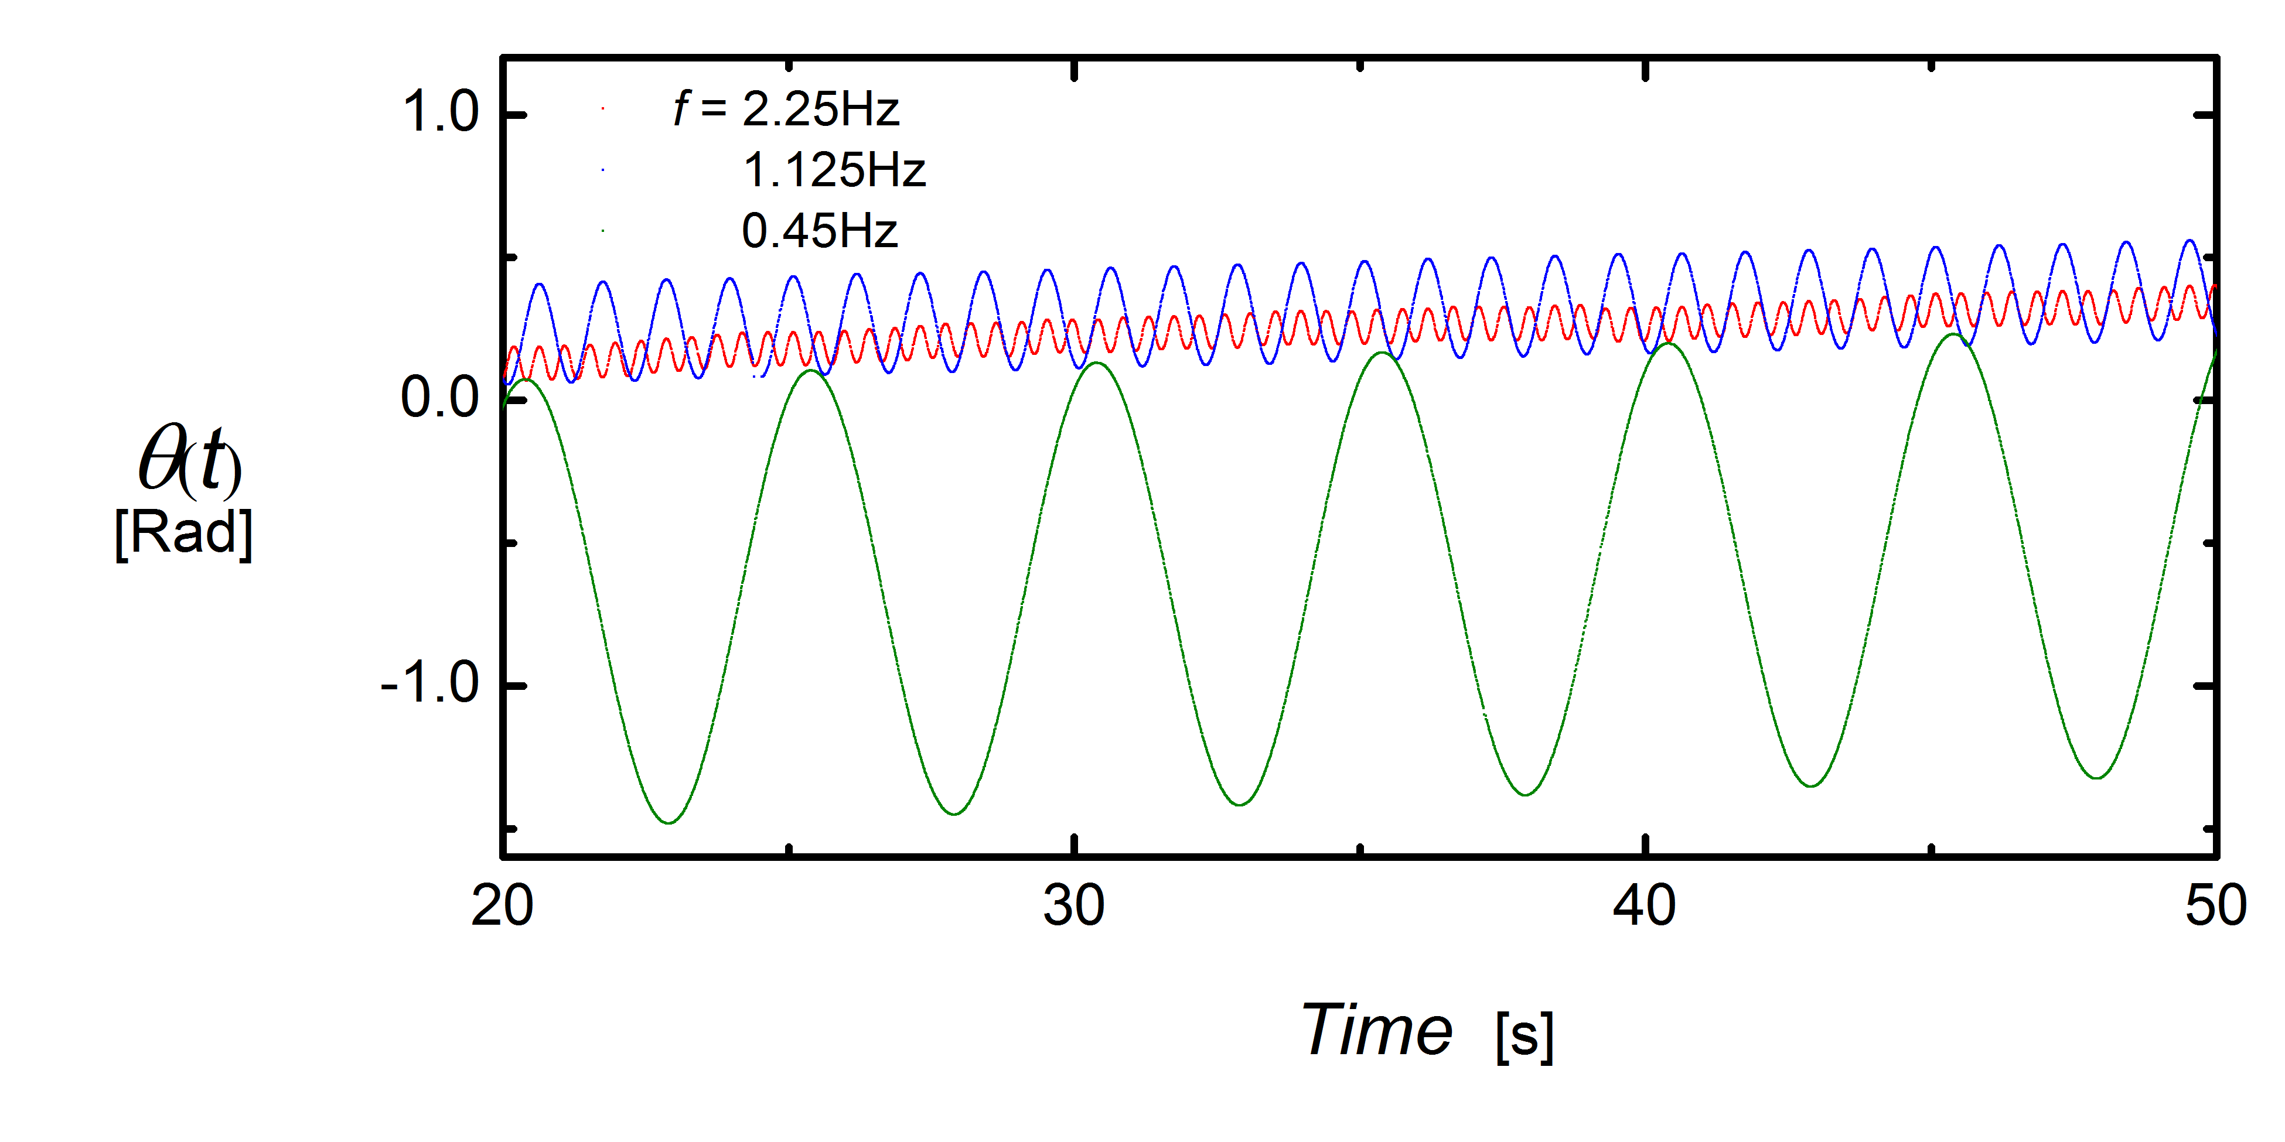
Motor Motion- Seesaw Mode
We attempt to achieve sinusoidal motion at early stage…

Slide 19
Chapter3.
Materials

Slide 20
Chapter3.
Materials
Materials
Normal Compression Test
-Single Ball
-Suspension
Ball Volume Estimation

Slide 21
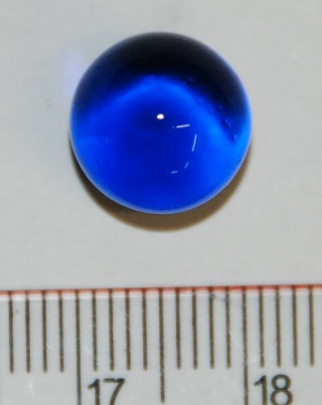
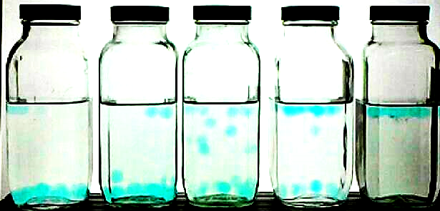

Materials
Hydro-gel particles, after swollen $D_{Ball}≅11$mm
Density match with 1.7% PVP solution
(360K Polyvinylpyrrolidone + DI Water)
dry, d ≈1mm

Slide 22
Chapter3.
Materials
Materials
Normal Compression Test
-Single Ball
-Suspension
Ball Volume Estimation

Slide 23
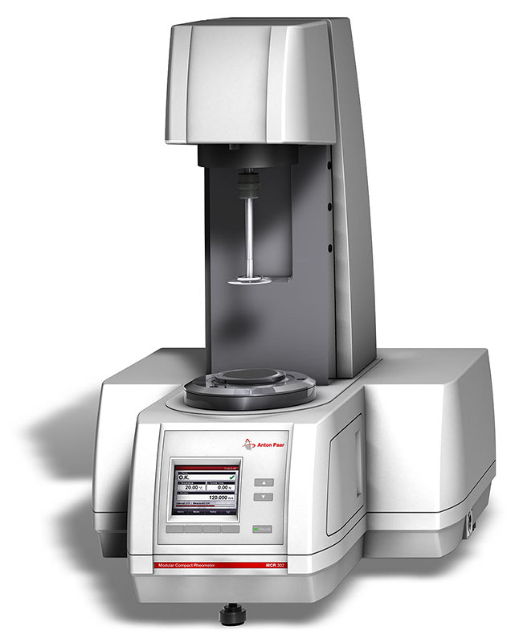

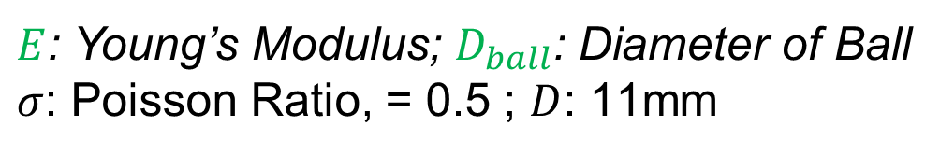

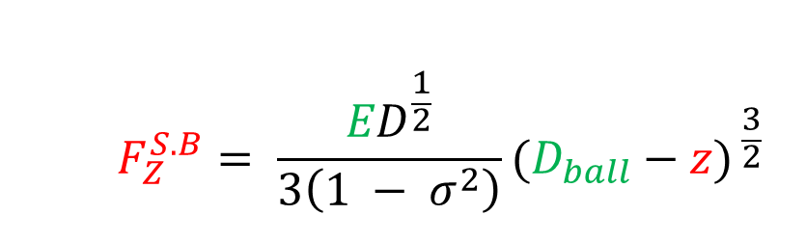




Normal Compression Test
– Single Ball (S.B)
Measuring head of Anton PaarA Rheometer gives curve $\left(Z, F_{Z}^{S.B}\right)$
Fit curve $\left(Z, F_{Z}^{S.B}\right)$ with Eq:
$$F_{Z}^{S.B}$$
$$F_{Z}^{S.B}= \frac{{ED}^{\frac{1}{2}}}{3\left(1 − σ^{2}\right)}(D_{ball}−{z)}^{ \frac{3}{2}}$$
$$Z≅11mm$$
$$F_{Z}^{S.B}= \frac{{ED}^{\frac{1}{2}}}{3\left(1 − σ^{2}\right)}(D_{ball}−{z)}^{ \frac{3}{2}}$$
$$D_{ball}$$
$$Z≡0mm$$
$E$: Young’s Modulus; $D_{ball}$: Diameter of Ball
$σ$: Poisson Ratio, = 0.5 ; $D$: 11mm
# Puttock, M., & Thwaite, E. (1969).
Elastic compression of spheres and cylinders at point and line contact
# Precision of Anton PaarA --- $F_{Z}^{S.B}$ : 0.01N, Z: 0.001mm

Slide 24
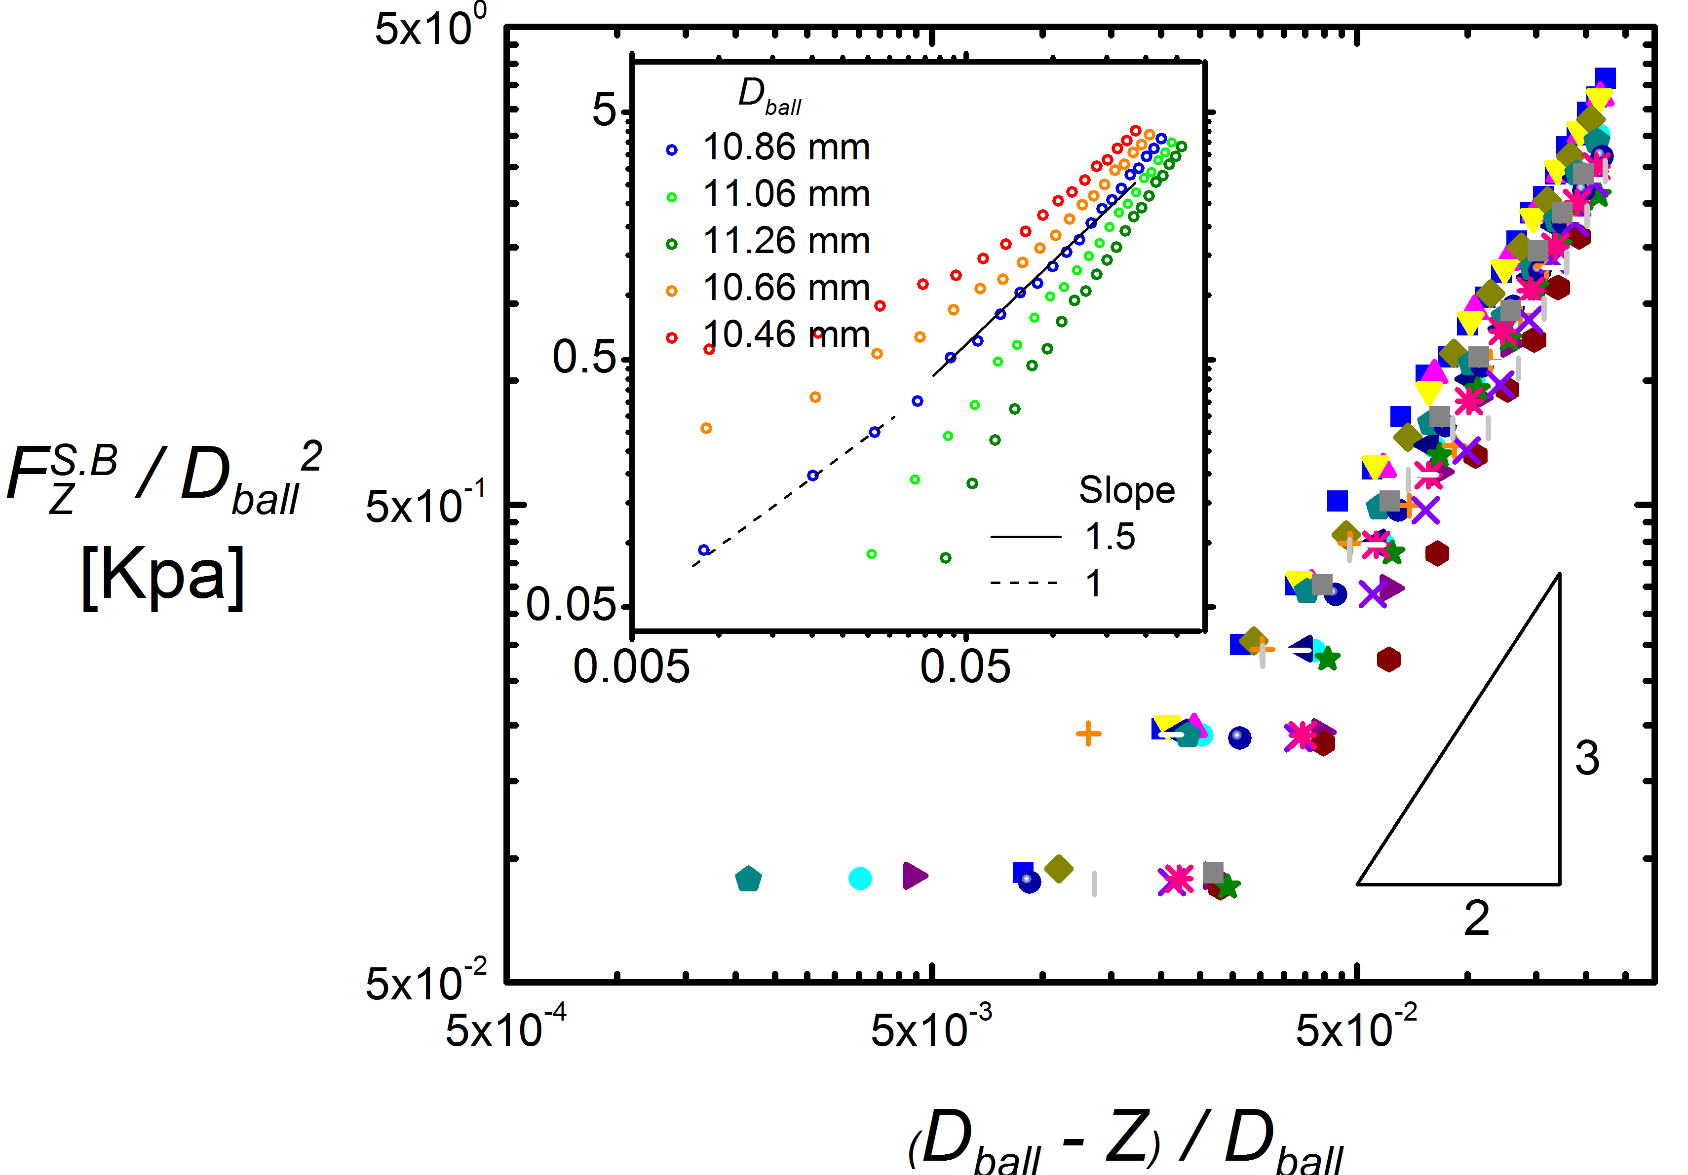
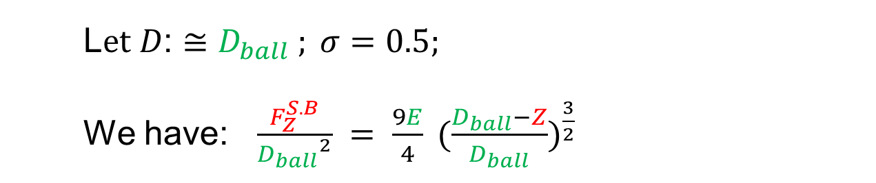
Stress
L$et D\text{: ≅ }D_{ball} ; σ=0.5;$
We have: $\frac{F_{Z}^{S.B}}{{D_{ball}}^{2}} = \frac{9E}{4} {(\frac{D_{ball}−Z}{D_{ball}})}^{\frac{3}{2}}$
Deformation

Slide 25
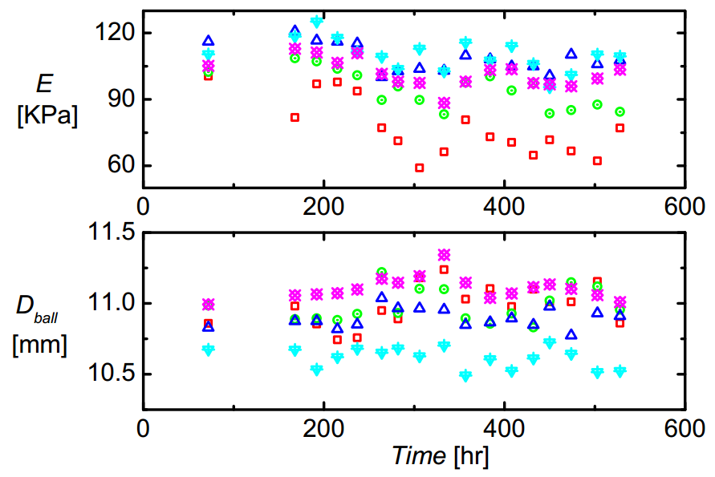
Time Dependence of Mechanical Properties of Hydrogel Balls
*Special thanks to 張睿恩
Using previously described compression test,
We measure 5 balls, once per day, and over 1 month.

Slide 26
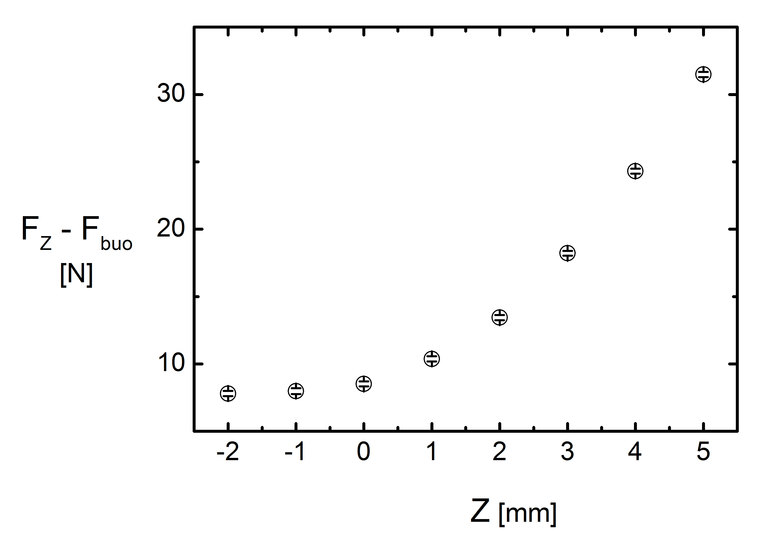



Normal Compression Test
– The Suspension
*Special thanks to 費祥霆
Use our rheometer, compress the hydrogel ball suspension, get $\left(Z, F_{Z}\right)$
$$F_{Z}$$
$$Z≡0mm$$
Further research, may see:
Lachhab, T., & Weill, C. (1999).
Compression of a soft sphere packing
The European Physical Journal-B

Slide 27
Chapter3.
Materials
Materials
Normal Compression Test
-Single Ball
-Suspension
Ball Volume Estimation

Slide 28
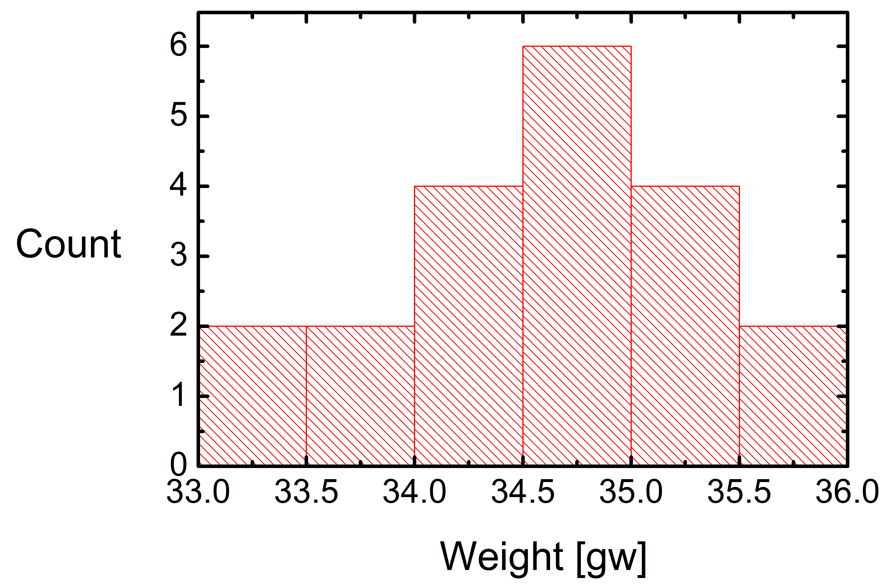
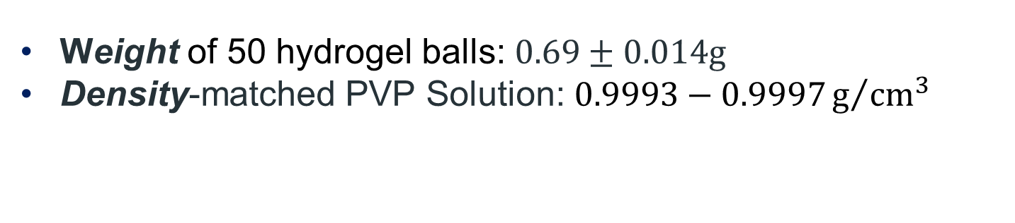

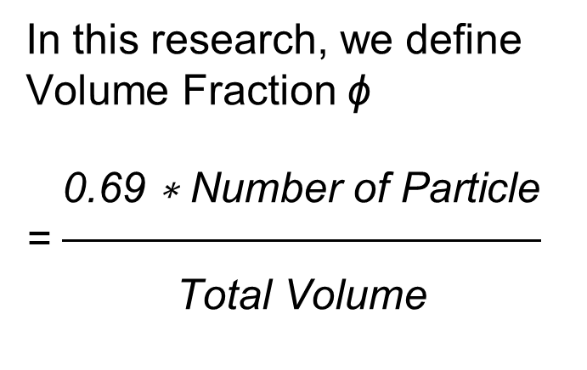
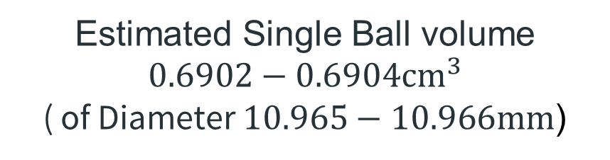
Estimated Ball Volume
Weight of 50 hydrogel balls: $0.69±0.014g$
Density-matched PVP Solution: $0.9993−0.9997g/{{cm}^{3}}$
From Weight / Density -
Total weight of 50 hydrogel balls
Estimated Single Ball volume
$$0.6902−0.6904{cm}^{3}$$
( of Diameter $10.965−10.966mm$)
In this research, we define
Volume Fraction ϕ
= $\frac{\begin{aligned}\text{0.69 ∗ }\text{Number} \text{of} \text{Particle} \\ \end{aligned}}{\begin{aligned} \\ \text{Total} \text{Volume}\end{aligned}}$
#Total Volume: $1565ml±20ml$

Slide 29

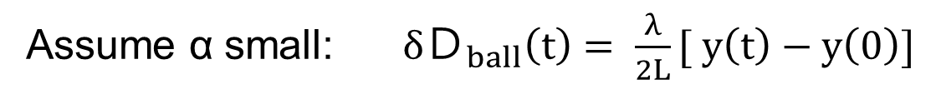
Measure Ball Diameter
by Optical Lever
*Special thanks to 黃柏嘉
Assume α small: $δＤ_{ball}\left(t\right)= \frac{λ}{2L}[ y\left(t\right)−y\left(0\right)]$
λ = 6cm
L = 4.0m
y(t)
α
2α
y(0)
$${δD}_{ball}$$

Slide 30
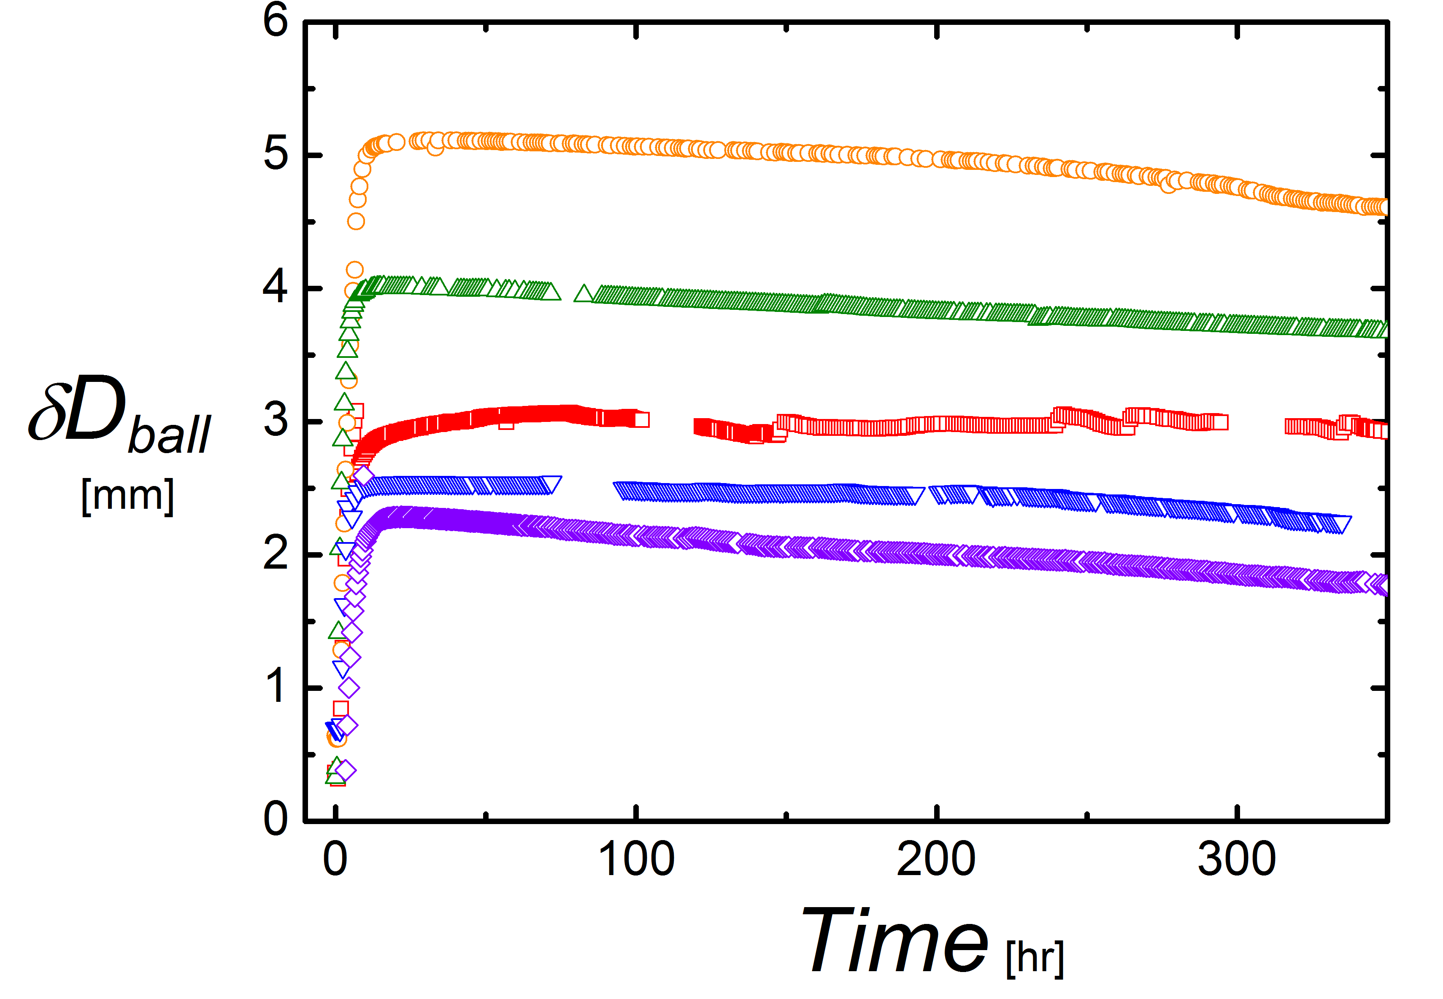
Measure Ball Diameter
by Optical Lever

Slide 31
Chapter4.
Experiment Results

Slide 32
Chapter4.
Experiment Results
Stress Response of the Material
Role of Interstitial Fluid
Plateau and Residual Stress
Time Scales in Relaxation Process
Steady State Measurement

Slide 33


Stress Response of the Material
$$≡ γ^{max}$$

Slide 34


Stress Response of the Material
- Single Cycle
Shear Strain
$$γ\left(t\right)=Θ(t)/2tanβ$$
Shear Rate
$$\dot{γ}(t)=Ω(t)/2tanβ$$
Stress
$${ σ}_{zz}\left(t\right)=F_{z}\left(t\right)/πR^{2}$$
$${ σ}_{xz}\left(t\right)=Torque\left(t\right)/\frac{2}{3}πR^{3}$$
Non-zero
Residual stress

Slide 35

Residual Stress After Long Waiting Time
Record the residual stress after 25-cycles Seesaw driving

Slide 36
Chapter4.
Experiment Results
Stress Response of the Material
Role of Interstitial Fluid
Plateau and Residual Stress
Time Scales in Relaxation Process
Steady State Measurement

Slide 37

Effects of Interstitial Fluid
WITH NO solution inside:
Residual stress
remains!

Slide 38


Effects of Interstitial Fluid
Start with NO solution, insert 25ml solution each cycle
Residual stress
2 times larger

Slide 39
Chapter4.
Experiment Results
Stress Response of the Material
Role of Interstitial Fluid
Plateau and Residual Stress
Time Scales in Relaxation Process
Steady State Measurement

Slide 40


Definition of
Plateau & Residual Stress
Characterize the stress curve by defining two stress value
Plateau (擬穩態應力值, ^{(P)}) & Residual Stress(殘餘應力, ^{(R)})
Normal Stress-
Symmetric with respect to
Shear in opposite directions
Shear Stress-
Anti-symmetric with respect to
Shear in opposite directions

Slide 41



Dependence of
Plateau (P) & Residual (R) Stress
On Experiment Parameters
${\dot{γ}}^{(on)}=1.37s^{−1}$、$Δ_{Off}=120s$
On Maximum
Shear Strain $γ^{max}$

Slide 42



Dependence of
Plateau (P) & Residual (R) Stress
On Experiment Parameters
$γ^{max}=5.47$、$Δ_{Off}=120s$
On
Shear Rate ${\dot{γ}}^{(on)}$

Slide 43


Dependence of
Plateau (P) & Residual (R) Stress
On Experiment Parameters
$γ^{max}=5.47$、$Δ_{Off}=120s$
On
Volume Fraction
ϕ

Slide 44
Chapter4.
Experiment Results
Stress Response of the Material
Role of Interstitial Fluid
Plateau and Residual Stress
Time Scales in Relaxation Process
Steady State Measurement

Slide 45


Time Scales in Relaxation Process

Slide 46


Time Scales in Relaxation Process
- Single Exponential Fitting
Fit Normal Stress with
: ${S_{xz}ｅ}^{{−\left(t−t_{1}\right)}/{τ_{xz}}}{+R}_{xz}$
Fit Shear Stress with
: ${S_{zz}ｅ}^{{−\left(t−t_{1}\right)}/{τ_{zz}}}{+R}_{zz}$
$τ_{xz} 、 τ_{zz}$： Time scales of the relaxation Process
$R_{xz}$ $、 R_{zz}$: Residual stress at $t →∞$

Slide 47


Time Scales in Relaxation Process
- Single Exponential Fitting

Slide 48


Time Scales in Relaxation Process
- Double Exponential Fitting
Fit Normal Stress with
G_{zz}(t): ${{S1}_{xz}ｅ}^{{−\left(t−t_{1}\right)}/{{τ1}_{xz}}}+{{{S2}_{xz}ｅ}^{{−\left(t−t_{1}\right)}/{{τ2}_{xz}}}+R}_{xz}$
Fit Shear Stress with
G_{xz}(t): ${{S1}_{zz}ｅ}^{{−\left(t−t_{1}\right)}/{{τ1}_{zz}}}+{{{S2}_{zz}ｅ}^{{−\left(t−t_{1}\right)}/{{τ2}_{zz}}}+R}_{zz}$
$${τ1}_{xz} 、 {τ1}_{zz}$$
$${τ2}_{xz} 、 {τ2}_{zz}$$
$R_{xz}$ $、 R_{zz}$ ： Residual stress at $t →∞$
：Time scales of the relaxation Process

Slide 49

Time Scales in Relaxation Process
- Double Exponential Fitting

Slide 50


Double Exponential Fitting
- Sensitive to Initial Parameters
G_{zz}(t): ${{S1}_{xz}ｅ}^{{−\left(t−t_{1}\right)}/{{τ1}_{xz}}}+{{{S2}_{xz}ｅ}^{{−\left(t−t_{1}\right)}/{{τ2}_{xz}}}+R}_{xz}$
G_{xz}(t): ${{S1}_{zz}ｅ}^{{−\left(t−t_{1}\right)}/{{τ1}_{zz}}}+{{{S2}_{zz}ｅ}^{{−\left(t−t_{1}\right)}/{{τ2}_{zz}}}+R}_{zz}$
Compute: $χ=\sum_{t∈\left[t1,t2\right]}{{ \left[G_{zz,xz}\left(t\right)−σ_{zz,xz}\left(t\right)\right]}^{2}}$

Slide 51

Double Exponential Fitting
- Sensitive to Initial Parameters
G_{zz}(t): ${{S1}_{xz}ｅ}^{{−\left(t−t_{1}\right)}/{{τ1}_{xz}}}+{{{S2}_{xz}ｅ}^{{−\left(t−t_{1}\right)}/{{τ2}_{xz}}}+R}_{xz}$
G_{xz}(t): ${{S1}_{zz}ｅ}^{{−\left(t−t_{1}\right)}/{{τ1}_{zz}}}+{{{S2}_{zz}ｅ}^{{−\left(t−t_{1}\right)}/{{τ2}_{zz}}}+R}_{zz}$

Slide 52
Chapter4.
Experiment Results
Stress Response of the Material
Role of Interstitial Fluid
Plateau and Residual Stress
Time Scales in Relaxation Process
Steady State Measurement

Slide 53


Steady State Measurement
Shear material with a constant rate $\dot{γ}$, with total strain $γ\sim 100$
Average the stress data within $γ≅\left[70, 100\right]$, get $σ_{zz}^{(0)}、σ_{xz}^{(0)}$
1s⁻¹

Slide 54


Systematic errors in
Steady State Measurement
3
1
Same set of parameters but execute with different orders
2
1
3
2
Re-open the upper boundaries

Slide 55

Compare the steady state measurement
With Plateau Value

Slide 56
Summary
Residue stress is created by direct contact, affected mainly by volume fraction and interstitial fluid, not other parameters
Analysis the relaxation process, we can roughly capture at least two relaxation time scale. One of which is around 1s.
Steady state measurement reveals the shear-thinning behavior for ϕ > 0.5, which is close to the ϕ that residual stress is below our apparatus precision.
In steady state measurement, the rate of change of shear rate changes also at time scale 1s.

Slide 57

Tool used to fix Boundaries

Slide 58

Effects of Interstitial Fluid
$$σ_{xz}^{R}$$

Slide 59

Phase Average Explanation
2nd Period
1st Period
+
..…
……
2nd
+
3nd
dt: Time Window
1st Period
3rd Period

Slide 60

Internal imaging at the mid-plane (thru the bottom)
LASER sheet + Nile Blue in particles [Thanks to Joshua Dijksman]
[Ref: Tsai, Voth, and Gollub, PRL 2003]
Movies: ORIGINAL SUBTRACTED
50fps @30fps
demo_SS3_20151016_03__vel=100_N=1600_frame820_1199_compressed_combine_Fei1026.avi

Slide 61


Yield Strain – Comparing with Oscillatory Shear
τ (Pa)
δτ
2γ_{max}
γ_{max}

