Slide 1
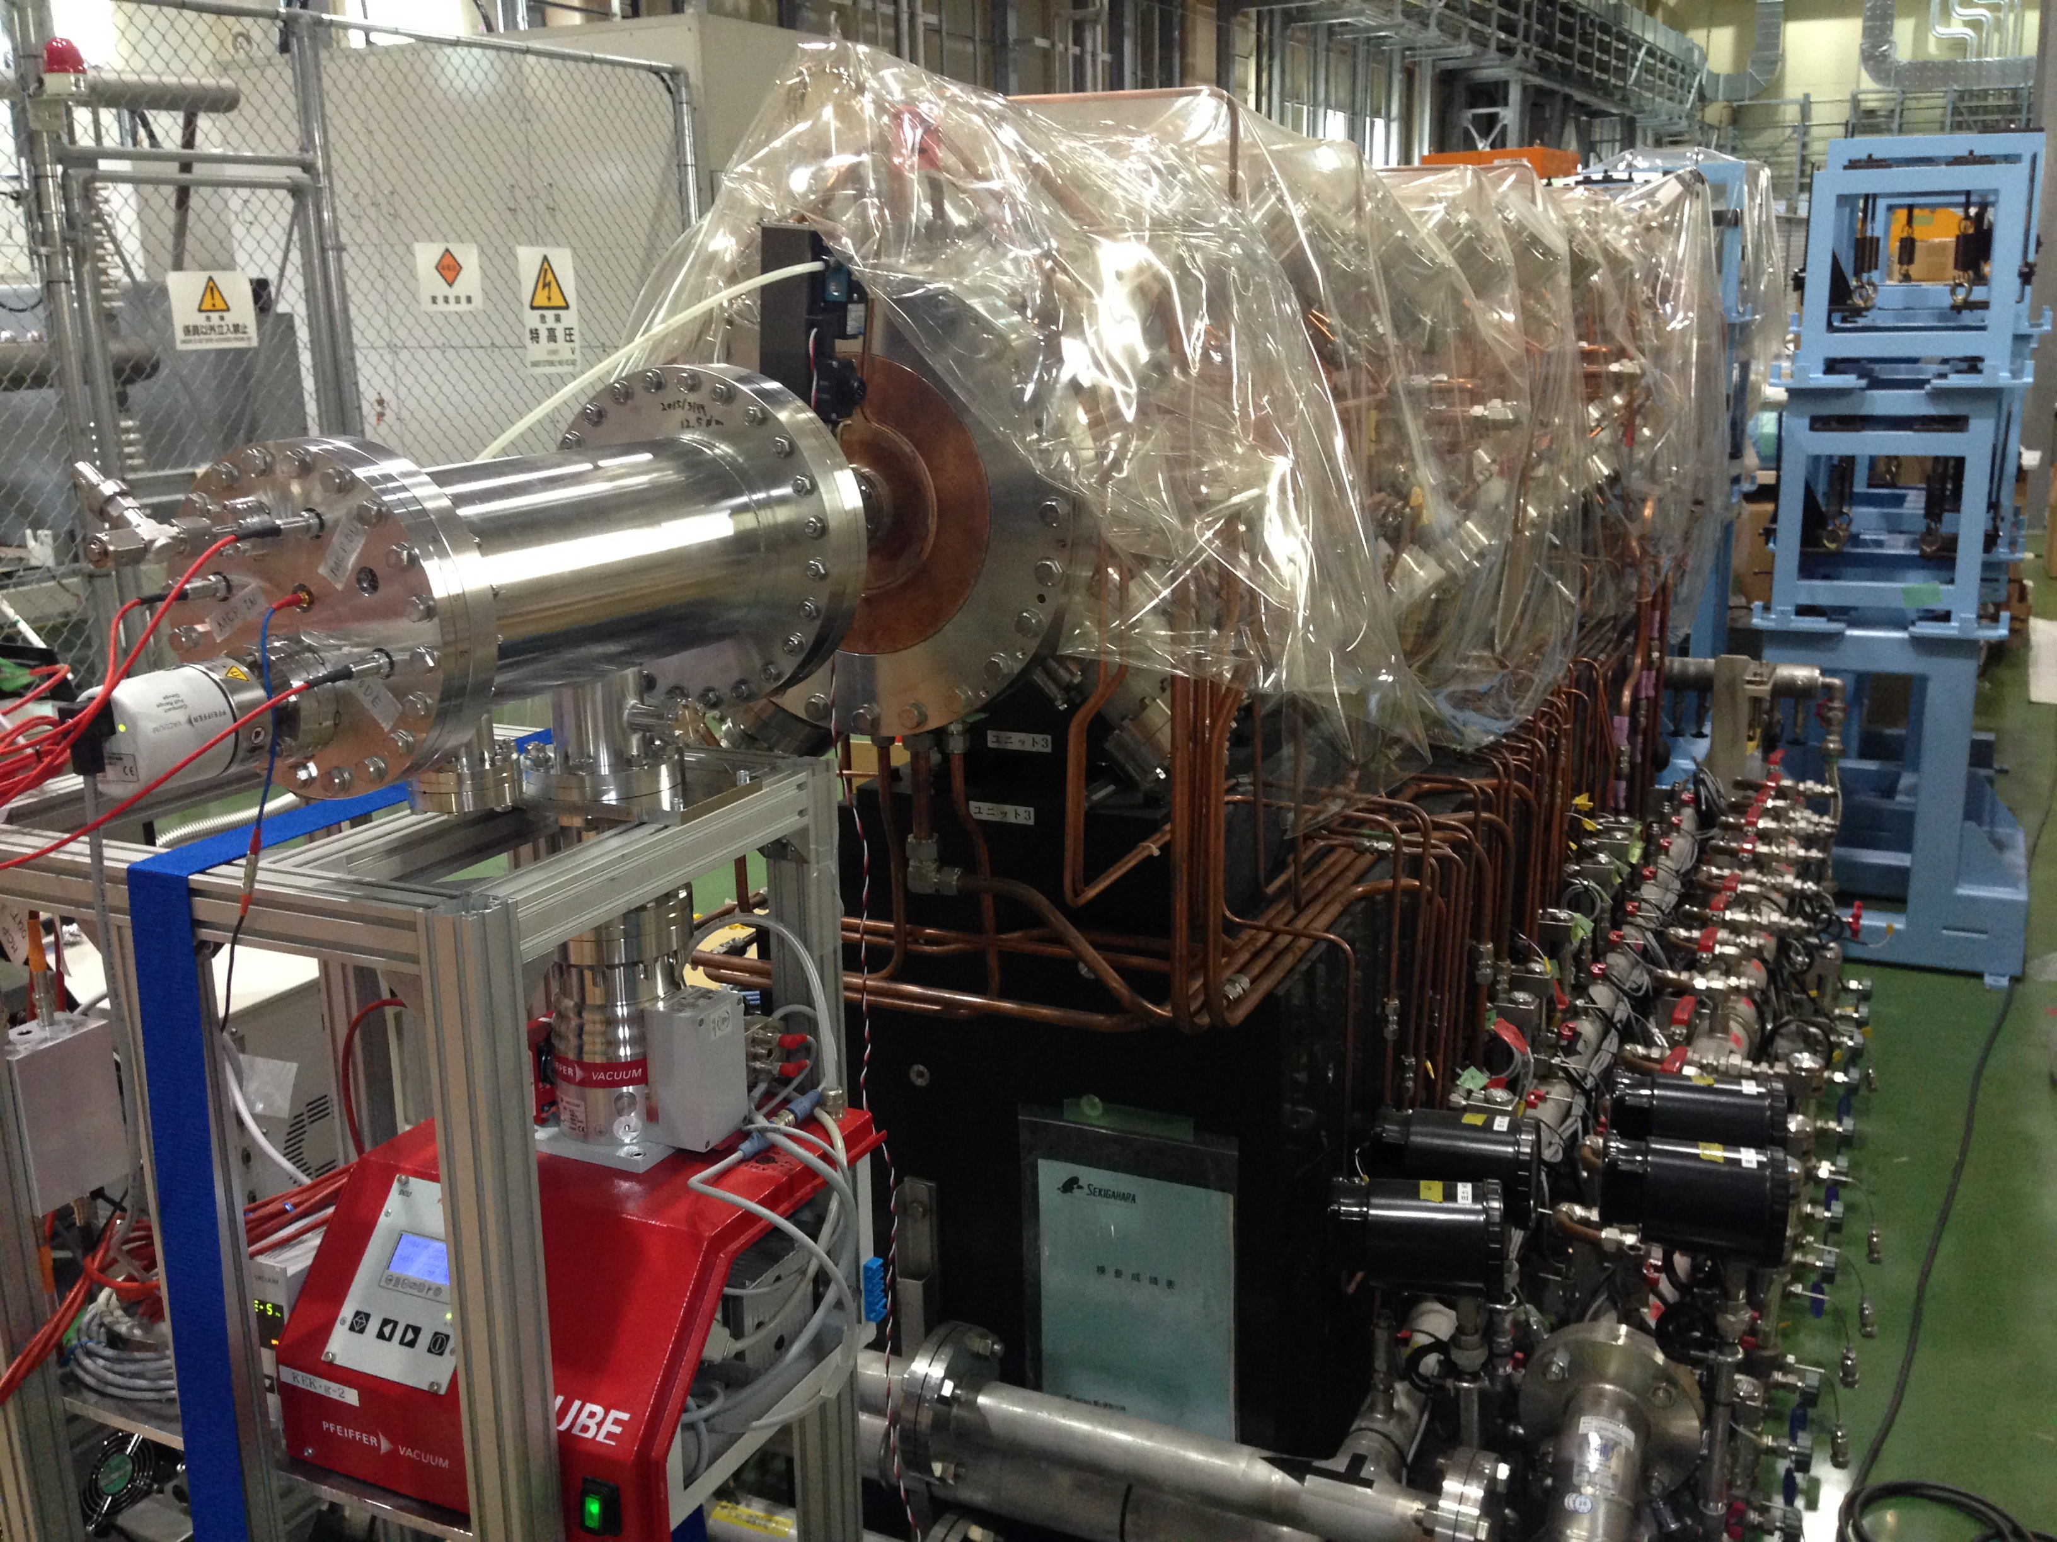
Measurement of muon g-2/EDM with ultra-slow muon at J-PARC
Tsutomu Mibe (IPNS/KEK)
http://g-2.kek.jp
Academia Sinica, Taipei
Oct. 6, 2015

Slide 2
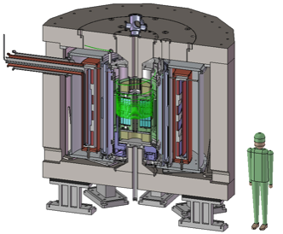
Why g-2 and EDM with new method?
BNL E821
    a_{μ} = 11 659 208.9 (6.3) x 10⁻¹⁰
      0.46ppm (stat.) + 0.28ppm (syst.) = 0.54ppm →Stat. dominant
FNAL E989 (Dave’s talk)
J-PARC E34
    Brand-new concept
      Ultra-cold muon beam
      Compact storage ring

Slide 3
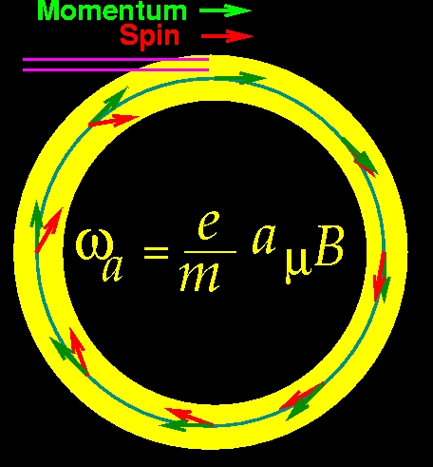
muon g-2 and EDM measurements
In uniform magnetic field, muon spin rotates ahead of momentum due to g-2 = 0
general form of spin precession vector:
BNL E821 approach
γ=30 (P=3 GeV/c)
J-PARC approach
E = 0 at any γ
FNAL E989
J-PARC E34

Slide 4
Major systematic uncertainties
BNL/FNAL major systematics (on ω_{a})
Source | BNL (ppm) | FNAL goal (ppm)
Gain changes | 0.12 | 0.02
Lost muons | 0.09 | 0.02
Pile up | 0.08 | 0.04
CBO | 0.07 | 0.04
E and pitch | 0.05 | 0.03
Total | 0.18 | 0.07
All related with beam quality and characteristics.
Largely suppressed
by using
“ulta-cold” muon

Slide 5
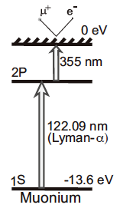
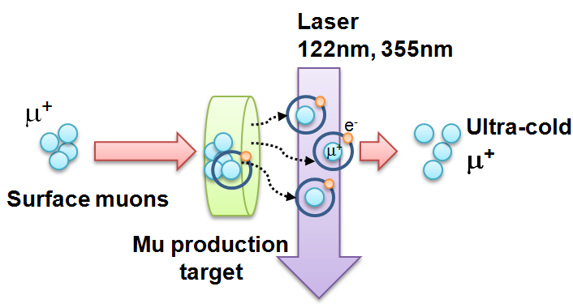
Ultra-cold Muon
Requirement for zero E-field:
Muons should be kept stored without E-focusing
→ Beam with ultra-small transverse dispersion,
i.e. Δp_{T}/p ~0
Laser resonant ionization of Mu (μ⁺e⁻)
re-acceleration
p =
28MeV/c
3 keV/c
300 MeV/c
Δp_{T}/p ~3 keV / 300 MeV =1E-5

Slide 6
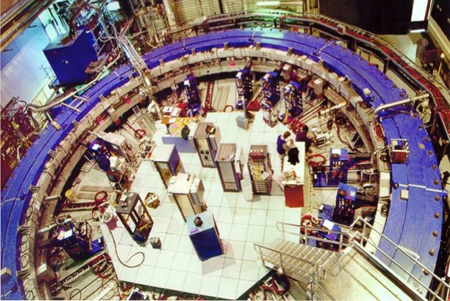
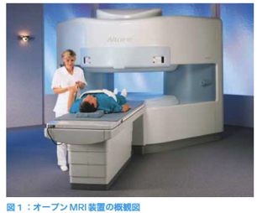
A compact muon g-2/EDM experiment
Advantages
  Suited for precision control of B-field
    Example : MRI magnet , 1ppm local uniformity
  Possibility of spin manipulation
    Effective to cancel various systematics
  Completely different systematics than the BNL E821 or FNAL
BNL E821 / FNAL E989
J-PARC E34
66cm
14m
P= 3.1 GeV/c , B=1.45 T
P= 0.3 GeV/c , B=3.0 T
Hitachi co.

Slide 7
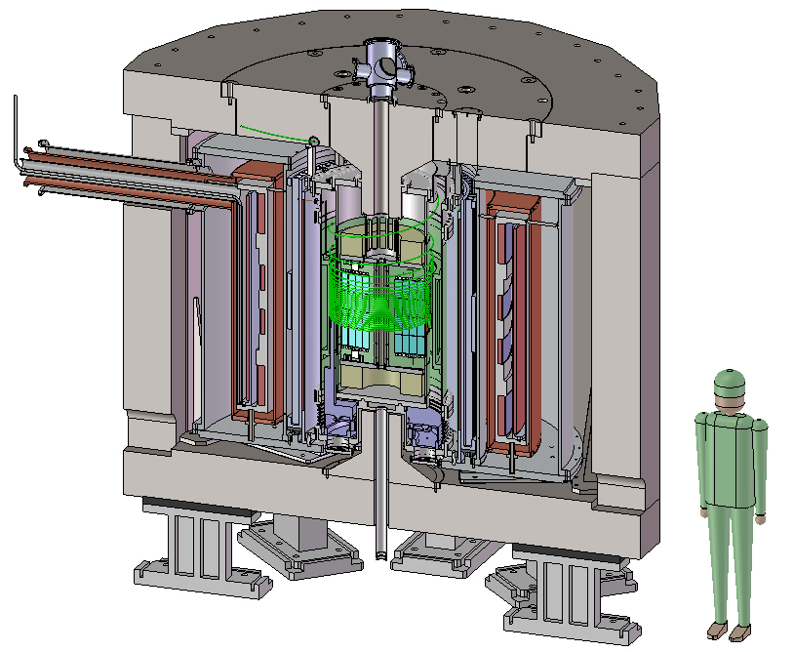
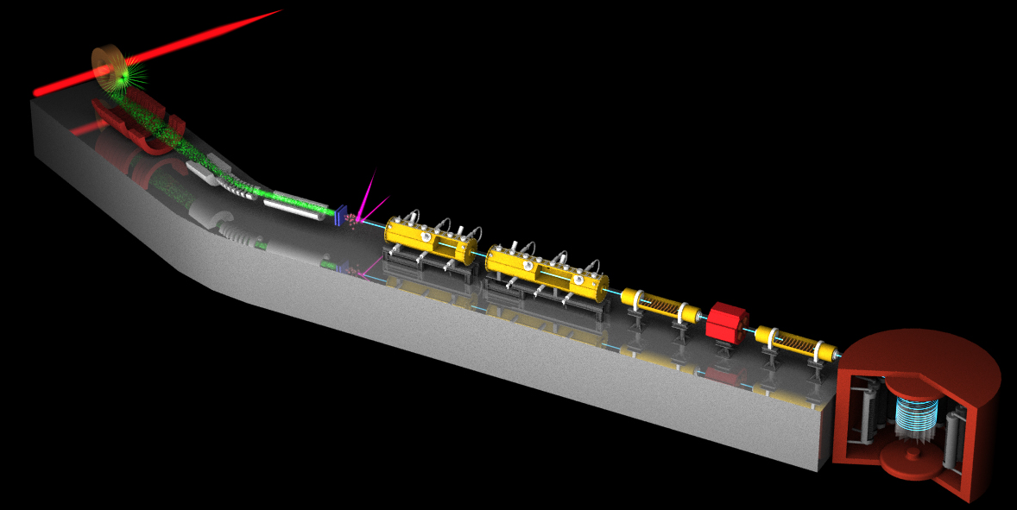
New Muon g-2/EDM Experiment at
J-PARC with Ultra-Cold Muon Beam
Silicon
Tracker
3 GeV proton beam
( 333 uA)
Graphite target
(20 mm)
Surface muon beam
(28 MeV/c, 3x10⁸/s)
66 cm
Muonium Production
(300 K ~ 25 meV⇒2.3 keV/c)
Surface muon
Super Precision Storage Magnet
(3T, ~1ppm local precision)
Ultra Cold μ+ Source
Muon
storage
Resonant Laser Ionization of Muonium (~10⁶ μ⁺/s)
Muon LINAC (300 MeV/c)
Δ(g-2) = 0.1ppm
EDM 〜 10-21 e・cm

Slide 8
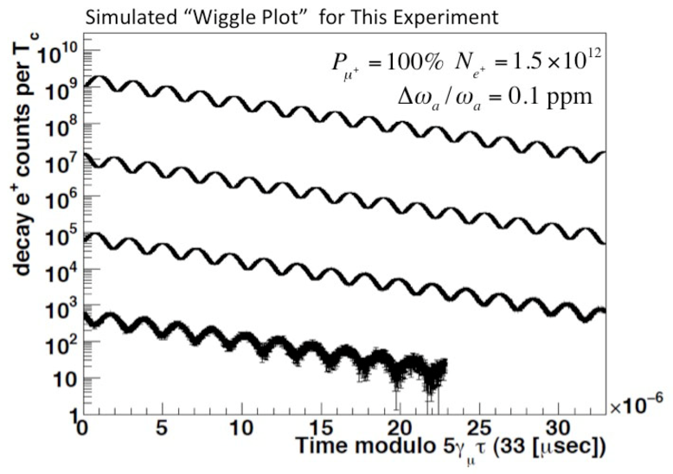
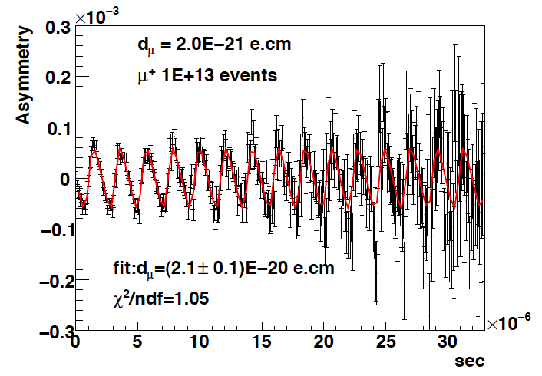
Expected time spectrum of e⁺ in μ→e⁺νν decay
p>200 MeV/c
d_{μ}=2E-20 e・cm
ω
number of e⁺
ω
Up-down asymmetry
∝EDM
e⁺ decay time (sec)
e⁺ decay time (sec)

Slide 9
Comparison of experiments
 | BNL-E821 | Fermilab | J-PARC
Muon momentum | 3.09 GeV/c |  | 0.3 GeV/c
gamma | 29.3 |  | 3
Storage field | B=1.45 T |  | 3.0 T
Focusing field | Electric quad |  | Very weak magnetic
# of detected μ+ decays | 5.0E9 | 1.8E11 | 1.5E12
# of detected μ- decays | 3.6E9 | - | -
Target Precision (stat) | 0.46 ppm | 0.1 ppm | 0.1 ppm

Slide 10
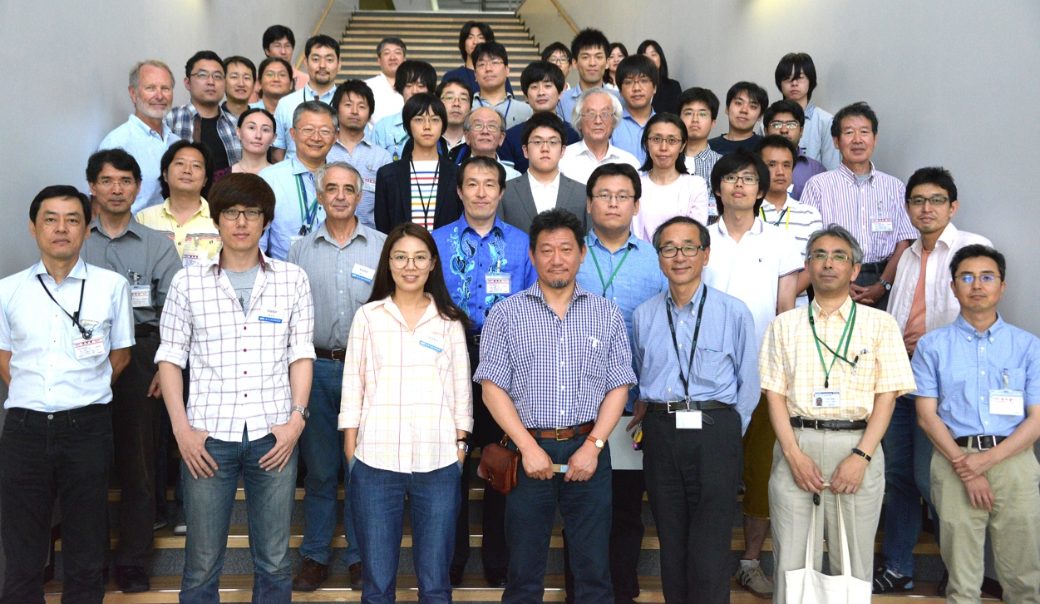
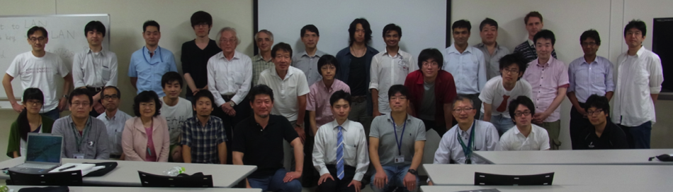
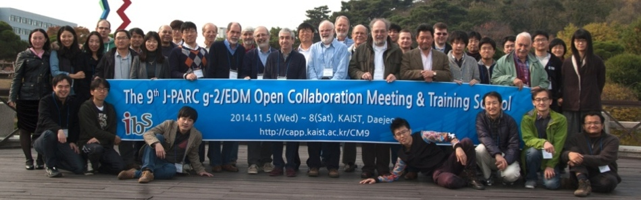
E34 collaborators
Collaborators
  Proposal (2009） ７２
  Conceptual Design Report (2011） ９２
  Technical Design Report (2015) １３６（16 graduate students）
  （27 also in COMET）
９ countries, 49 institutions
  Canada, China, Czech, France, Japan, Korea, Russia, UK, USA (in alphabetical order)
J-PARC 2015.6
J-PARC 2014.9
KAIST (Korea) 2014.11
Dec 2009 : Proposal submitted
Dec 2012 : CDR submitted
Jan 2013 : Stage-1 status granted from PAC (IMSS,IPNS)
P34 →E34

Slide 11
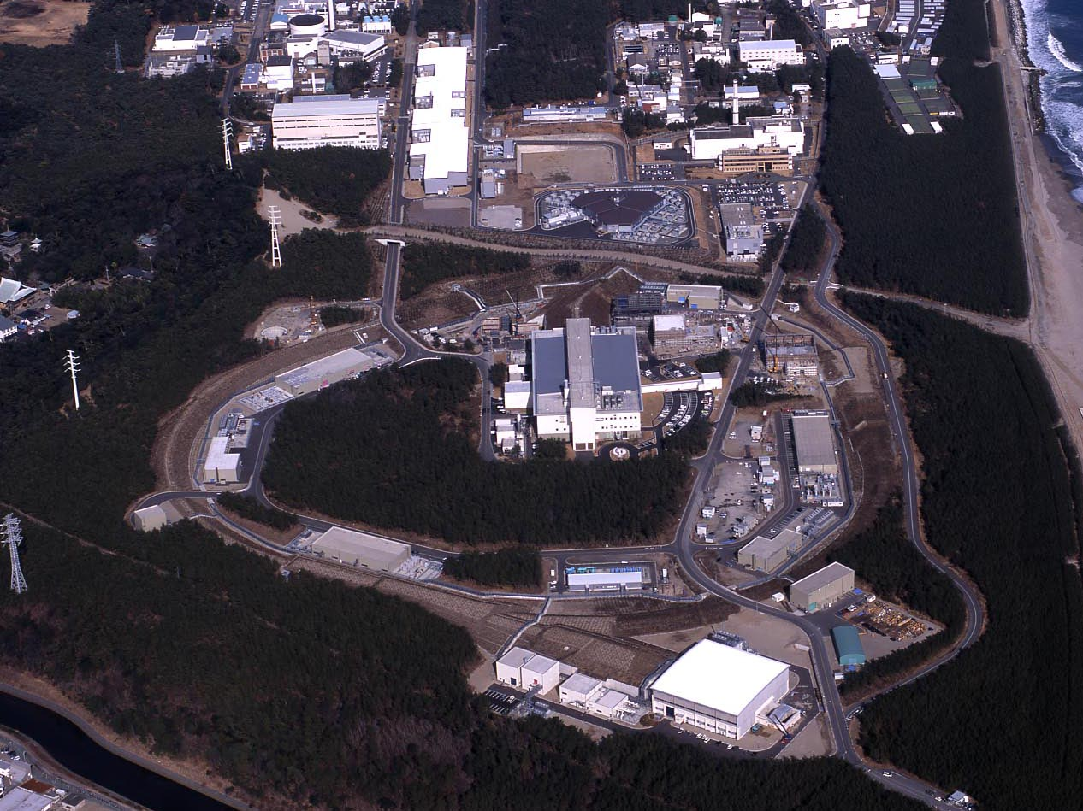
J-PARC Facility
(KEK/JAEA)
LINAC
3 GeV
Synchrotron
Neutrino Beam
To Kamioka
Material and Life Science
Facility
Main Ring
(30 GeV)
Hadron Hall
Bird’s eye photo in Feb. 2008

Slide 12
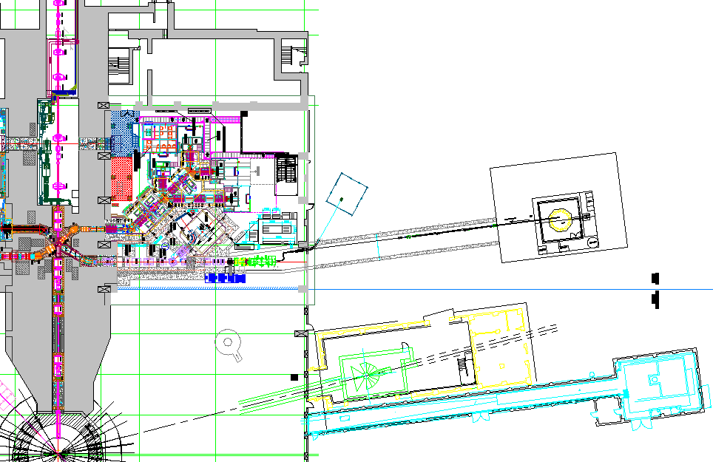
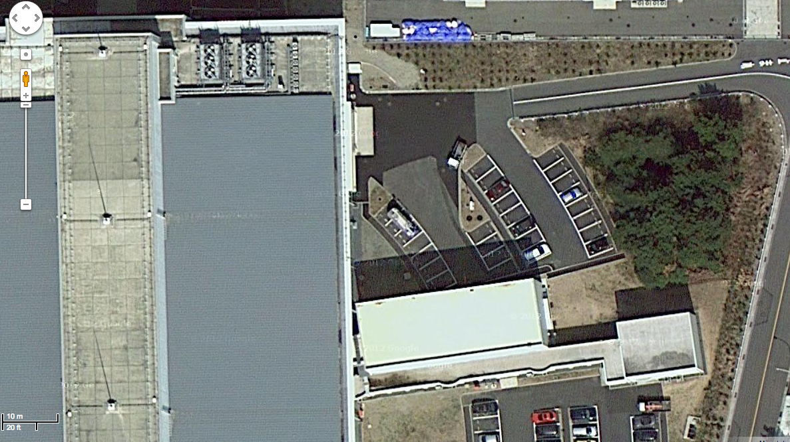
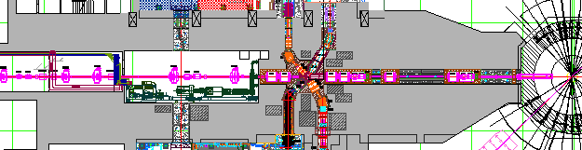
Proposed experimental site
Material and Life science Facility in J-PARC
Parking lot
g-2/EDM
storage magnet
H-Line
muon linac
muon
production
target
Mu-HFS
DeeMe
sparation neutron
source

Slide 13
TDR
Summary
TDR describes a technical design to achieve measurement of muon g-2 and EDM beyond BNL E821 precision.
  BNL E821 J-PARC E34
  g-2: 0.46 ppm → 0.37 ppm (→0.1ppm)
  EDM: 0.9 x 10⁻¹⁹ ecm → 1.3 x 10⁻²¹ ecm
prepared by 136 authors

Slide 14
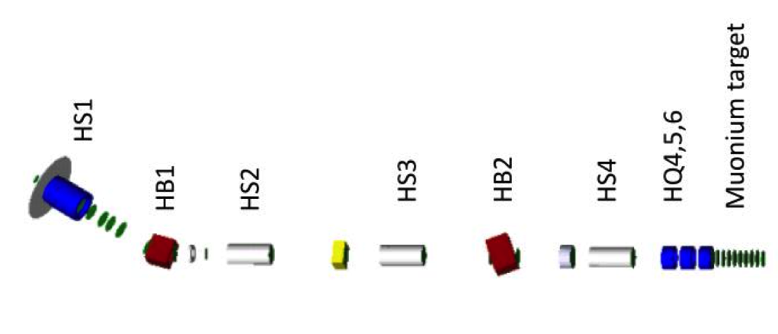
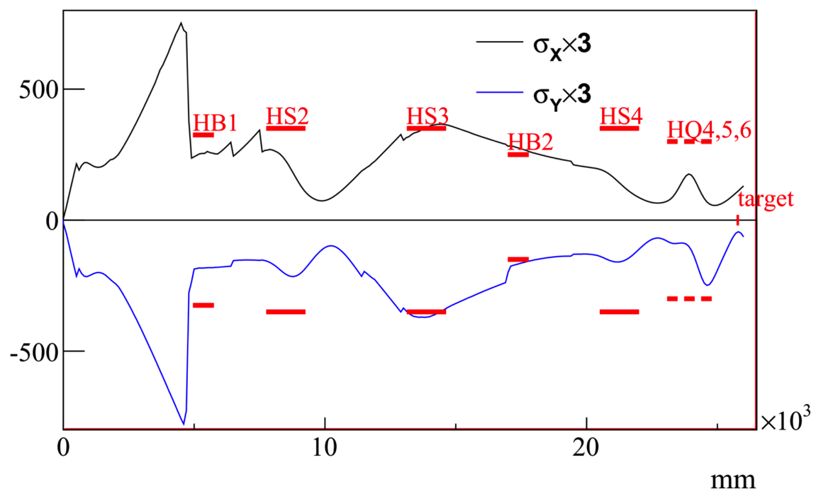
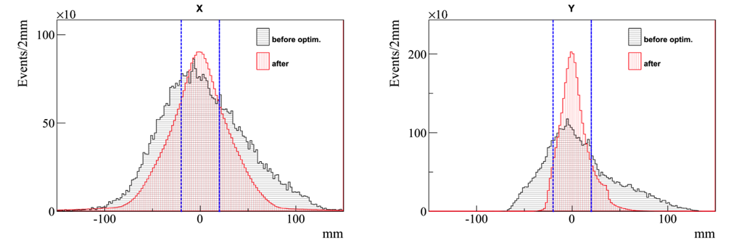
Surface muon beamline (H-line)
M. Otani, N. Kawamura
Beamline configuration
  Muon beam intensity was estimated by scaling from measured intensity at D-line (200kW) and simulated beam transport efficiency 16%:
  3.2 E+8/sec (w/ SiC)
  on Mu production target
  at 1MW
installed
in preparation by IMSS
Envelope (mm)
(G4beamline)

Slide 15
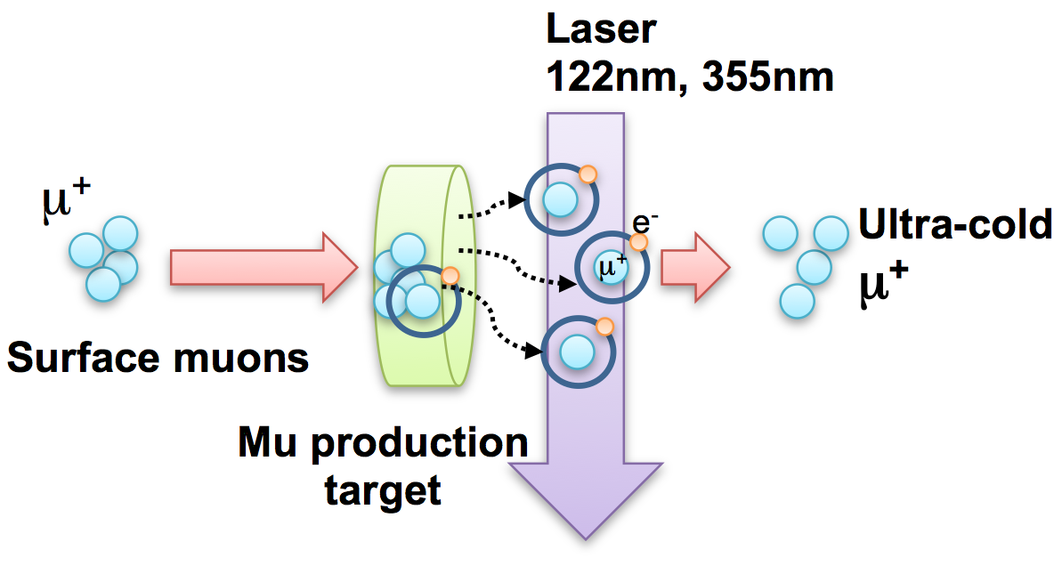
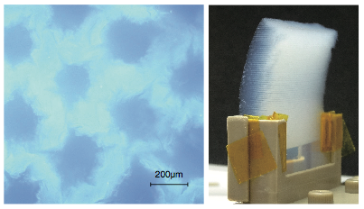
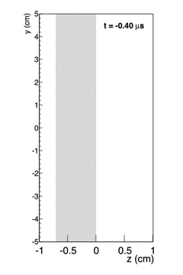
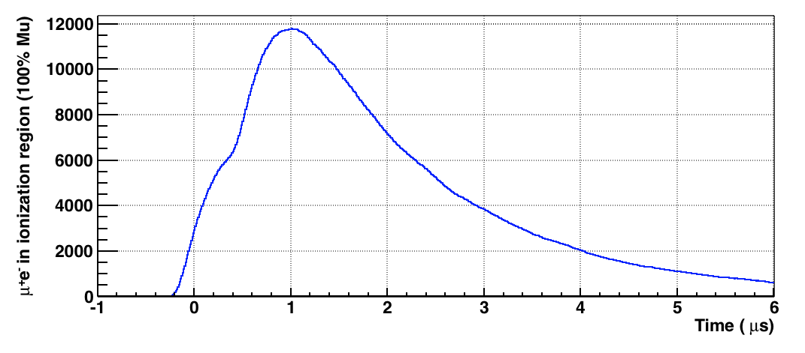
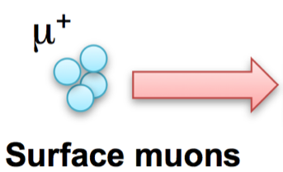
Muonium production
RIKEN, TRIUMF, UVic,
Chiba, Korea U, KEK
Mu production target
(laser-ablated silica aerogel)
3x10⁸/sec
9x10⁵/sec
G. Beer et al., Prog.Theor.Exp.Phys. (2014)091C01
Laser timing
ε(surface μ→ Mu) = 3.8E-3
Simulation
in J-PARC condition
double pulses
(0.6 μs interval,25Hz)
Elapsed time
1st pulse 2nd pulse

Slide 16
Ultra slow muon source summary
Proton
Surface muon transport
Mu production
Laser ionization
Extraction
energy 4 MeV 20 meV 20 meV ~100 eV
efficiency 0.16 0.0038 0.73 0.76
status to be ready ready evaluation evaluation

Slide 17
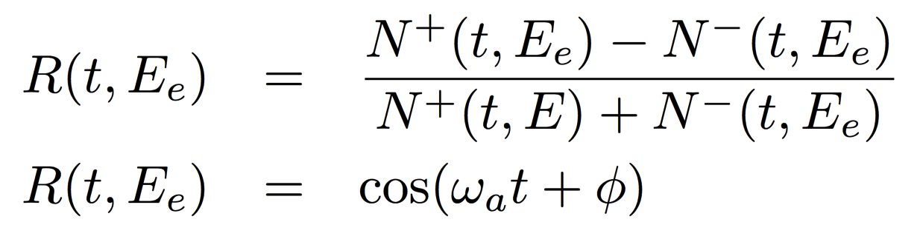
Spin reversal
(ONLY possible in J-PARC E34)
Raw time distribution
Asymmetry distribution
Simulation (w/ inefficiency)
Simulation (w/ inefficiency)
Plots by E. Won

Slide 18
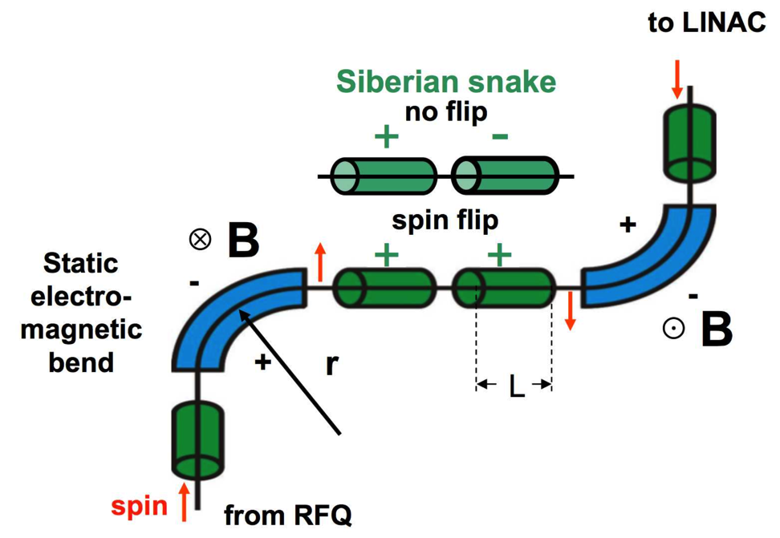
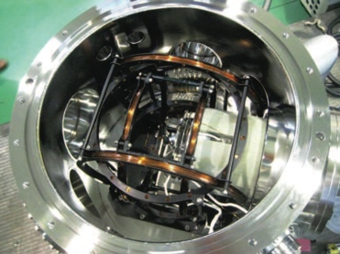
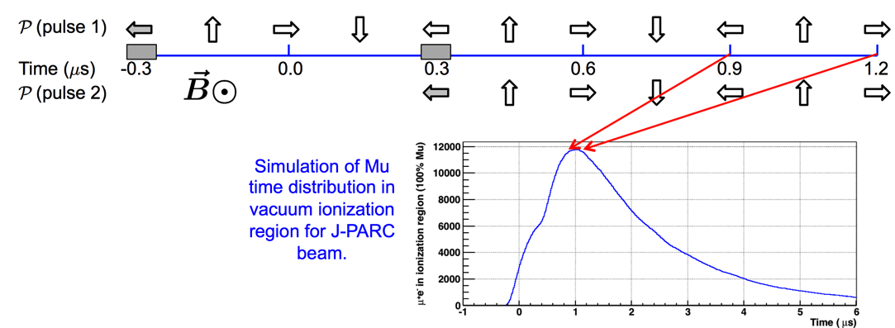
Spin reversal
(ONLY possible in J-PARC E34)
Two spin reversal apparatus are installed.
Flip at rest (Muonium)
In-flight flip
B = 1.9 kG
L = 22 cm
B=1.19 G
Ishida, Okada, Marshall
Satunov

Slide 19
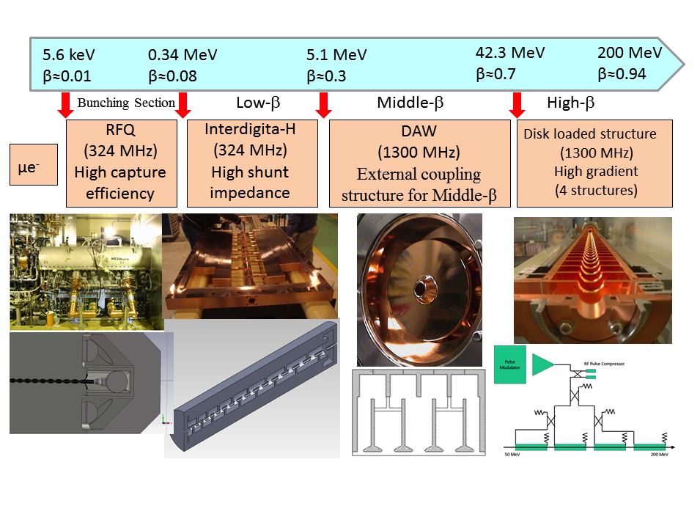
Adopted technology for muon acceleration
Bunching
Section
External coupling
structure for low-β
Similar to electron
accelerator to obtain
high gradient.
High hunt impedance

Slide 20
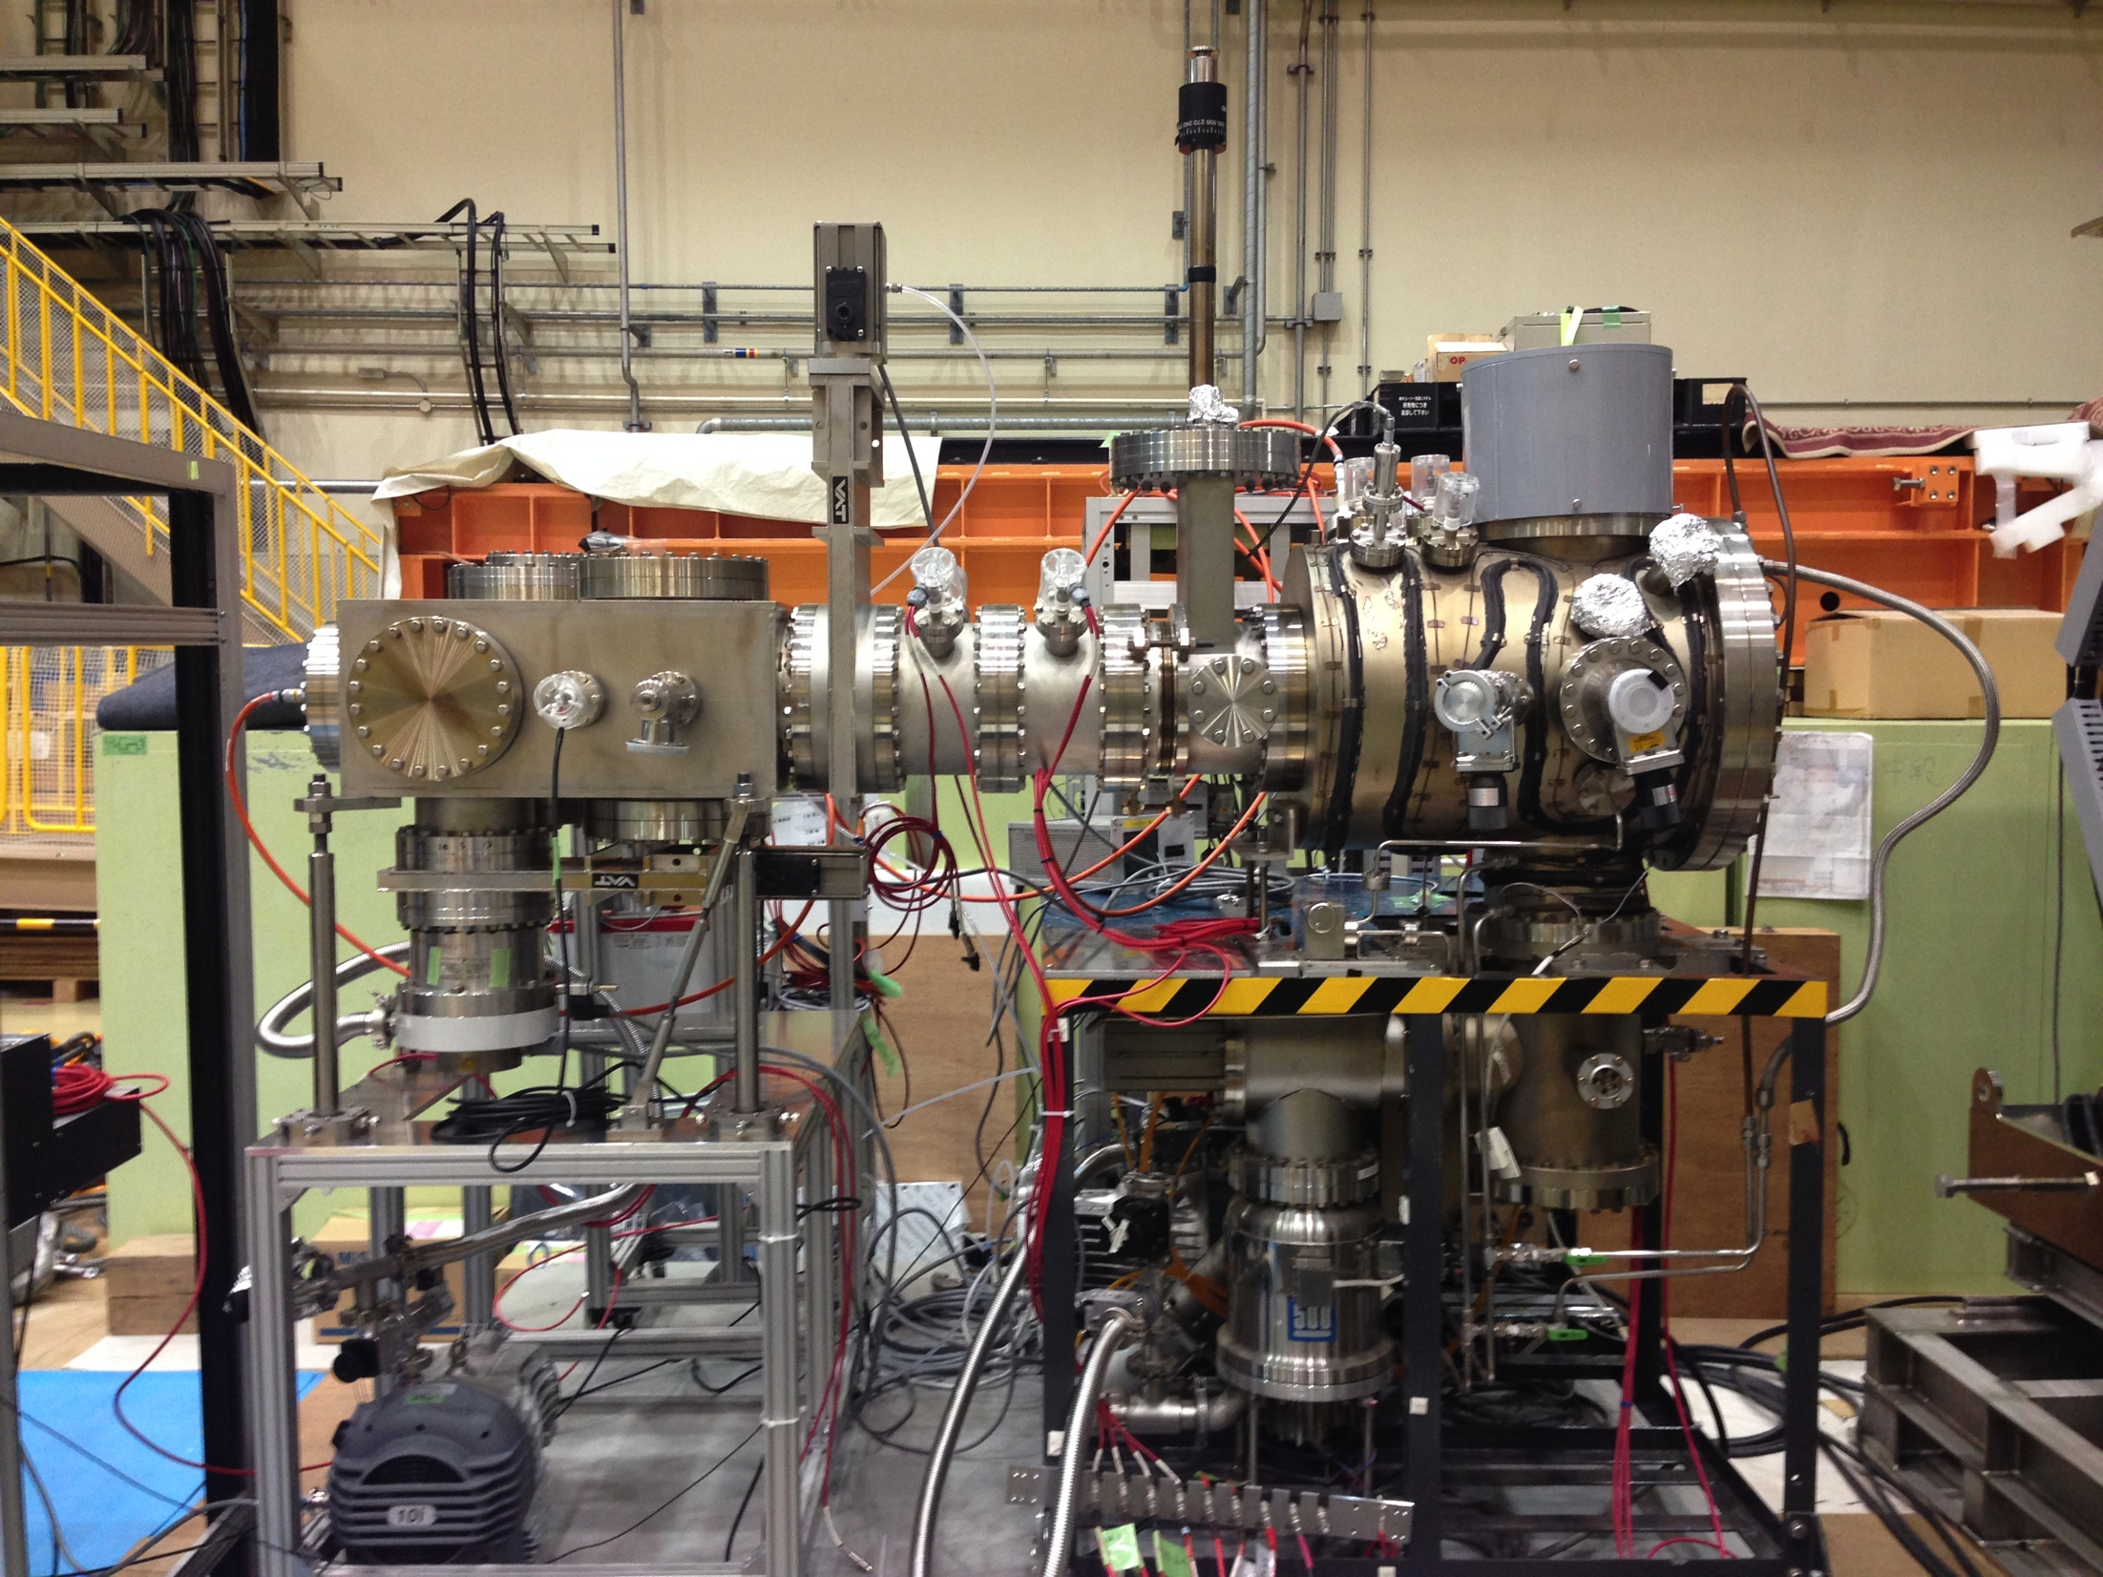
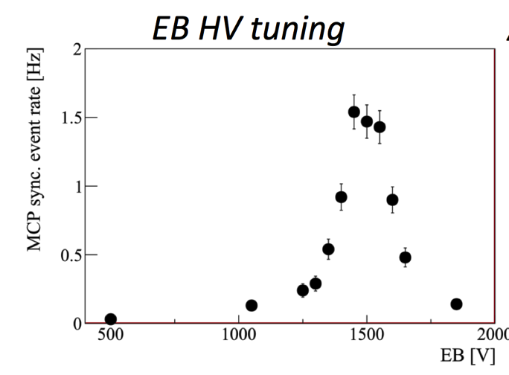
Muon acceleration studies at J-PARC
surface
muon beam
Energy
5.4 keV
photo-electron signal at end
Electric
Quads.
Mu target
Electrodes
viewport
for laser
Main apparatus were recycled from RIKEN-RAL port-3
To be commissioned with Mu- at MLF D-line

Slide 21
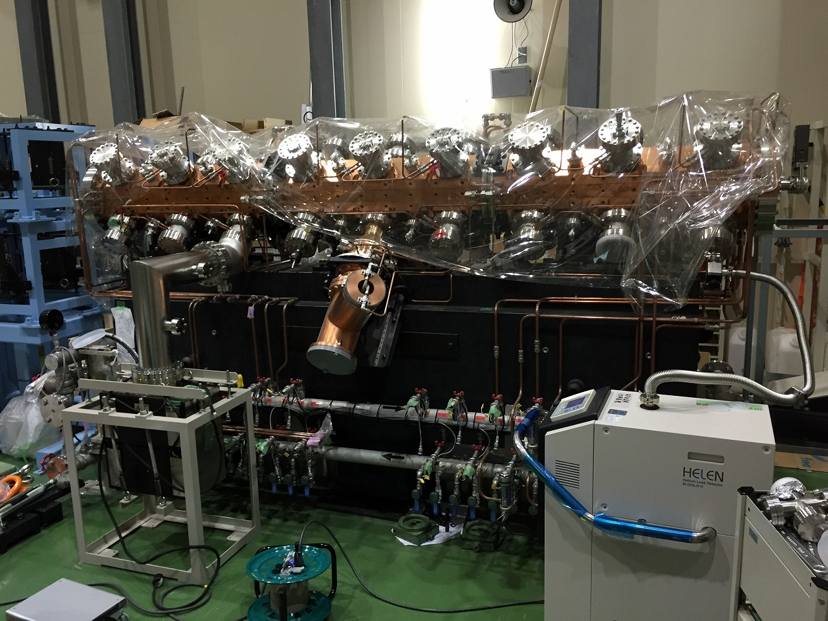
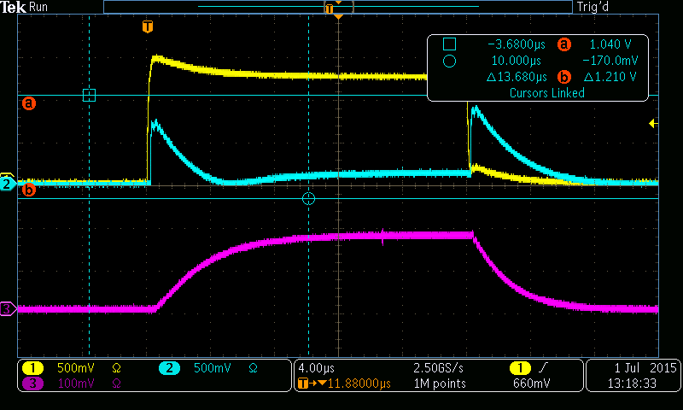
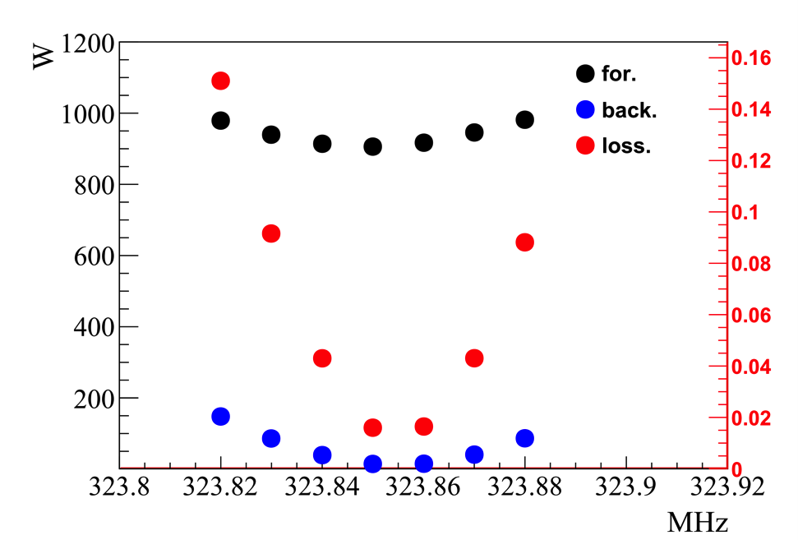
RFQ offline test at J-PARC
Y. Kondo, M. Otani
Data taken in July, 2015
Back.
For.
RFQ in

Slide 22
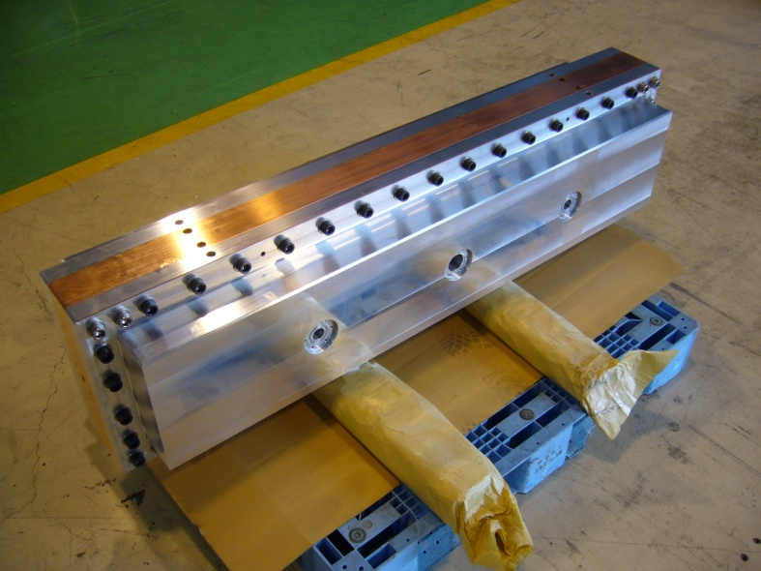
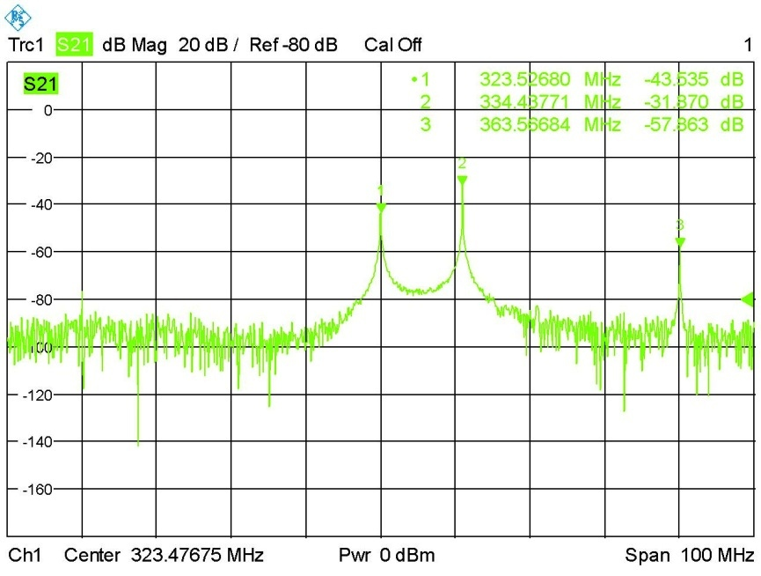
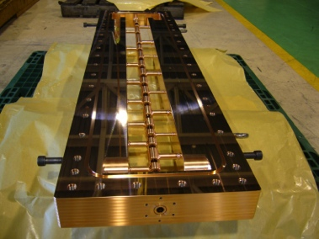
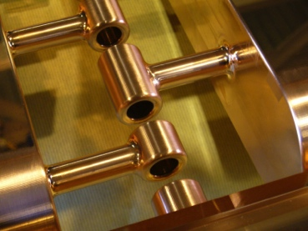
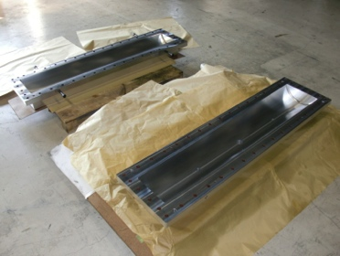
Muon IH prototype
Hayashizaki (TITECH) et al.
Side shells
(Aluminum)
Center plate (OFC)
1st mode： 323.5 MHz（operating mode）
2nd mode：334.4 MHz
3rd mode：363.6 MHz

Slide 23
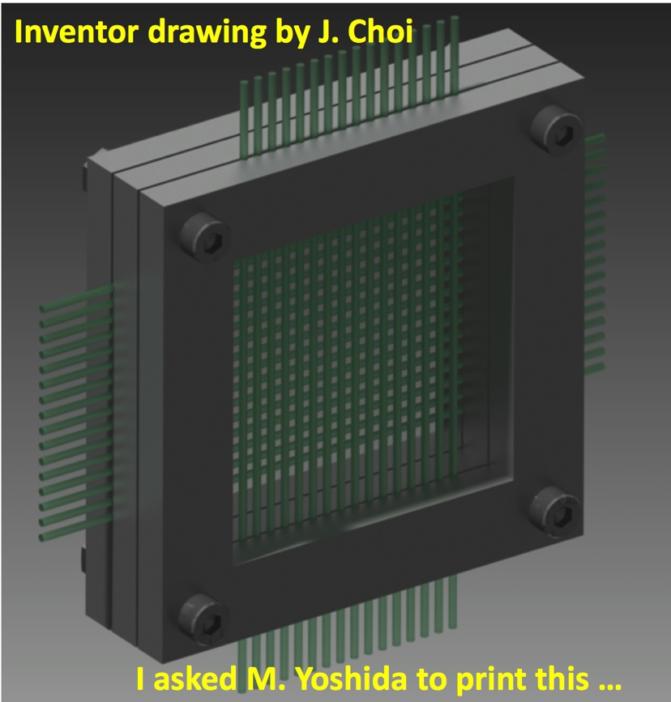
Muon BPMs
BPM for low energy muon
(less than 1 MeV)
BPM for higher energy muon
(more than 1 MeV)
Scintillation fibers
(φ1mm)
To be tested with muon beam
B. Kim (SNU)
E. Won, J. Choi (Korea U)

Slide 24
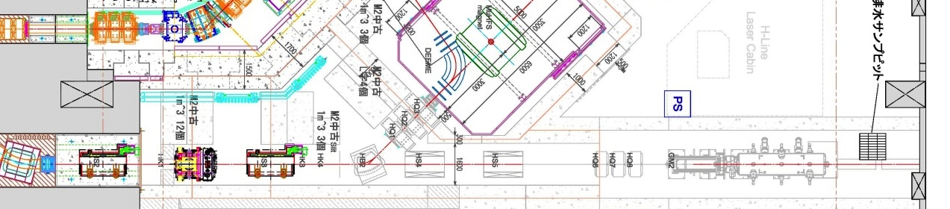

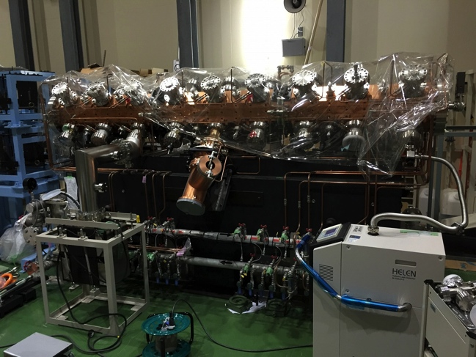
Muon acceleration test
World first muon accelerator!
MLF MUSE H-line
acceleration part
Surface muon transport
E=4MeV
E=25meV
E=340keV
installed
Funding requested from IMSS
Ready for installation
Mu/Mu- production Electro-static accel.
RFQ
Beam monitor
A short extension of muon transport line + shield will make this possible.

Slide 25
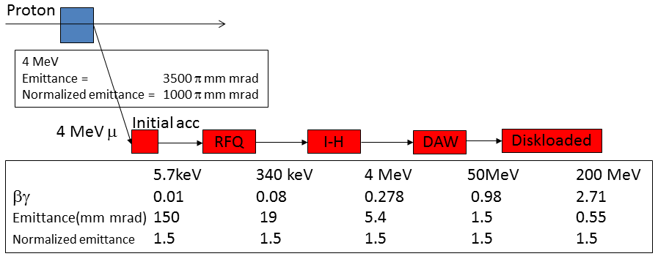
Muon acceleration summary
transmission 0.72 0.95 1.00 1.00 0.98
decay survived ↑ 0.81 0.98 0.99 0.99
status ready ready evaluation prototype prototype

Slide 26
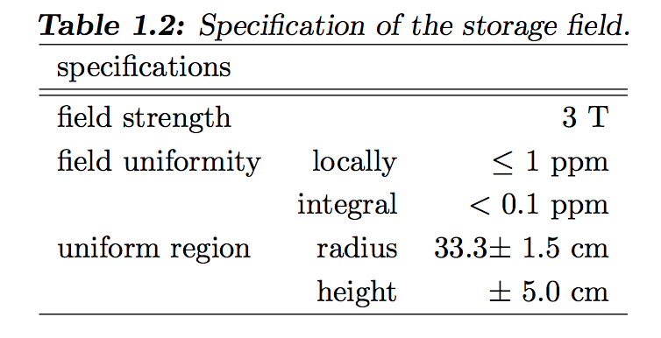
Muon storage magnet and detector
Iron yoke
Cryogenics
Muon storage orbit
2900 mm
e+ tracking
detector
Super conducting coils
666 mm
26
26

Slide 27
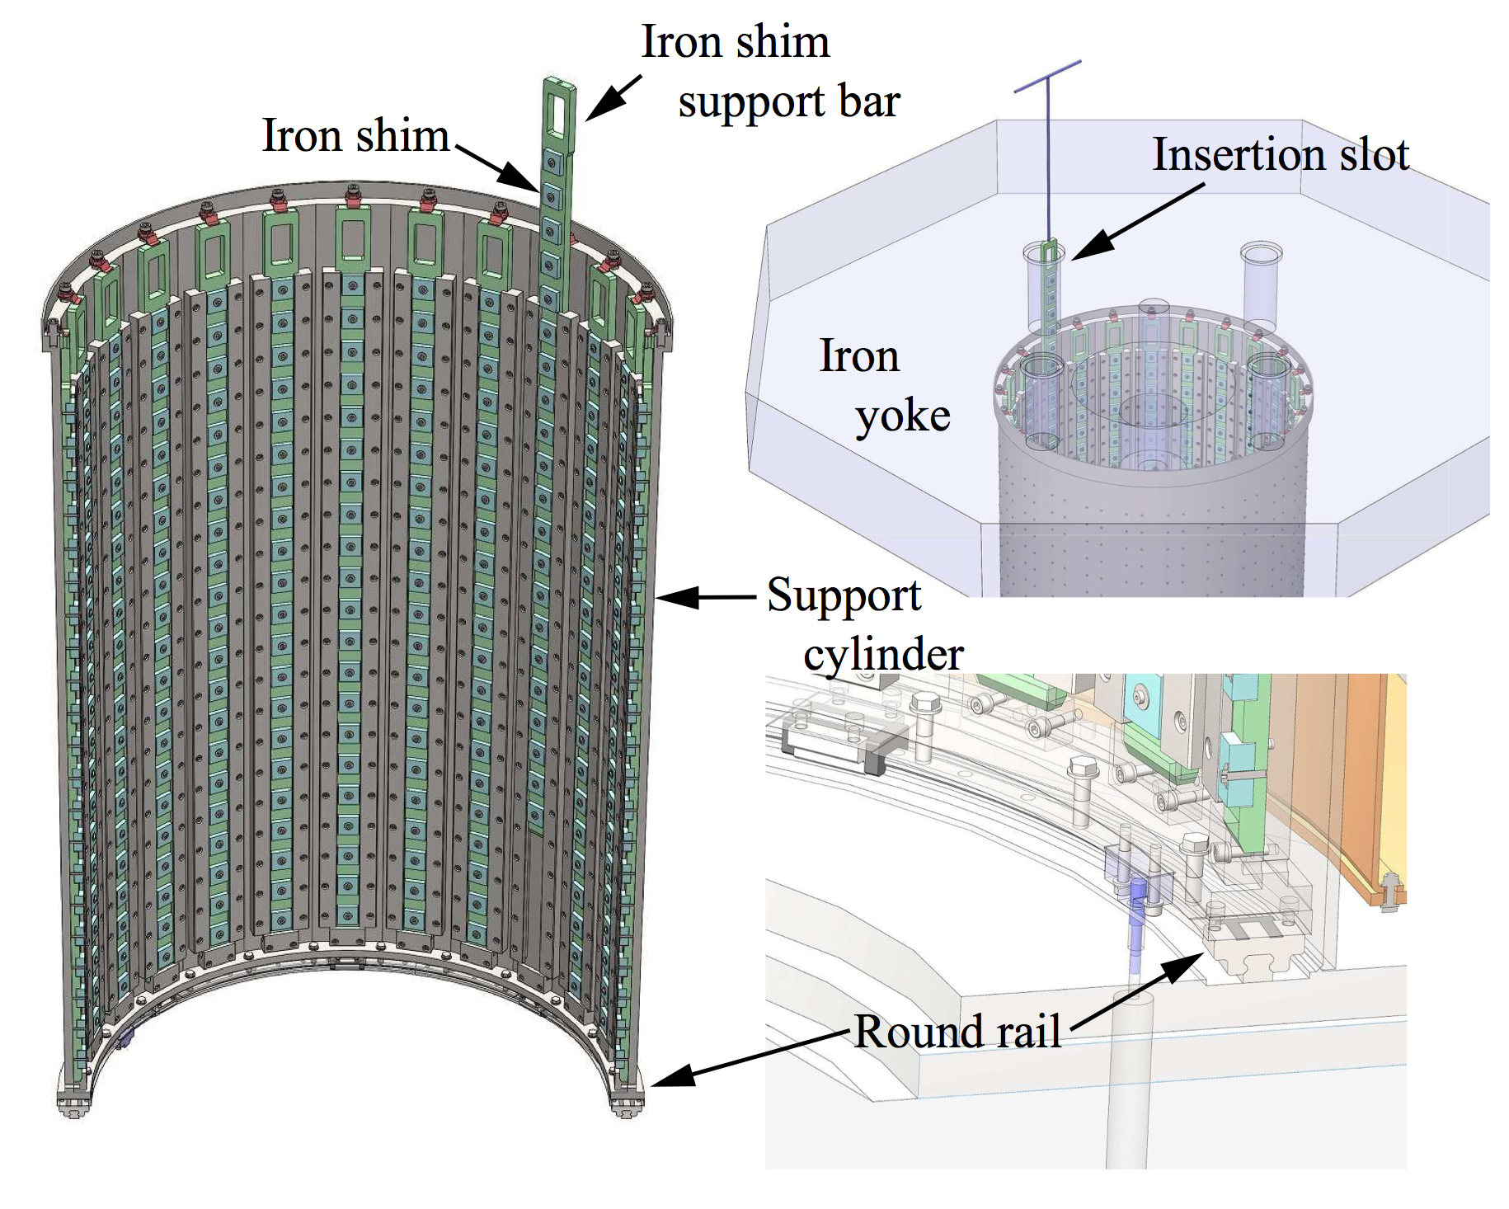
Organization of iron shim arrays

Slide 28
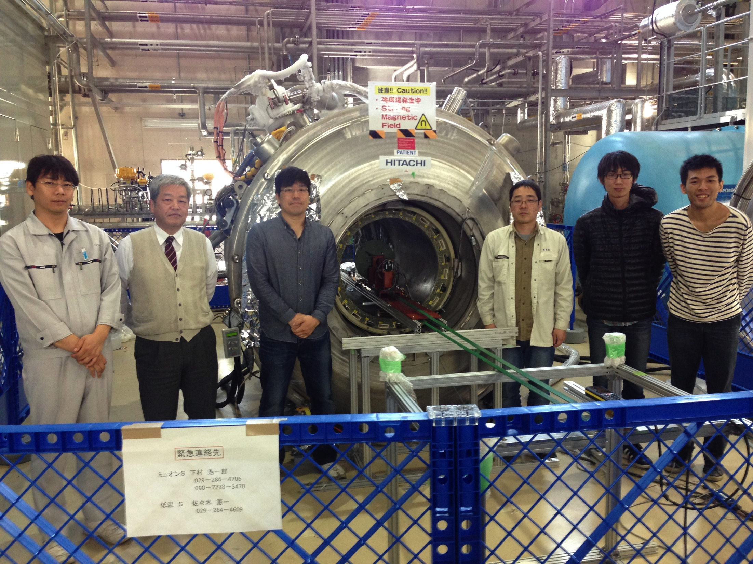
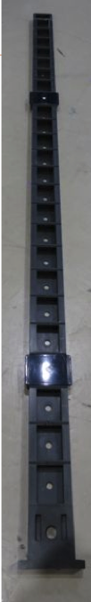

B-field shimming test with a medical MRI magnet (1.7 T) at J-PARC
Shim tray

Slide 29
Field shimming by iron arrays
Plots by K. Sasaki
Before shimming
600 ppm
B(μT)
-1000 ppm
azimuthal angle (rad)
axial position (mm)
0.6 ppm
After shimming
B(μT)
-0.8 ppm
r = 140 mm
azimuthal angle (rad)
ppm-level uniformity
is achieved.
axial position (mm)

Slide 30
Positron tracking detector

Slide 31
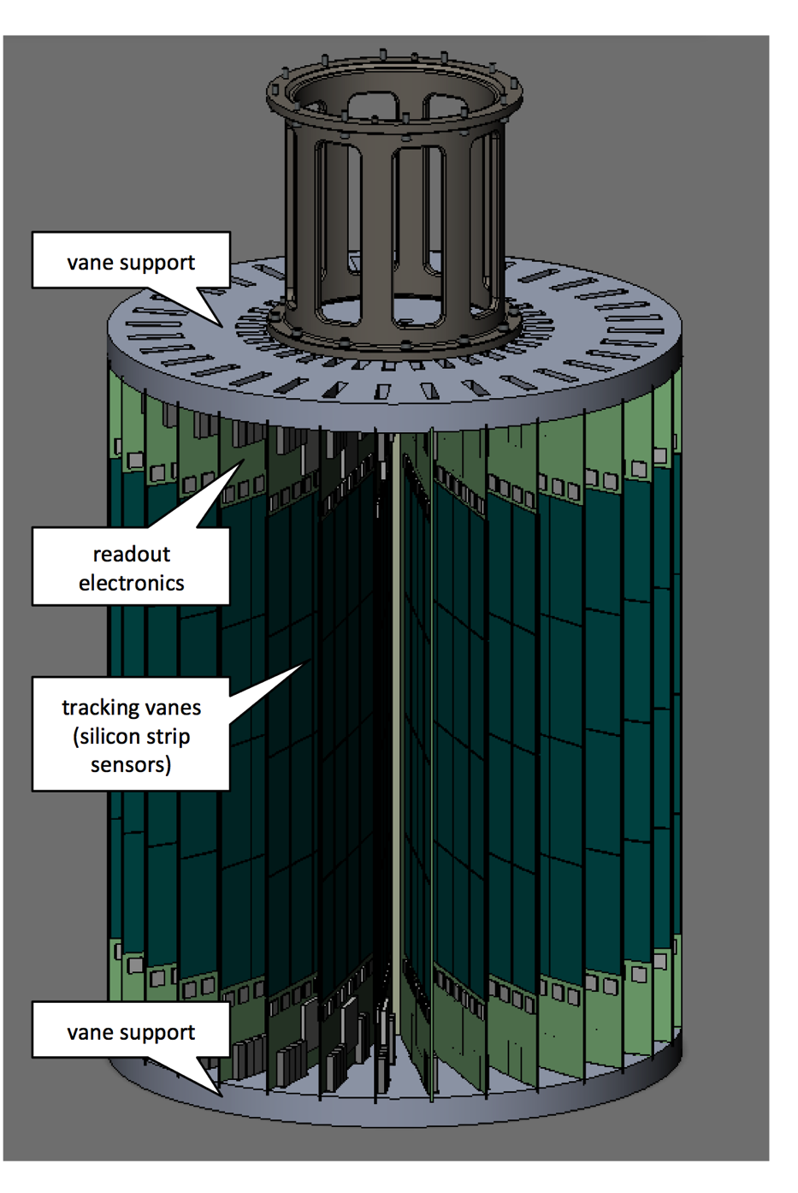
Positron tracking detector
M. Sakurai, N. Shoichiro
Detector construction fund (~1.5M USD) was approved.
Postdoc opportunities : http://inspirehep.net/record/1394918

Slide 32

Track reconstruction
A typical simulated event of muon decay (p = 200 MeV/c)
Full acceptance coverage
Track angle information → Sensitivity to muon EDM

Slide 33







Silicon strip tracker
Detector module
Frontend
electronics
Silicon sensors
400mm
Test Si-strip sensor (KEK, Kyushu)
128ch FE ASIC (KEK, Kyushu)
e+ 200MeV
(Tohoku)
Voltage (mV)
DC-DC convertor (Korea U)
Construction budget (~1.5 Oku yen, Kakenhi-S) was approved.
Time (ns)

Slide 34
Projected statistical sensitivity
With presently established design, one expects
  Ultra-cold muon intensity : 3.3E+5/sec [1.0E+6/sec]
  Statistical uncertainty on a_{μ}: 0.37ppm
  Statistical uncertainty on d_{μ}: 1.3E-21 e・cm
    Running time = 2E+7 sec, polarization = 50%
design
E821
0.46ppm
9E-20 e・cm
Already good enough to test BNL E821 results.

Slide 35
Summary
J-PARC E34 aims to measure muon g-2 and EDM with ultra-cold muon beam.
Progress
  Technical design report
  A part of construction budget was approved.
    Postdoc opportunities
Intended to start data taking from 2019.
New technologies
  Polarized thermal Muonium atoms
  Polarized muon acceleration

Slide 36

Summary of experimental conditions

Slide 37

Muon beam intensity
1MW, SiC target are assumed.

Slide 38
Technically driven schedule
Assumption : Major construction fund become available in JFY2016
Note : Detector construction fund (Kakenhi-S) is available.

Slide 39



Transport beam line and injection
Bend 12.5°
Injection
LINAC EXIT
Bend beam and control dispersion zero
Apply X-Y coupling
Free drift LD=350cm
Storage magnet
8.8m
Super conductive solenoid magnet
μ⁺beam
tunnel
¼ model (OPERA)
H. Iinuma, H. Nakayama

Slide 40




Kicker and weak focusing field
Radial field distribution
Pulsed Radial field ;
B_{kick}(t)=B_{peak} ×sin(ωt) ×exp(-t/τ)
ω=π/T_{kick}
  T_{kick}~500nsec
  Peak field B₀~2 gauss
2pairs of coil, pulsed high current
I(t)=I_{peak} ×sin(ωt)
I_{peak} ∼100A/coil
Decay loss ~ 1%
Weak magnetic focus n = 1.5E-4
FLDATA-20130620.txt
±10mm
Simple harmonic motion volume
Zoom up
±0.3mrad
Kick!!
Vertical phase space
2014/11/7
H. Iinuma, H. Nakayama

Slide 41

Specifications: USM source
Item | Specifications
Mu production target | laser-ablated silica aerogel (30 mg/cc, φ50 mm, 8 mm thick)
Laser ionization region | 1-6mm from the target surface
Target electrode voltate | 5 kV
Mesh | 88% opening
SOA voltages | 4.8 kV → GND
SOA aperture | 240 mm

Slide 42





Specifications: surface muon transport
ESS

Slide 43



Specifications: LINAC
RFQ
324MHz APF IH-DTL
IN
OUT
Operation parameters (IH-DTL ver.153)
Frequency [MHz]
324
Length of IH-DTL [mm]
1440
Number of Gaps [gaps]
17
Electric field on the axis [MV/m]
9.00
Average bohr radius [mm]
7.5
RF Power [kW]
168
Q value
11822
Shunt impedance [MΩ/m]
56.6
Input energy [keV]
340
Output energy [MeV]
3.75
Acceptance [πmm-mrad]
1.8

Slide 44



Specifications: LINAC
DAW
Disc-loaded structure
Operation frequency 1300 MHz
Input beam energy 42 MeV
Output beam energy 200 MeV
Field gradient ~20 MV/m
RF power 40 MW
Total length ~10 m
Power source
821 mm

Slide 45




Specifications: Injection line & kicker
Item | Specifications
Inner radius | 300 mm
Outer radius | 360 mm
Coil separation | 350 mm
Pulse shape | Sine or half-sine
Kick time | 390 - 655 ns
Peak B-field | 2 Gauss

Slide 46




Specifications: storage magnet

Slide 47



Specifications: Silicon strip tracker

Slide 48



Specifications : Silicon strip tracker
Detector module
Item | Specifications
Fiducial volume | 240mm (radial) x 400 mm (axial)
Number of vane | 48
Sensor technology | Single-sided Silicon strip sensor (p-on-n)
Strip | axial-strip : 100mm pitch, 72mm long , 1024 ch radial-strip: 188mm pitch, 98mm long, 384 ch
Sensor dimension | 74 mm x 98 mm x 0.32mm
Number of sensor | 1152 ( 12 sensors per vane)
Number of channel | 811,008ch
Time measurement | Period : 33ms, Sampling time : 5ns
Frontend
electronics
Silicon sensors
400mm

Slide 49


Muonium HFS and μ_{μ}/μ_{p} ratio
Future g-2 experiments (~0.1ppm) require more precise determination of magnetic moment ratio μ_{μ}/μ_{p} (current uncertainty : 0.12ppm)
Photo by K. Sasaki
From g-2
measurement
From Muonium HFS
measurement
An improved measurement of Mu-HFS and μ_{μ}/μ_{p} is in preparation at J-PARC (KEK IMSS K. Shimomura et al.)
Picture by K. Tanaka

