Slide 1


Spin of the nucleon:
Experimental Overview
Gerhard K. Mallot /CERN-PH

Slide 2
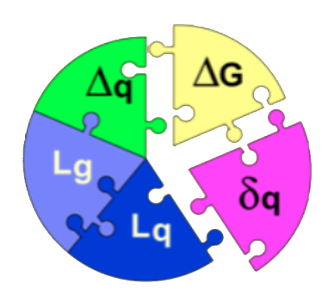
Outline
Introduction
DIS and SIDIS data
TMDs
GPDs
Outlook

Slide 3
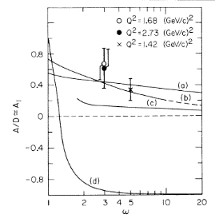
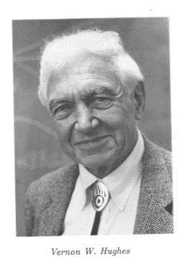
Introduction
Nucleon spin structure measurements are not easy
The start: 1971 approval of Yale-SLAC experiment E80, data 1976
After more than 4 decades we learned a lot …
… and new questions arose.
From collinear to TMD and 3D structure of the nucleon

Slide 4
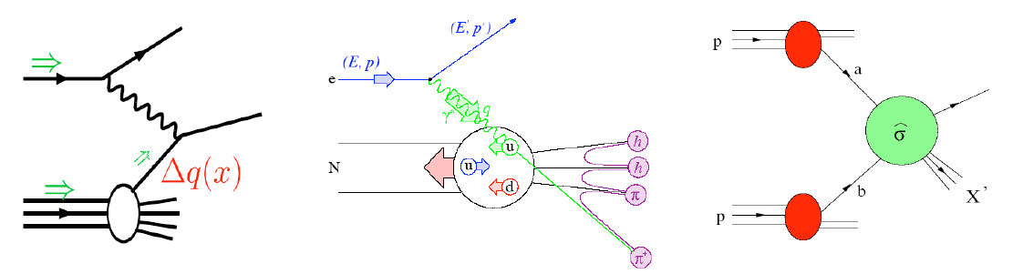
Tools to study the partonic nucleon structure
Factorisation of hard interaction and nonperturbative nucleon structure/fragmentation:
PDF parton distribution functions
FF fragmentation functions
DIS
SIDIS
pp
PDF
PDF⊗FF
PDF⊗PDF

Slide 5
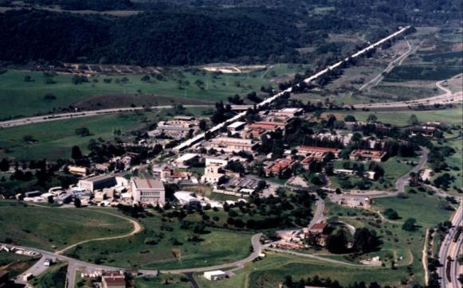
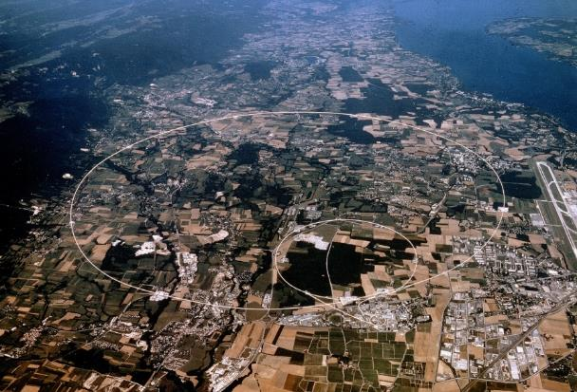
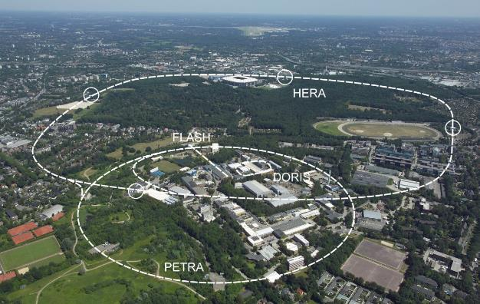
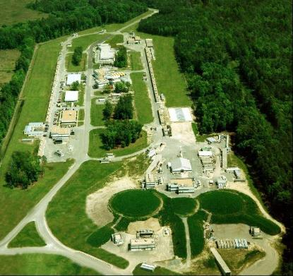
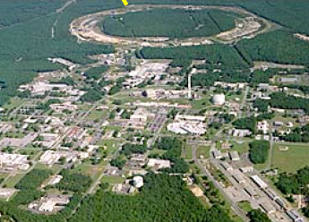
Laboratories
SLAC
CERN
49 GeV e–
160/280 GeV µ⁺
DESY
RHIC
JLab
27 GeV e±
6 GeV e – → 12 GeV
250+250 GeV pp

Slide 6
Global effort: Pol. DIS/pp
 | 1970 | 1980 | 1990 | 2000 | 2010
SLAC
CERN
DESY
JLab
RHIC
E80
E130
E142/3 E154/5
EMC
SMC
COMPASS I
HERMES
CLAS/HALL-A
EIC
Phenix/Star
A worldwide effort since decades

Slide 7





Kinematic reach
similar x ranges as in DIS and pp
much higher Q² in pp (RHIC: 250 + 250 GeV)
$$Q^{2}$$
[GeV²]
EIC
$$x$$

Slide 8
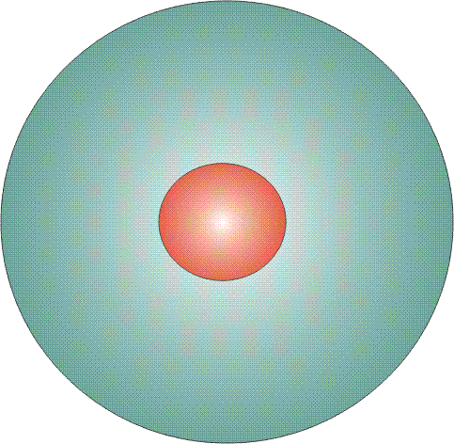
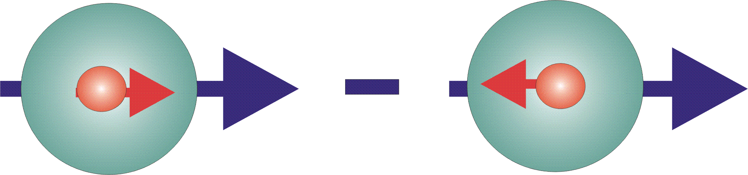

Structure: Parton Distribution Functions
Three twist-2 PDFs
q(x)
f₁^{q} (x)
unpolarised PDF
quark/gluon with momentum xP in a nucleon
Δq(x)
g₁^{q}(x)
helicity PDF
quark/gluon with spin parallel to the nucleon spin in a longitudinally polarised nucleon
transversity PDF
quark with spin parallel to the nucleon spin in a transversely polarised nucleon
Δ_{T}q(x)
h₁^{q}(x)

Slide 9
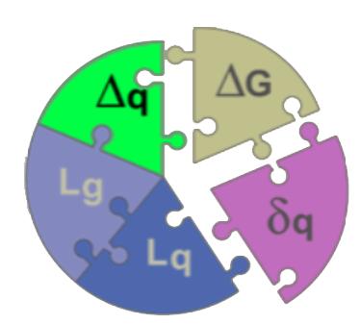
Quark polarisation

Slide 10
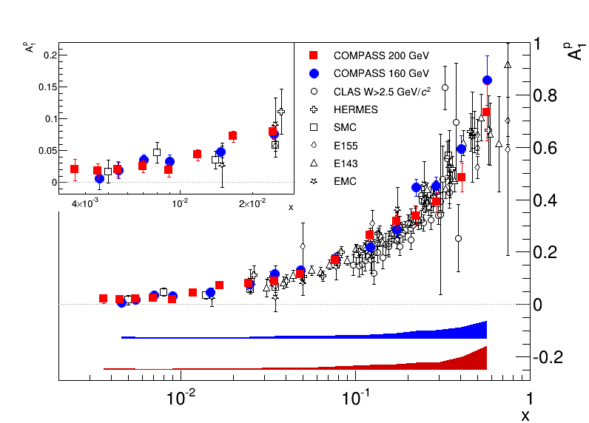
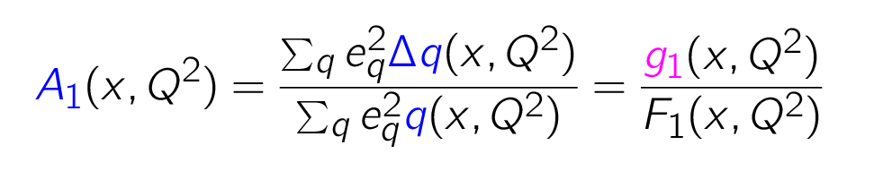

World data on proton A₁ spin asymmetry
$A_{1}\left(x\right)$ proton
+
arXiv:1503.08935
W > 2.5 GeV
inclusive scattering:

Slide 11

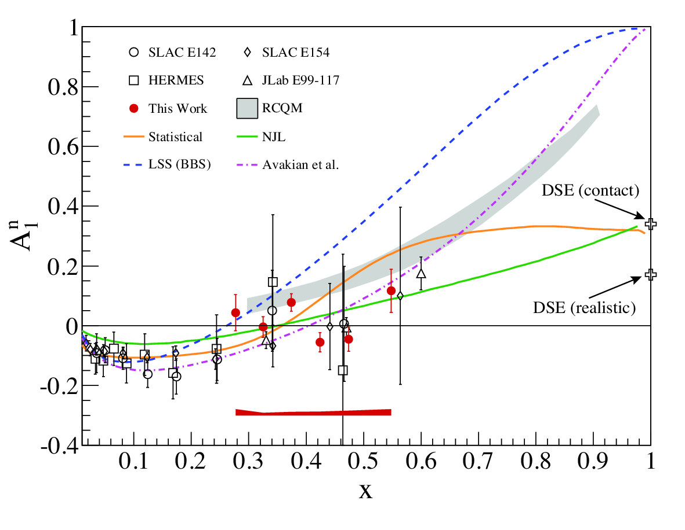

Hall A: precise $A_{1}^{n}$ data
Consistent with zero-crossing
around x = 0.5
³He gas target
PLB 744 (2015) 309–314

Slide 12
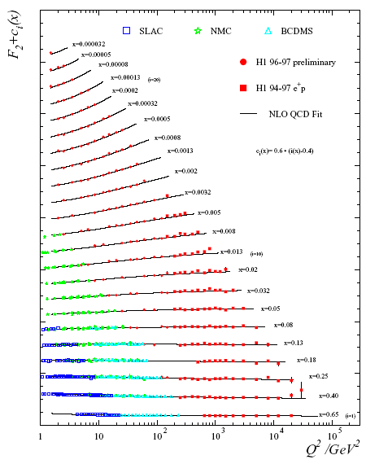
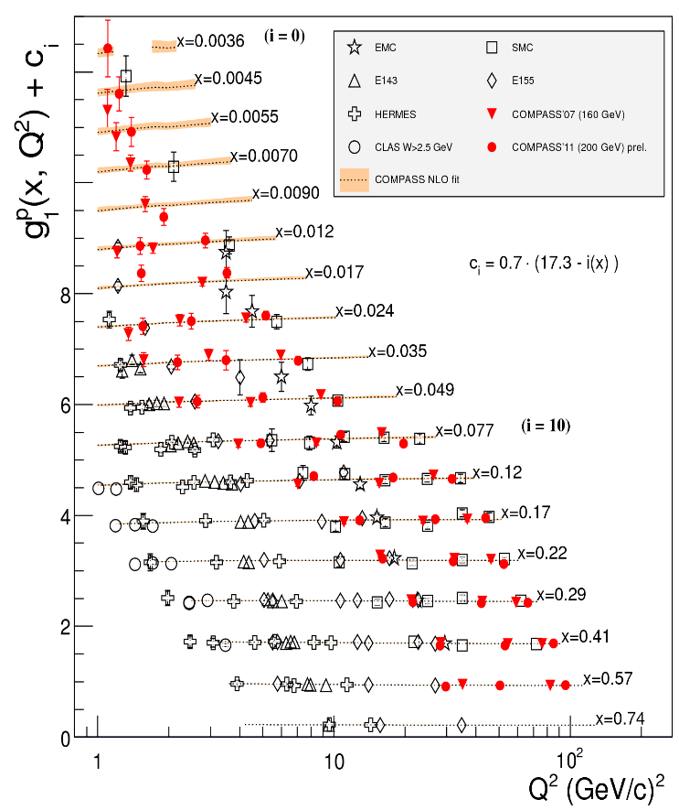
F₂(x,Q²)
g₁(x,Q²)
p
W > 2.5 GeV
arXiv:1503.08935

Slide 13

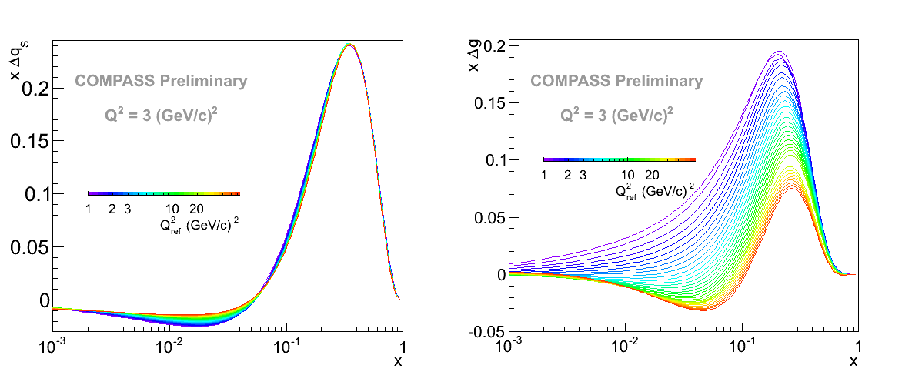


NLO QCD fit to world DIS data
study of PDF shapes, $Q_{\text{ref}}^{2}$ dependence
ΔΣ
Δg
$$Q^{2}=3 \text{GeV}\text{2}$$
arXiv:1503.08935

Slide 14
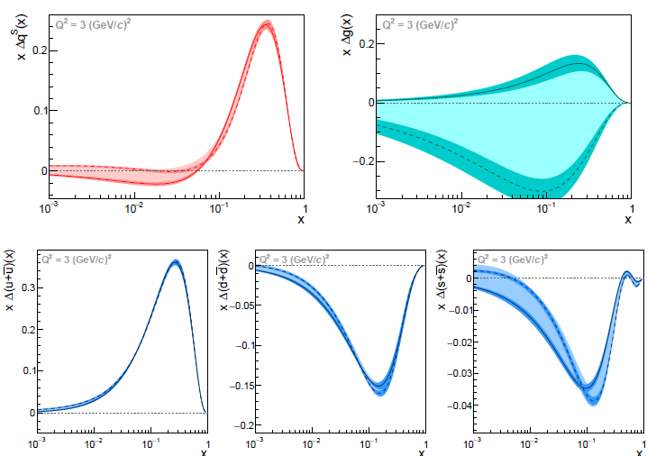



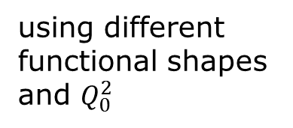

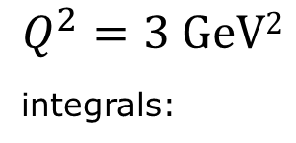

NLO QCD fit to world DIS data
$$Q^{2}=3 \text{GeV}\text{2}$$
^{integrals:}
ΔΣ
Δg
$$0.27≤ΔΣ≤ 0.39$$
$$−1.6 ≤ΔG≤ 0.5$$
$$0.82≤ΔU≤ 0.85$$
$$−0.45≤ΔD≤−0.42$$
$$−0.11≤ΔS≤−0.08$$
Δu
Δd
Δs
using different
functional shapes
and $Q_{0}^{2}$
arXiv:1503.08935
come back to World data fits incl. SIDIS and pp later

Slide 15
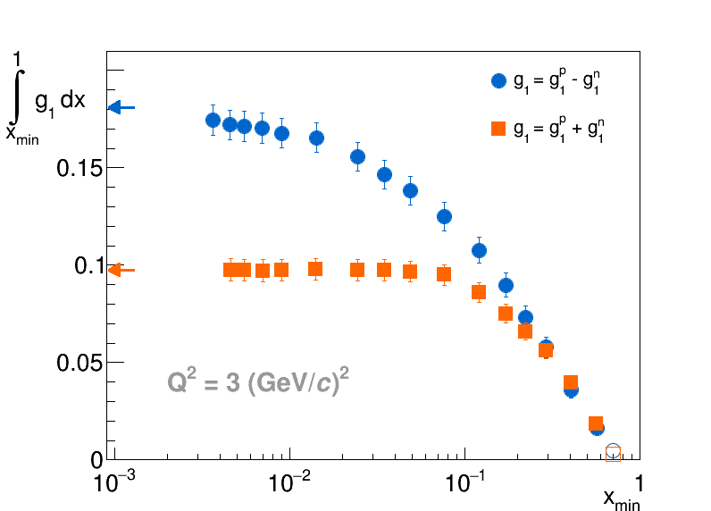
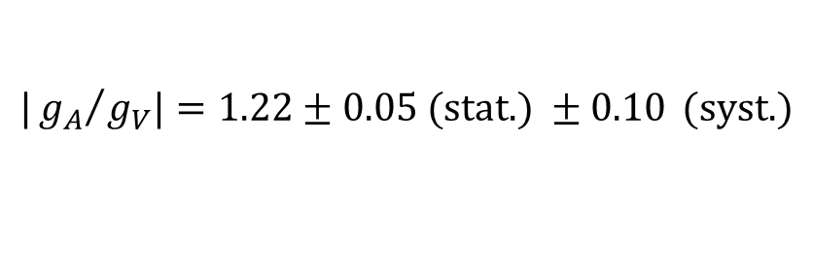

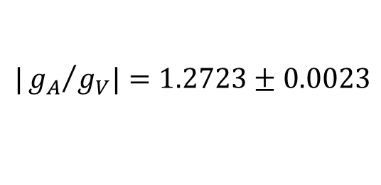
Sum rules
Bjorken
$$Γ_{1}^{NS}\left(Q^{2}\right)=\frac{1}{6}\left|\frac{g_{A}}{g_{V}}\right|C_{1}^{NS}\left(Q^{2}\right)$$
NS:
Si:
Bjorken sum rule
verified to 9%
`Ellis-Jafffe’
BJ SR major contribution
from small x
EJ SR no contribution
at small x
arXiv:1503.08935
COMPASS data only:
$$|{g_{A}}/{g_{V}|=1.22±0.05 (\text{stat}\text{.) }±0.10} (\text{syst}\text{.)}$$
from neutron β decay:
$$|{g_{A}}/{g_{V}|=1.2723±0.0023}$$

Slide 16
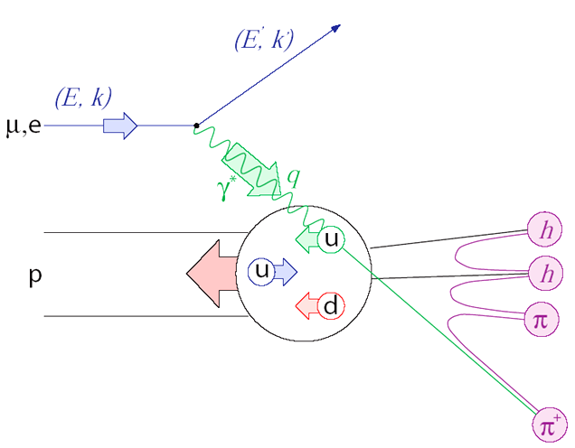
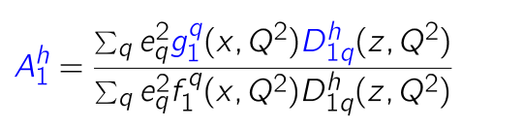

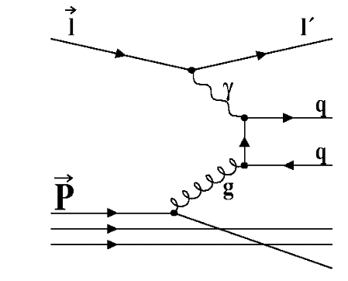
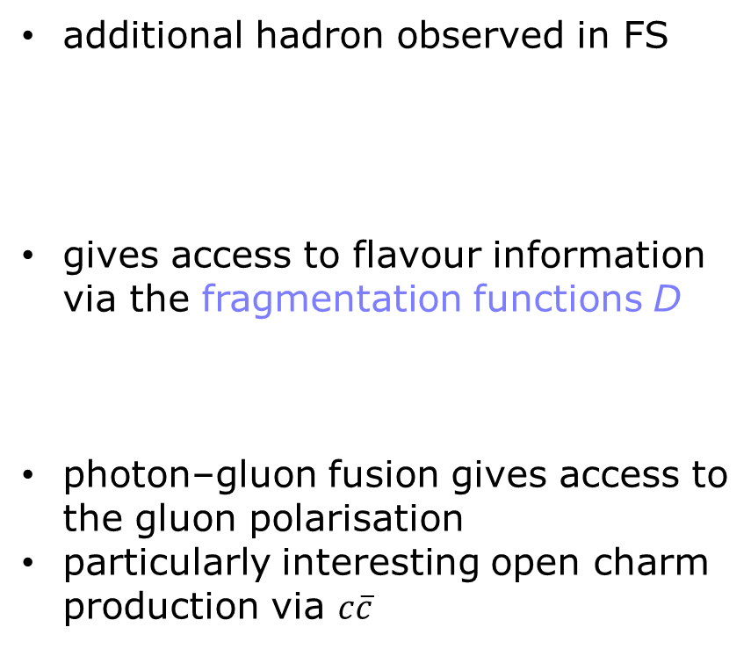
Semi-inclusive DIS results
additional hadron observed in FS
gives access to flavour information
via the fragmentation functions D
photon–gluon fusion gives access to
the gluon polarisation
particularly interesting open charm
production via $c\overline{c}$

Slide 17
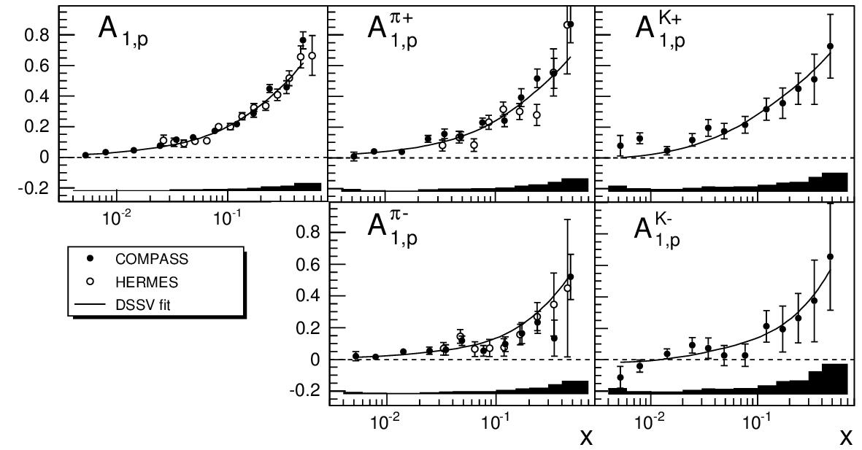
Incl. & semi-incl. A₁
Compass and Hermes data for proton
similar data for deuteron
incl.
π⁺
K⁺
PLB 693 (2010) 227–235
π –
K⁻

Slide 18
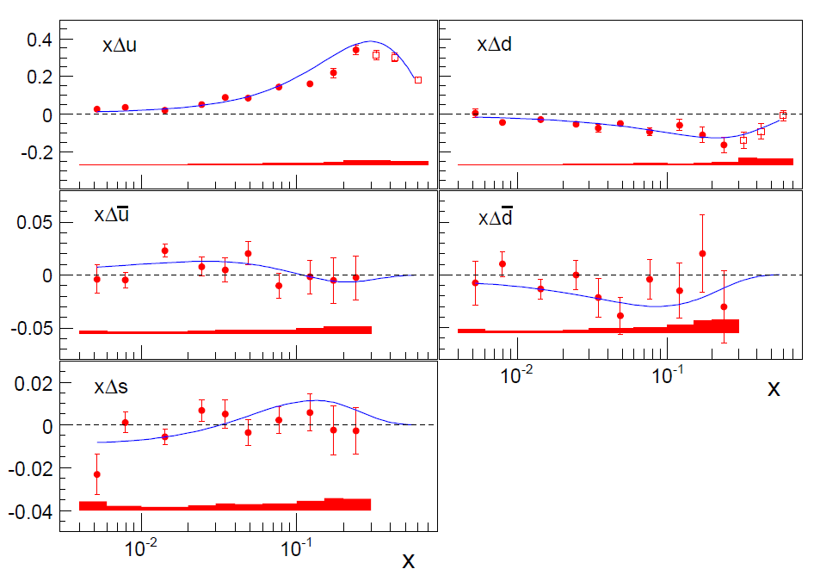
The role of quark flavours
LO analysis of 5p+5d asymmetries, DSS FF
Line: NLO DSSV not including these data
5-flavour fit,
assuming Δs = Δs
PLB693 (2010) 227
Hermes: PRD 71 (2005) 012003

Slide 19
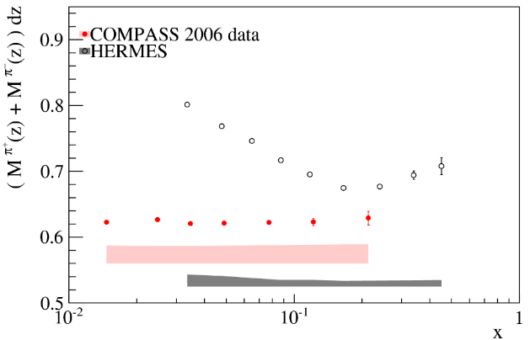
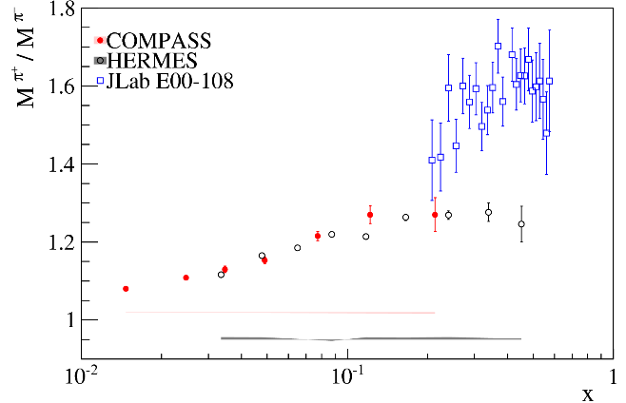
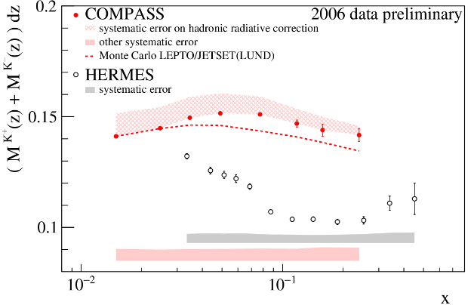



pion and kaon multiplicities (unpol)
preliminary
π
π+/π-
K
deuteron data, int. over z, p_{T}, Q²
large discrepancies in multiplicities
ratio π⁺/π⁻ ok, K⁺/K⁻ differ ~ 20%
Compass data being finalized
impact on FF → strange quark PDF
Hermes K: PRD 89 (2014) 097101; π: PRD 87 (2013) 074029

Slide 20



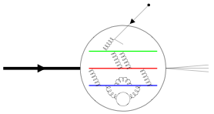


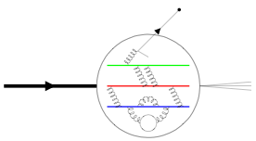



W production & antiquark polarisation
→
pp collisions at 250 GeV+ 250 GeV
and
parity-violating long. SSA:
sensitive to antiquark polarisation
→
p
signature: high${ p}_{T}$ lepton
p

Slide 21




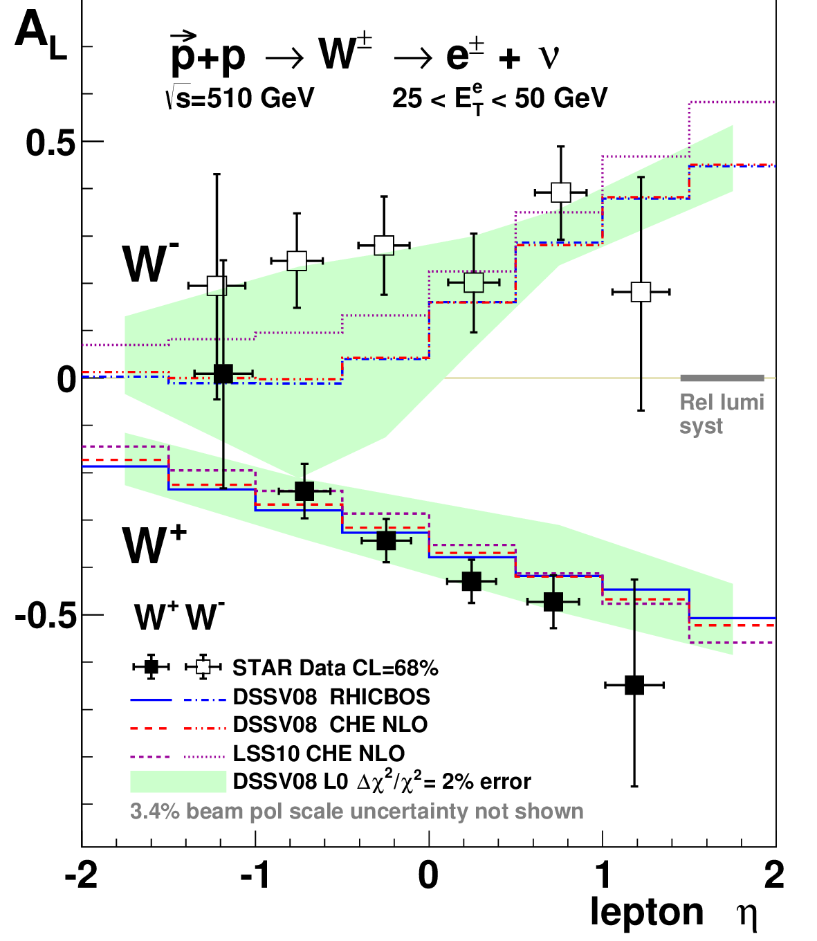
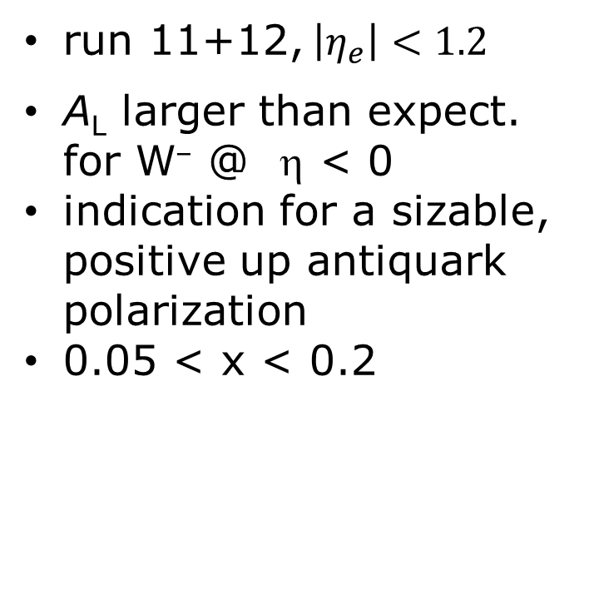
W production in pp
run 11+12, $\left|η_{e}\right|<1.2$
A_{L} larger than expect.
for W– @ η < 0
indication for a sizable,
positive up antiquark
polarization
0.05 < x < 0.2
PRL 113 (2014) 072301

Slide 22


W production in pp
arXiv:1504.07451
Run 12+13, $\left|η\right|<0.35$
also larger A_{L} for W–
wrt to DSSV14
recent NNPDF1.1
includes RHIC W data
NNPDF: NPB 887 (2014) 276

Slide 23
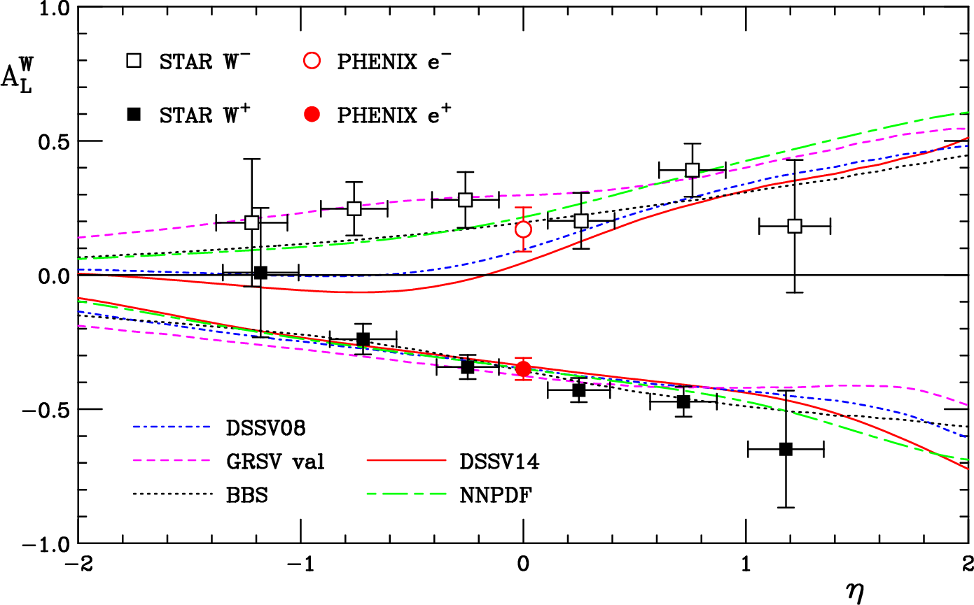
W production in pp
Ringer, Vogelsang: arXiv:1503.07052

Slide 24
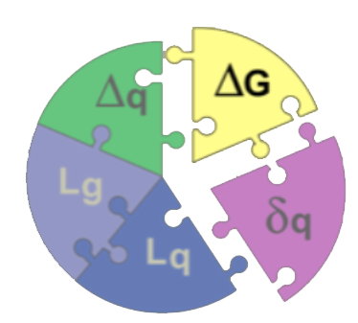
Gluon polarisation

Slide 25
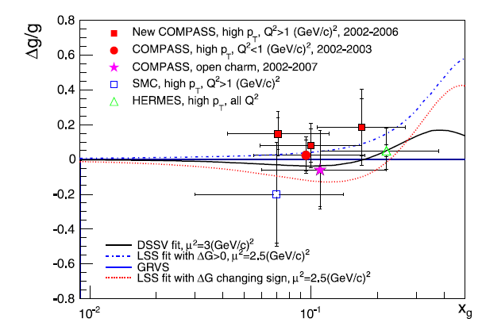
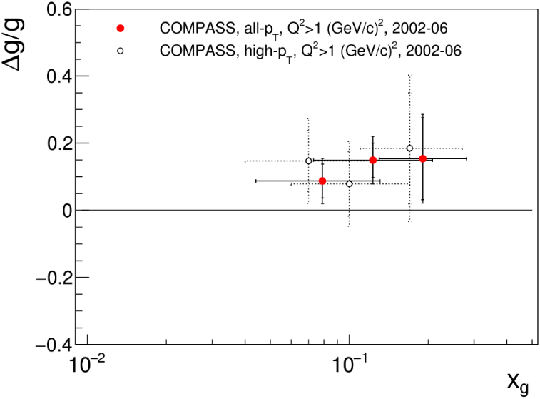
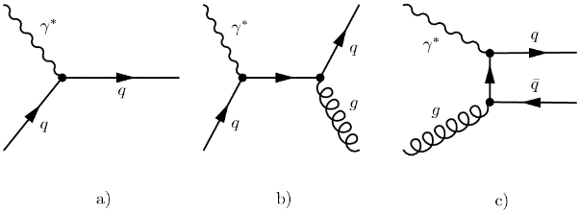
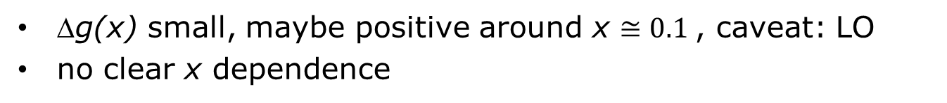
Δg/g from PGF (DIS, LO)
preliminary
Q² > 1 GeV²
Q² < 1 GeV²
open charm (D mesons)
PLB 718 (2013) 922
Δg(x) small, maybe positive around x $≅0.1$, caveat: LO
no clear x dependence

Slide 26
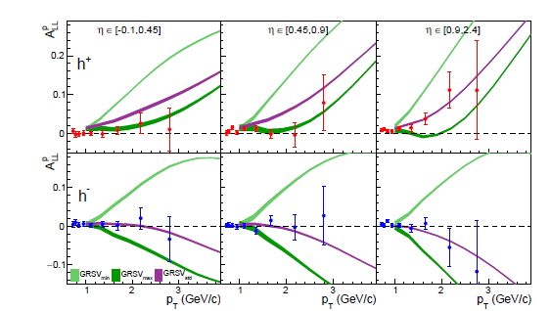

Δg/g from single hadron (NLO)
quasi-real photoproduction of single hadrons, à la RHIC $π^{0}$ prod.
calc. by group of Vogelsang, agreement for unpolarised case
caveat: NNL resummation missing for polarised case
3 bins of
pseudorapidity $η$
FF important,
using DSS (2015),
agree best with meas.
multiplicities
data prefer positive
gluon polarisation
as suggested by
recent RHIC data
proton
min
std
max
arXive:1509.03526

Slide 27
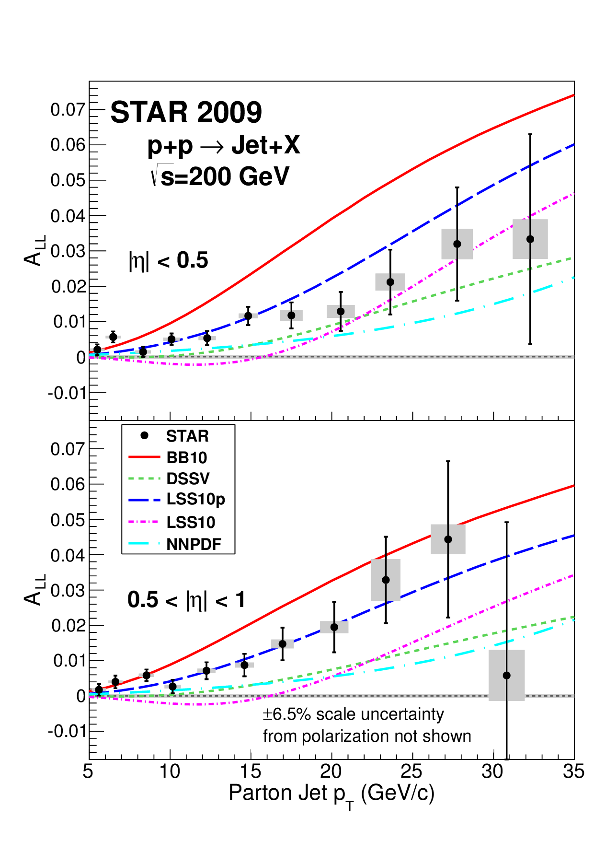

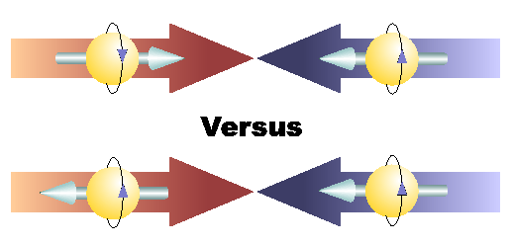
STAR single jet asymmetry A_{LL}
pp → jet + X
@ $\sqrt{s}=200 \text{GeV}$
2009 data, mid rapidity
$A_{LL}∝∆g$
A_{LL} in good agreement
with LSSp (pos. Δg)
PRL 115 (2015) 092002

Slide 28
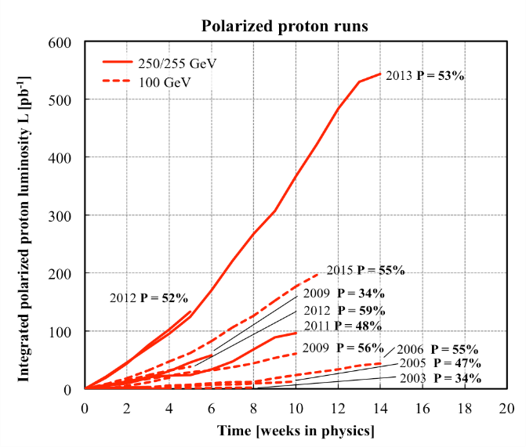


STAR single jet asymmetry A_{LL}
prelim. 2012 data, $\sqrt{s}=510 \text{GeV}$
agree with 2009 data and LSS10p and DSSV14
DSSV14 includes 2009 data

Slide 29

Inclusive neutral pion production
PRD 90 (2014) 012007

Slide 30



Impact of Star jet data
PRL 113 (2014) 012001
big impact on pol. gluon distribution
$\int_{0.05}^{1}{Δg\left(x\right)\text{d}x≃0.20}$
need data at small x

Slide 31

Transversity

Slide 32



Transversity h₁
chiral-odd → vanishes in DIS → SIDIS
leads to azimuthal modulation in the
Collins angle $φ_{C}=φ_{h}+φ_{S}−π$
($−π$ used by COMPASS)
amplitude
Collins fragmentation function $H_{1}^{⊥}\left(z,p_{T}\right)$ from $e^{+}e^{−}$
convolution $\left(⨂\right)$ over intrinsic transverse momentum k_{T}

Slide 33




Collins asymmetry for proton & deuteron
proton
deuteron
first proton data
from Hermes
sizable for proton
mirror symmetry
$π^{+}$ and ${ π}^{−}$
small for deuteron
π±
PRL 94 (2005) 012002
K±
K⁰
PLB 744 (2015) 250
PLB 673 (2009) 127

Slide 34




Collins FF from $e^{+}e^{−}$
${∝H}_{1}^{⊥}⨂H_{1}^{⊥}$
Belle, Barbar, BESIII
clear signals
Belle: PRD 90 (2012) 052003
Babar: PRD 90 (2014) 052003
BESIII: arXiv:1507.06824

Slide 35



Determination of h₁ from SIDIS & $e^{+}e^{−}$
u
d
Anselmino et al.,
PRD 87 (2013) 094019
Kang et al.,
PRD 91 (2015) 071501(R)

Slide 36



Transversity from dihadron asymmetries
Transversity couples to IFF $H_{1}^{∢}$
leads to azimuthal modulation in the
dihdron angle angle $φ_{RS}=φ_{R}+φ_{S}−π$
amplitude product of PDF and IFF,
no convolution
IFF $H_{1}^{∢}\left(z,M_{h}^{2}\right)$ from $e^{+}e^{−}$ as for $H_{1}^{⊥}$

Slide 37



2h asymmetries
PLB 736 (2014) 124
d
small
PLB 713 (2012) 010
PLB 736 (2014) 124
p
similar to 1h
for a recent determ. of h₁ see e.g. Radici et al. JHEP 1505, 123
common physics mechanism of 1h and 2h asym.?

Slide 38


g2 quark gluon correlations: Hall A
HallA: PhysRevLett.113.022002

Slide 39



Three dimensional structure of the nucleon
$x$ longitudinal momentum fraction
$k_{T}$ intrinsic transverse momentum
$b_{T}$ impact parameter
from EIC white paper arXiv:1212.1701

Slide 40



TMD parton distributions
3 $k_{T}$ integrated PDFs at twist
8 intrinsic-transverse-momentum dependent PDFs at leading twist
Azimuthal asymmetries with different angular modulations in Φ_{h} and Φ_{s}
Sivers

Slide 41





Sivers TMD
azim. asym. in ${φ_{Siv}=φ}_{h}−φ_{S}$
if non-zero → orbital angular momentum
induces distortions in the PDF of polarized nucleons
Prokudin

Slide 42





Sivers asymmetry
proton
sizable for proton
Hermes vs Compass:
some Q² evolution
small for deuteron
gluon: indication from 2h
$$π^{±}$$
$$K^{±}$$
Hermes: PRL 103 (2009) 152002
COMPASS: PLB 744 (2015) 250

Slide 43


TMD Q² evolution (Sivers proton)
Aybat, Prokudin, Rogers, PRL 108 (2012) 242003
Torino fit to Hermes data at $\left\langle Q^{2}\right\rangle =2.4$ GeV² evolved to $\left\langle Q^{2}\right\rangle =3.8$ GeV² of the Compass 2010 data
Quite rapid decrease of asymmetry with Q²

Slide 44




Restricted universality in SIDIS and pol. DY
T-odd TMD
`gauge link changes sign
for T-odd TMD’, restricted
universality of T-odd TMDs
J.C. Collins, PLB536 (2002) 43
Sivers
Boer-Mulders
important prediction, needs to be verified

Slide 45


COMPASS polarized DY
Predictions vary strongly, e.g.
running now!
Fermilab, RHIC, …
x_{F}=x_{π}−x_{p}

Slide 46






Generalized PDF’s
Correlating transverse spatial and
longitudinal momentum degrees of freedom
PDFs and elastic FF as limiting cases
H, H → f₁ , g₁ for ξ→ 0;
no such limiting cases for E, E
H (E) for nucleon helicity (non)conservation
DVCS
~
Ji’s sum rule for total orbital momentum:
X.-D. Ji, PRL 78 (1997) 610

Slide 47

Generalized PDF’s
cannot be measured directly and not everywhere
need global fits to many diff. measurements
measure small excl. cross sections, much more difficult than incl./semi-incl.
DVCS
  cleanest interpretation
  interference Bethe-Heitler
HEMP (vect. & ps.scalar)
  additional information on
  flavour and glue

Slide 48


DVCS: experimental kinematic ranges

Slide 49




Deeply virtual Compton scattering
μ’
γ*
γ
μ
θ
φ
p
cross-section depend on lepton charge and pol., and on target pol.
contributions with different azimuthal dependence from:
BH interference DVCS

Slide 50


DVCS @ CLAS
2015 CLAS NH₃ proton data
164 four-dimensional bins in
$Q^{2}$, $x_{B}$, $−t$, $φ$
TSA, BSA, DSA
determine the imaginary part of CFF $H_{Im}$ and ${\tilde{H}}_{Im}$of GPDs $ℋ$ and $\tilde{ℋ}$
most sensitive to ${\tilde{H}}_{Im}$
CLAS: PRD 91 (2015) 052014

Slide 51


COMPASS GPD, SIDIS
GPD data 2016–2017
liquid hydrogen target
160 GeV muon beam
CAMERA recoil detecor

Slide 52
Outlook
a wealth of new data
gluon polarisation likely to be positive at x ≅ 0.2, need low x_{g} data
Multilicities and FF to be clarified, in particular for kaons/strange quarks, impact PDF determination
TMD show: there is orbital angular momentum
measure the sign change of T-odd TMDs in DY!
new data coming up JLab 6/12, COMPASS, JPARC
and eventually EIC

Slide 55



Status of PDFs: global analyses (DSSV)
DSSV PPNP (2012) 251
unpolarised

Slide 56


Deeply virtual Compton scattering
CLAS
leading lepton-spin
asym. amplitude $A_{LU}^{\sin{φ}}$
differential in t, x, Q²
PRL 100 (2008) 162002

Slide 57


Slide 60


COMPASS-II Polarised Drell-Yan
First ever polarized Drell–Yan experiment
190 GeV/c π⁻ beam on transv. pol. proton target
Access to transversity , the T-odd Sivers and Boer–Mulders TMDs

Slide 61
2015 run: polarised target
Polarised target
  control system fully operational
  power supplies fully operational
  polarisation of 80-90% reached
  built-up time < 2 days

Slide 62

Drell−Yan muon pair mass regions
J/ψ region
4 < M_{μ+μ-} < 9 GeV
Safe region , HMR
2 < M_{μ+μ}- < 2.5 GeV
possible region
Combinatorial background < 1:1

Slide 63


COMPASS polarized DY, projections HMR
Predictions vary strongly, e.g.
x_{p}
x_{π}
x_{F}=x_{π}−x_{p}
x_{F}

Slide 64


Camera detector for exclusivity

Slide 65


DVCS
DVCS is the cleanest process to determine GPDs
need a world-wide effort
global analysis over large kinematic range mandatory
COMPASS-II: bridges HERA to JLAB 11 GeV kinematics
}
fixed target
collider
E=160 GeV
E=27 GeV
E=11 GeV
W > 2GeV
B

Slide 66




DVCS–Bethe-Heitler interference I
DVCS can be separated from BH and constrain the GPD H e.g. using different charge & spin (e_{μ}& P_{μ}) cross section combinations of the μ beam
Deep VCS
Bethe-Heitler
Note: μ± beams have opposite polarisation at COMPASS
Charge & Spin sum and difference:
Im I and Re I related to

Slide 67


Projection for beam charge-and-spin asym.
Amplitude of cos φ modulation of
fits by Kumericki, Mueller

Slide 68
Geometry target region
beam
LH2 target

Slide 69


t-slope for ρ⁰ production
ρ⁰
also φ, ω, ..

Slide 70


COMPASS II proj. data
Example: Charge & spin asymmetry
Cancelation of several experimental uncertainties
Easier to measure than absolute cross-sections
Asymmetries, sums and differences in
6x_{B} ×4 Q² bins as function of φ
Simulation for 2 years data taking, 160 GeV/c
and a 2.5 m long liquid H₂ target
LO:
μ’
γ*
γ
μ
θ
φ
p

Slide 71


`Tomography’
ξ=0 → t = −Δ_{T}² , no long. mom. transfer
Transverse size as function of longitudinal momentum fraction
adapted from JLAB 12 GeV CDR

Slide 72


projected t-slope
COMPASS-II projection, 2 years of data taking
x_{B} region unique to COMPASS
transition from HERA → HERMES/JLab

Slide 73
COMPASS-II Polarised Drell-Yan
COMPASS-II: 190 GeV/c π⁻ beam on transversely pol. proton target
π⁻ valence u-antiquark picks nucleon’s u quark
in valence region (u-quark dominance)
Access to transversity , the T-odd Sivers and Boer-Mulders TMDs

Slide 74

Target region for DY
Quench and Exhaust Lines
Cable trays
Transfer Line
Absorber
Control Racks
Pol. target
He-pipes
Micro Wave guides

Slide 75


Gluon polarisation from PGF (LO)
LO reanalysis of 2002-2004,
2006 deuteron data
Q² > 1 GeV²
novel method using events
with any p_{T} and NN weights
simultaneous determ.
of leading order asym.
reduces syst. uncertainty
determination of Δg(x)
in 3 x ranges

Slide 76

Spin independent cross-section
semi-inclusive single
hadron production
COMPASS kinematics
good agreement with NLL
resummation
cross-section asymmetries
can be used to determine
the gluon polarisation
need NLL resummation for
polarised case
De Florian, Pfeuffer, Schaefer, Vogelsang,
PRD 88 (2013) 014024
COMPASS, PRD 88 (2013) 091101

