Slide 1
Understanding and Computing the Nucleon Spin
Xiangdong Ji
Shanghai Jiao Tong University
University of Maryland
Circum-Pan-Pacific Spin Symposium, Oct. 5, 2015

Slide 2
The spin structure of the nucleon has been one of the central questions driving advances in hadronic physics.
  Physics motivations for COMPASS
  Important arguments for J-Lab 12 GeV upgrade
  Key considerations for EIC
  Reason for larger and better lattice QCD calculations

Slide 3
Limited to theoretical discussions that I am familiar with….

Slide 4
Theory confusion:
There has been much theoretical confusion about spin sum rule for the nucleon, many dozens of theoretical papers have been written on the subject.
  F. Wang, X. S. Chen, Wakamatsu, E. Leader, C. Lorce, Y. Hatta, X. Ji, F. Yuan, Y. Zhao, …
Some still claim that confusion is there.
But the confusion is over, move on!

Slide 5
Spin sum rules: Summary
If one allows only local gauge-invariant contributions, there is only one sum rule.
If one allows non-local definitions, there are infinity possibilities theoretically
  However, only one is relevant experimentally.

Slide 6
Locality-> the unique spin sum rule
Locality and gauge-invariance yield the unique result (Ji, 1996)
½ = ½ ΔΣ + Lq + Jg
  Does not allow gluon spin term
  Lq and Jg can be measured in principle through twist-2 GPDs.
  Frame independent, allowing computations with the standard lattice QCD (K. F. Liu, H.W. Lin, etc).

Slide 7
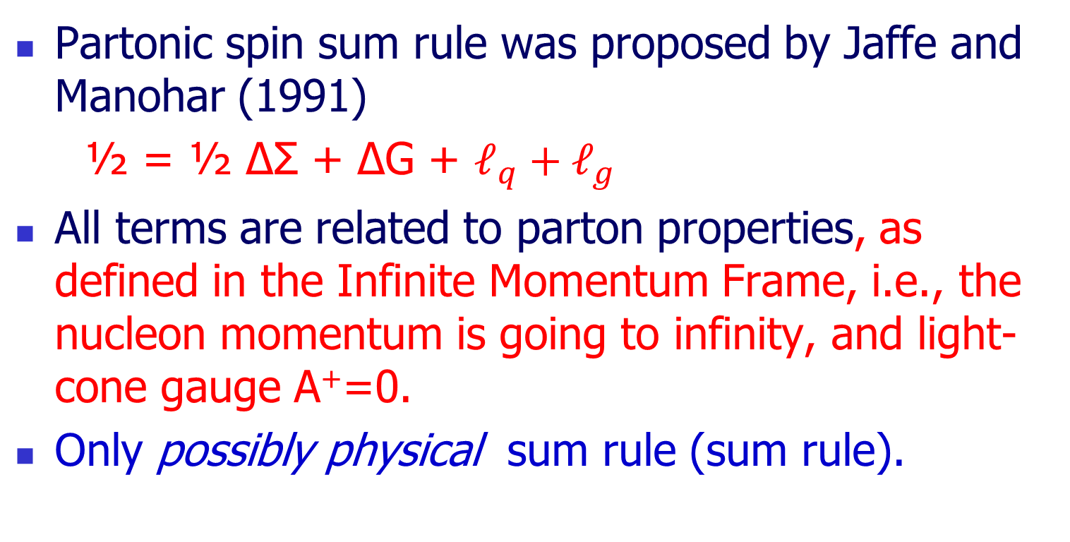
Partonic spin sum rule
Partonic spin sum rule was proposed by Jaffe and Manohar (1991)
½ = ½ ΔΣ + ΔG + $ℓ_{q}+ℓ_{g}$
All terms are related to parton properties, as defined in the Infinite Momentum Frame, i.e., the nucleon momentum is going to infinity, and light-cone gauge A⁺=0.
Only possibly physical sum rule (sum rule).

Slide 8
Puzzle?
Are partons physical?
  Yes, partons are what you probed in high-energy scattering process in an experiment.
  No, partons are defined in the infinite momentum frame and light-cone gauge (frame and gauge-dependence)
How come a physical quantity depending on gauge choice? In particular the gluon polarization ΔG is physically measurable, but depends on light-cone gauge.

Slide 9
I did not have a good answer for a long time.
But I was bothered by many wrong answers, which drove me to understand this question deeper.
The answer finely becomes clear in 2013…
which is leading to a new theoretical approach for partonic physics.

Slide 11
Jaffe and Manohar sum rule was motivated by canonical (free-field) contributions to the QCD angular momentum.
The canonical contributions are not manifestly gauge-invariant, But
  They may have gauge invariant matrix elements?!
  F. Wang, X. Song, hep-ph/9802346,
  E. Leader, PRD, 2012

Slide 12
A clarifying paper

Slide 13
A renewed attempt 10 years later

Slide 14
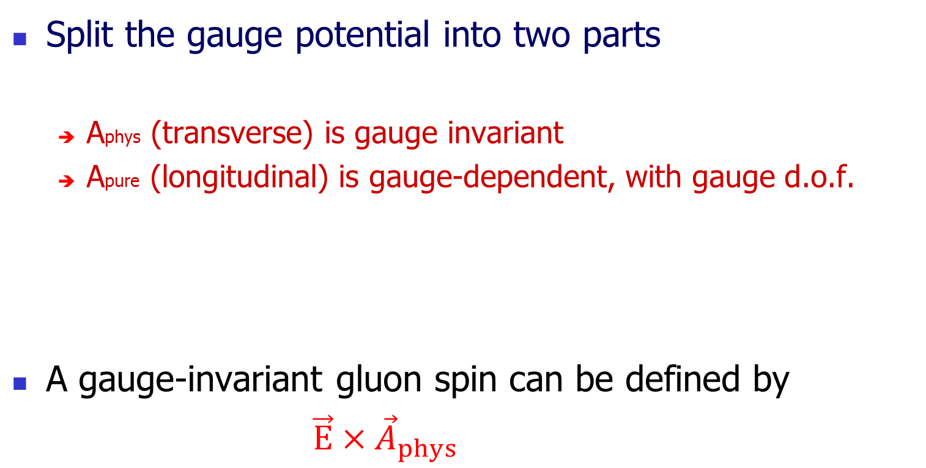
A simple idea motivated by QED
Split the gauge potential into two parts
  Aphys (transverse) is gauge invariant
  Apure (longitudinal) is gauge-dependent, with gauge d.o.f.
A gauge-invariant gluon spin can be defined by
$\vec{E}×{\vec{A}}_{phys}$

Slide 15
But… (X. Ji, PRL comment, 2010)
Splitting is not unique
  One can choose a gauge, in which Aphys can be solved in terms of Fµν.
  Then Apure be formally defined as A− Aphys,
  This leads to infinite number of different sum rules
  This reflects the original gauge dependence.
Apure and Aphys are no longer local. So the spin sum rules are no longer local sum rules (comment)
There is no manifest connection to experiment, or Jaffe-Manohar sum rule.

Slide 16
Frame dependence!
The sum rule proposed has non-trivial frame dependence!
  Cannot follow simple Lorentz transformation.
  This is true for any non-local spin sum rule.
  No discussion on this in the literature!

Slide 18
In the following 2 years, keeping thinking more about frame dependence
Frame dependence of Aphys can be calculated in a matrix element, it is non-analytical in β=v/c; it has a log dependence! Clearly not a simple Lorentz transformation.

Slide 19
Two kinds of gluons
There are two kinds of gluons inside the nucleon: Coulomb (confining, binding) gluons
Radiation gluons
However, the separation is not physical because charges and currents do not respond to these fields separately.
The separation is also frame dependent.

Slide 20

Coulomb gluon
Consider a heavy quark at rest, it generates a gluonic Coulomb field, and the corresponding
potential depends on gauge choices.
This contribution to the gluon spin is gauge dependent.

Slide 21
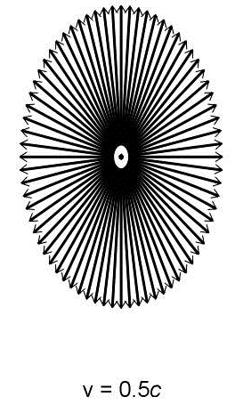
Radiation gluon
When the heavy quark moves, it also generates a radiation gluon field, which has non-zero B compoent.
Radiation gluon’s contribution to the gluon spin is gauge-invariant.

Slide 22
Frame dependence
The relative sizes of the two types of gluons are frame dependent, and cannot be obtained in one frame from another through simple Lorentz transformation.
In the IMF limit, the radiation gluon becomes physical and entirely dominates over the Coulomb gluon, The contribution from the latter becomes negligible.
Thus ONLY in the IMF, the radiation-gluon spin becomes a physical observable (Weizsacker-William’s picture) .This is exactly what high-energy scattering experiments measure!

Slide 23
Significance of Large momentum limit
So Chen et al’s construction only becomes physically useful in the large momentum limit
  Radiation gluon becomes physical on-shell gluon
  The connection to experiment can be made.
The frame-dependence is non-trivial. It helps to recover the anomalous dimensions of operators in QCD factorization theorems for high-energy scattering.

Slide 24
Non-uniqueness? Universality class
Many of the frame-dependent and gauge-dependent sum rules (universality class) collapse into the light-cone sum rule of Jaffe and Manohar in IMF.
  Coulomb gauge is not special, one can start with any class of gauges that are consistent with notion of radiation gluons and get the same result.
Y.Hatta, Ji and Zhao, Phys.Rev. D89 (2014) 8, 085030
Zhao, Liu, Yang, arXiv: 1506.08832

Slide 25
The simple answer
In the infinite momentum frame, partons become on-shell. New physical, gauge invariant observables are generated from the bound states.
Another (more complicated way) of arriving at the WW approximation.
However, it provides a new way to calculate ΔG

Slide 26
A long story for ΔG
Spin puzzle
Large ΔG?
RHIC spin program
Good measurements
No direction calculation from lattice QCD, because it is a “light-cone” quantity.
Now we provide a first recipe
  Calculate ExA in an appropriate gauge with a finite momentum nucleon and boost!

Slide 27
Kentucky group

Slide 30
Approaching partonic sum rule from boost
Matching conditions
Ji, Zhang, Zhao, Phys. Lett. B743 (2015) 180-183

Slide 31
A new approach to light-cone physics
Parton Physics from Large-Momentum Effective Field Theory, X. Ji
Sci. China Phys.Mech.Astron. 57 (2014) 7, 1407-1412

Slide 32
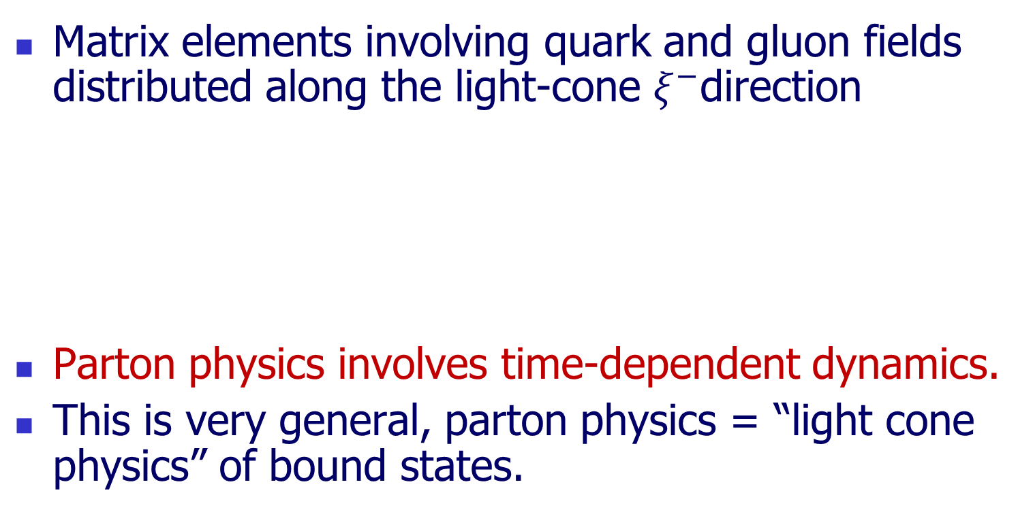
PDF’s are light-cone correlations
Matrix elements involving quark and gluon fields distributed along the light-cone $ξ^{−}$direction
Parton physics involves time-dependent dynamics.
This is very general, parton physics = “light cone physics” of bound states.
^{t}
𝜉⁻
𝜉⁺
^{z}

Slide 33
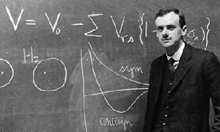
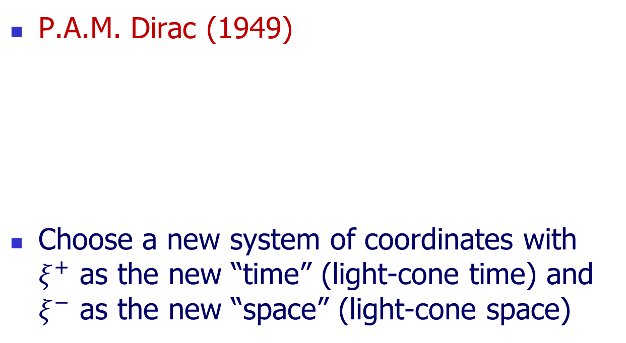
Light-cone quantization
P.A.M. Dirac (1949)
Choose a new system of coordinates with $ξ^{+}$ as the new “time” (light-cone time) and $ξ^{−}$ as the new “space” (light-cone space)
New “Space”
New “time”
t
𝜉⁻
𝜉⁺
z

Slide 34
LCQ and Partons
In LCQ, Light-cone correlation becomes “equal-time” correlation.
Parton physics is manifest through light-cone quantization (LCQ)

Slide 35
Wilson’s unsolved problem
In early 1990’s, Ken Wilson became a strong proponent for LCQ as a non-perturbative approach to solve QCD, and thus a way to calculate parton physics.
Except for 1+1 dimension, the progress in real QCD has been stagnant.

Slide 36
Solution of the problem?
Step 1: Light-cone correlations can be approximated by “off but near” light-cone “space-like” correlations
Step 2: Any space-like separation can be made simultaneous by suitably choosing the Lorentz frame.
t
𝜉⁻
𝜉⁺
Step1
Step2
x

Slide 37

A Euclidean quasi-distribution
Consider space correlation in a large momentum P in the z-direction.
  Quark fields separated along the z-direction
  The gauge-link along the z-direction
  The matrix element depends on the 3-momentum P.
  This distribution can be calculated using standard lattice method.
𝜉⁰
⁰
^{Z}
𝜉³

Slide 38
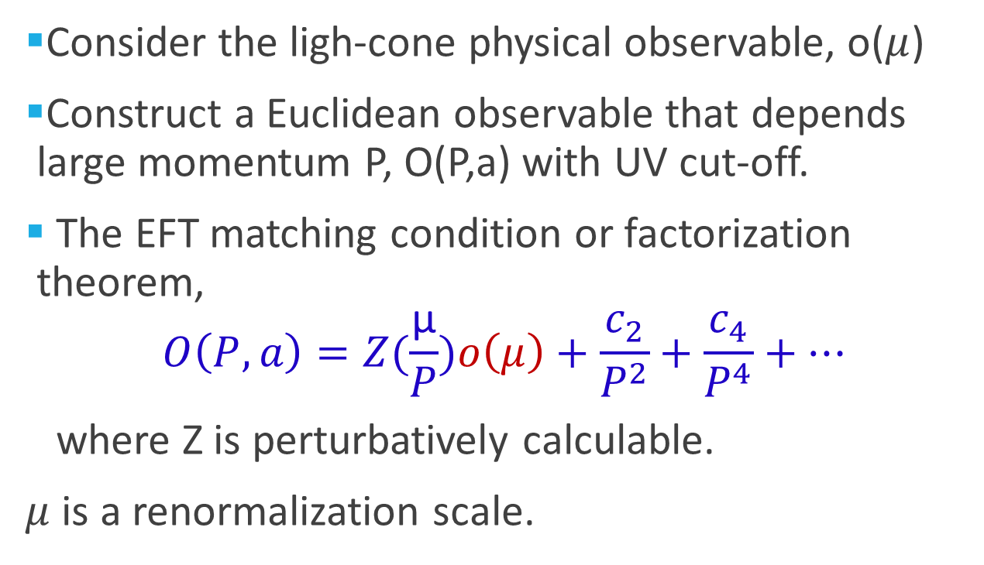
Effective field theory language
Consider the ligh-cone physical observable, o($μ$)
Construct a Euclidean observable that depends large momentum P, O(P,a) with UV cut-off.
The EFT matching condition or factorization theorem,
$$O\left(P,a\right)=Z(\frac{\text{μ}}{P})o\left(μ\right)+\frac{c_{2}}{P^{2}}+\frac{c_{4}}{P^{4}}+…$$
where Z is perturbatively calculable.
$μ$ is a renormalization scale.

Slide 39
Power of the approach
PDF (W. Lin’ talk)
GPDs (matching, Xiong et al)
TMDs (matching, Yuan et al)
Light-cone wave functions
Higher twist observables
Etc.

Slide 40
Electron-Ion Collider
An electron-ion collider will help us to understand the partonic structure of the nucleon in an unprecedented level.
With the new theoretical approach, we are no longer depending on sum rules, we can calculate partons directly on lattice.
More investments in computation!

